Slide 1


Slide 2


獨家贊助
Make Organizing Fun!
讓收納更有趣!
www.matter-lab.com
www.facebook.com/matterlab.taiwan

Slide 3


Before
After

Slide 4

Before
After

Slide 5


Before
After

Slide 6


Before
After

Slide 7

Brush Image Effects 001
The quick brown fox jumps over the lazy dog. The quick brown fox jumps over the lazy dog.
The quick brown fox jumps over the lazy dog. The quick brown fox jumps over the lazy dog.
The quick brown fox jumps over the lazy dog. The quick brown fox jumps over the lazy dog.
The quick brown fox jumps over the lazy dog. The quick brown fox jumps over the lazy dog.

Slide 9
Brush Image Effects 002
The quick brown fox jumps over the lazy dog. The quick brown fox jumps over the lazy dog.
The quick brown fox jumps over the lazy dog. The quick brown fox jumps over the lazy dog.
The quick brown fox jumps over the lazy dog. The quick brown fox jumps over the lazy dog.
The quick brown fox jumps over the lazy dog. The quick brown fox jumps over the lazy dog.

Slide 11

Brush Image Effects 003
01
The quick brown fox jumps over the lazy dog.
02
The quick brown fox jumps over the lazy dog.
03
The quick brown fox jumps over the lazy dog.
04
The quick brown fox jumps over the lazy dog.

Slide 13
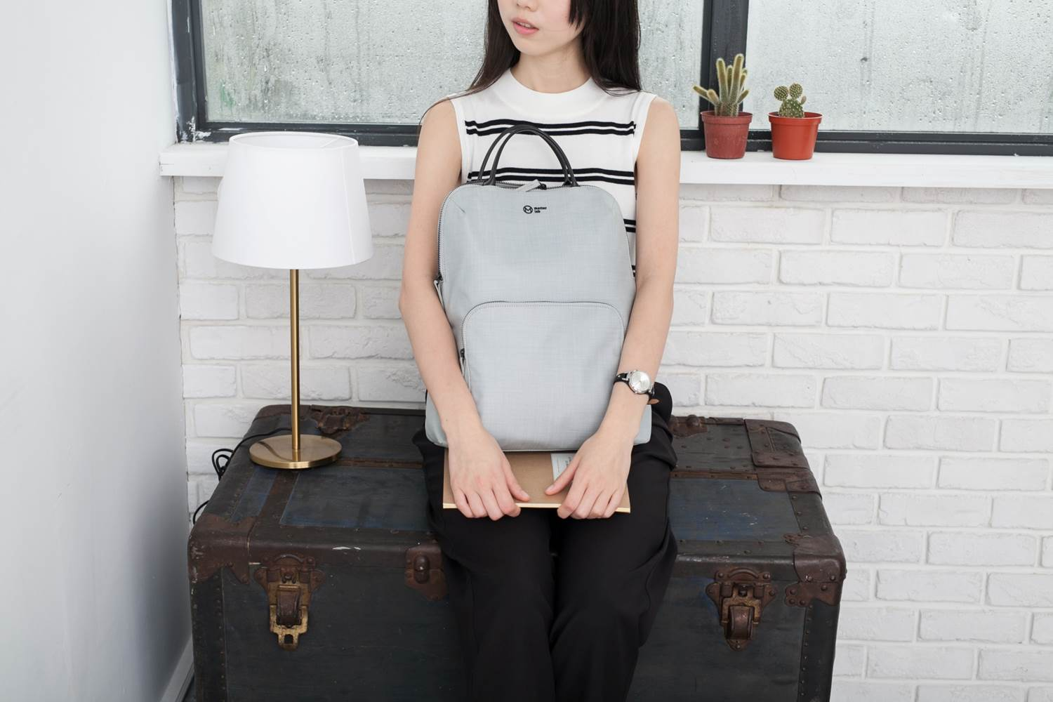
Brush Image Effects 004
The quick brown fox jumps over the lazy dog. The quick brown fox jumps over the lazy dog.
The quick brown fox jumps over the lazy dog. The quick brown fox jumps over the lazy dog.
The quick brown fox jumps over the lazy dog. The quick brown fox jumps over the lazy dog.
The quick brown fox jumps over the lazy dog. The quick brown fox jumps over the lazy dog.

Slide 15
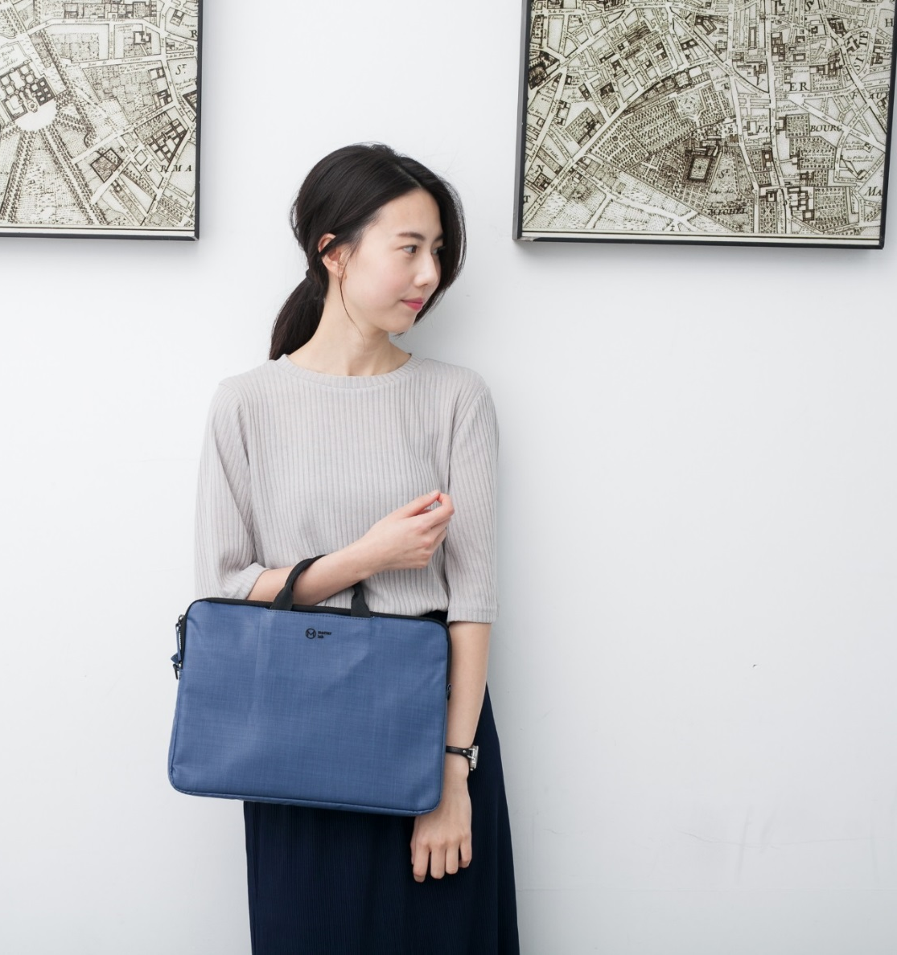
Brush Image Effects 005
The quick brown fox jumps over the lazy dog. The quick brown fox jumps over the lazy dog.
The quick brown fox jumps over the lazy dog. The quick brown fox jumps over the lazy dog.
The quick brown fox jumps over the lazy dog. The quick brown fox jumps over the lazy dog.
The quick brown fox jumps over the lazy dog. The quick brown fox jumps over the lazy dog.

Slide 17

Brush Image Effects 006
Agenda
The quick brown fox jumps over the lazy dog.
Process
The quick brown fox jumps over the lazy dog.
Security
The quick brown fox jumps over the lazy dog.
Success
The quick brown fox jumps over the lazy dog.

Slide 19

Brush Image Effects 007
The quick brown fox jumps over the lazy dog. The quick brown fox jumps over the lazy dog.
The quick brown fox jumps over the lazy dog. The quick brown fox jumps over the lazy dog.
The quick brown fox jumps over the lazy dog. The quick brown fox jumps over the lazy dog.
The quick brown fox jumps over the lazy dog. The quick brown fox jumps over the lazy dog.

Slide 21
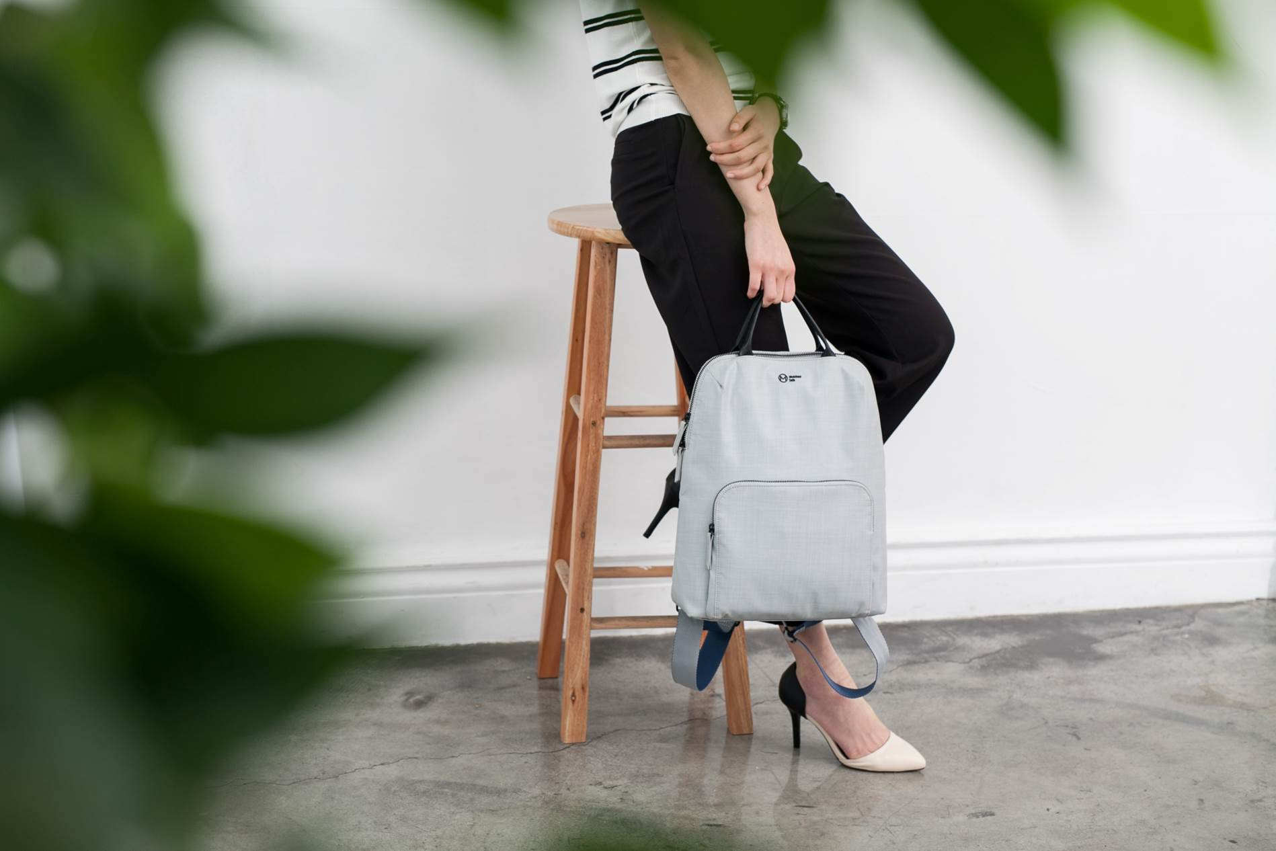
Brush Image Effects 008
The quick brown fox jumps over the lazy dog. The quick brown fox jumps over the lazy dog.
The quick brown fox jumps over the lazy dog. The quick brown fox jumps over the lazy dog.
The quick brown fox jumps over the lazy dog. The quick brown fox jumps over the lazy dog.

Slide 23
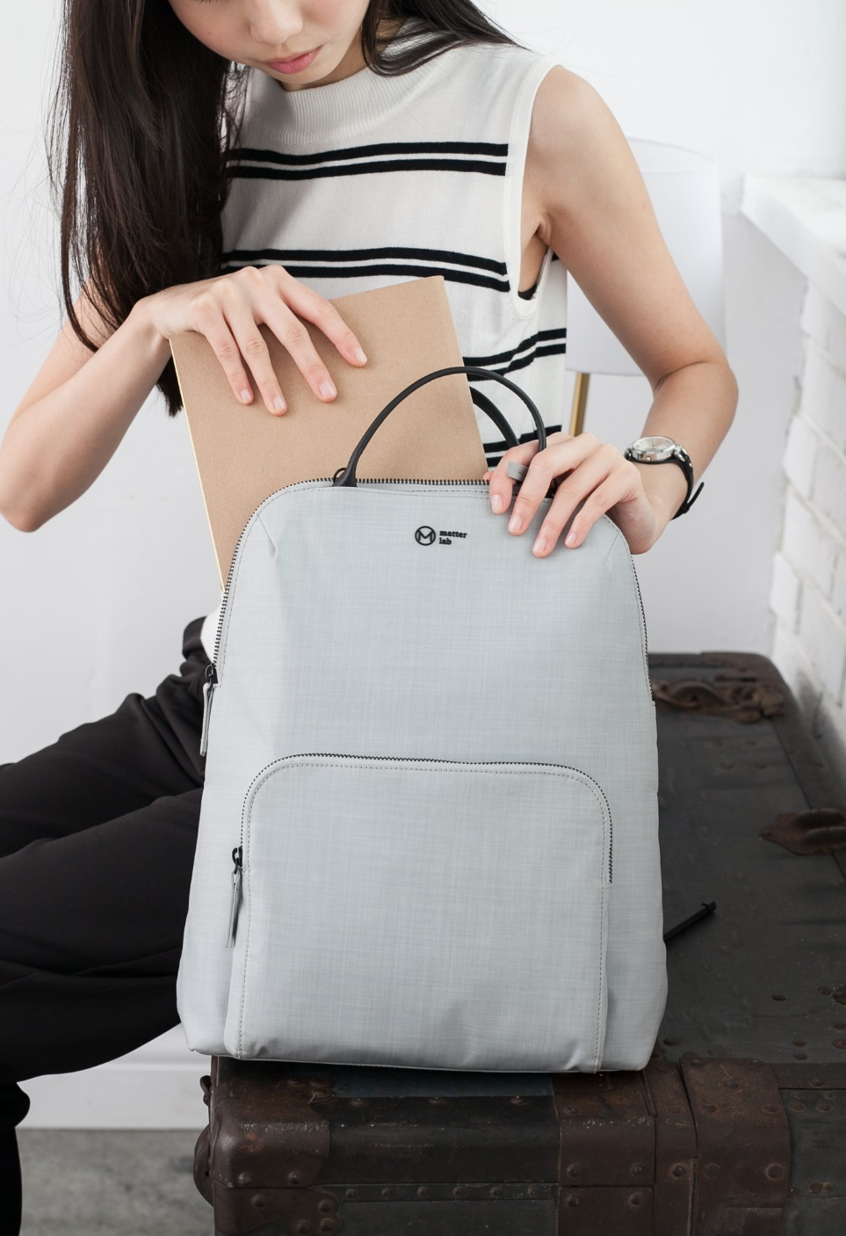
Brush Image Effects 009
The quick brown fox jumps over the lazy dog. The quick brown fox jumps over the lazy dog. The quick brown fox jumps over the lazy dog. The quick brown fox jumps over the lazy dog.

Slide 25

Brush Image Effects 010
The quick brown fox jumps over the lazy dog. The quick brown fox jumps over the lazy dog.
The quick brown fox jumps over the lazy dog. The quick brown fox jumps over the lazy dog.
The quick brown fox jumps over the lazy dog. The quick brown fox jumps over the lazy dog.
The quick brown fox jumps over the lazy dog. The quick brown fox jumps over the lazy dog.

Slide 27

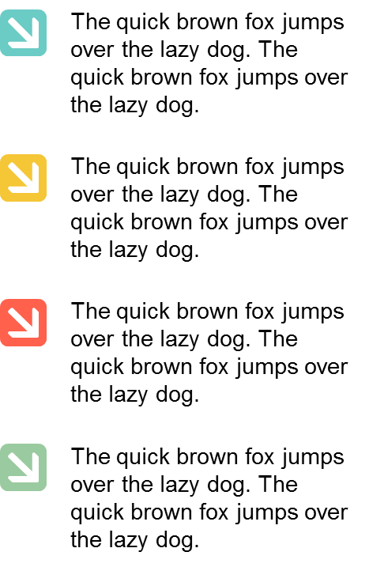
Brush Image Effects 011

Slide 29
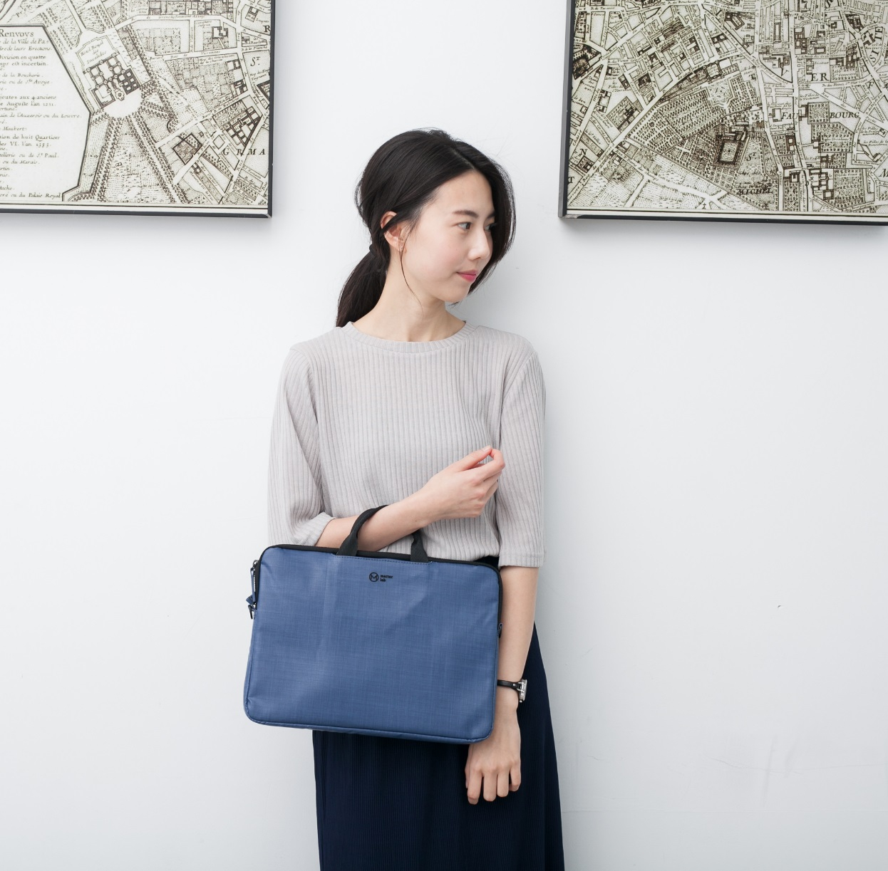
Brush Image Effects 012
01
The quick brown fox jumps over the lazy dog.
02
The quick brown fox jumps over the lazy dog.
03
The quick brown fox jumps over the lazy dog.
04
The quick brown fox jumps over the lazy dog.

Slide 31

Brush Image Effects 013
The quick brown fox jumps over the lazy dog. The quick brown fox jumps over the lazy dog.
The quick brown fox jumps over the lazy dog. The quick brown fox jumps over the lazy dog.
The quick brown fox jumps over the lazy dog. The quick brown fox jumps over the lazy dog.
The quick brown fox jumps over the lazy dog. The quick brown fox jumps over the lazy dog.

Slide 33
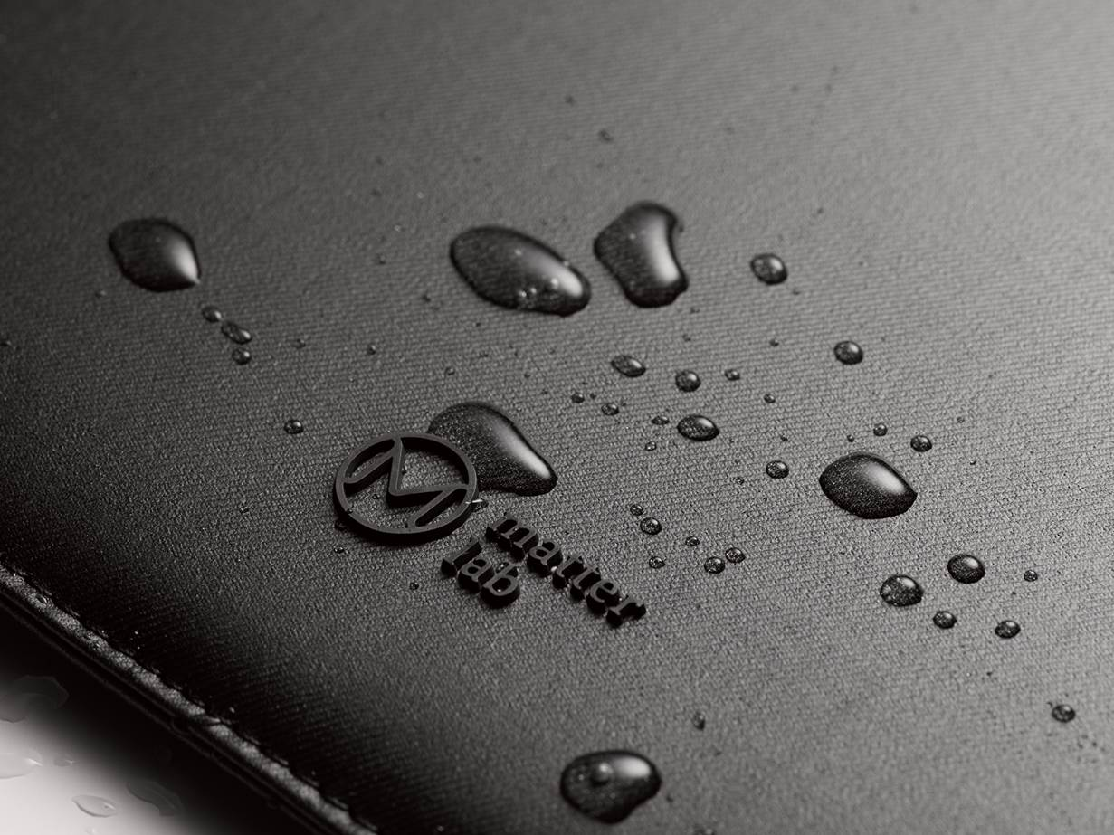
Brush Image Effects 014
Agenda
The quick brown fox jumps over the lazy dog.
Process
The quick brown fox jumps over the lazy dog.
Security
The quick brown fox jumps over the lazy dog.
Success
The quick brown fox jumps over the lazy dog.

Slide 35

Brush Image Effects 015
The quick brown fox jumps over the lazy dog. The quick brown fox jumps over the lazy dog.
The quick brown fox jumps over the lazy dog. The quick brown fox jumps over the lazy dog.
The quick brown fox jumps over the lazy dog. The quick brown fox jumps over the lazy dog.

Slide 37
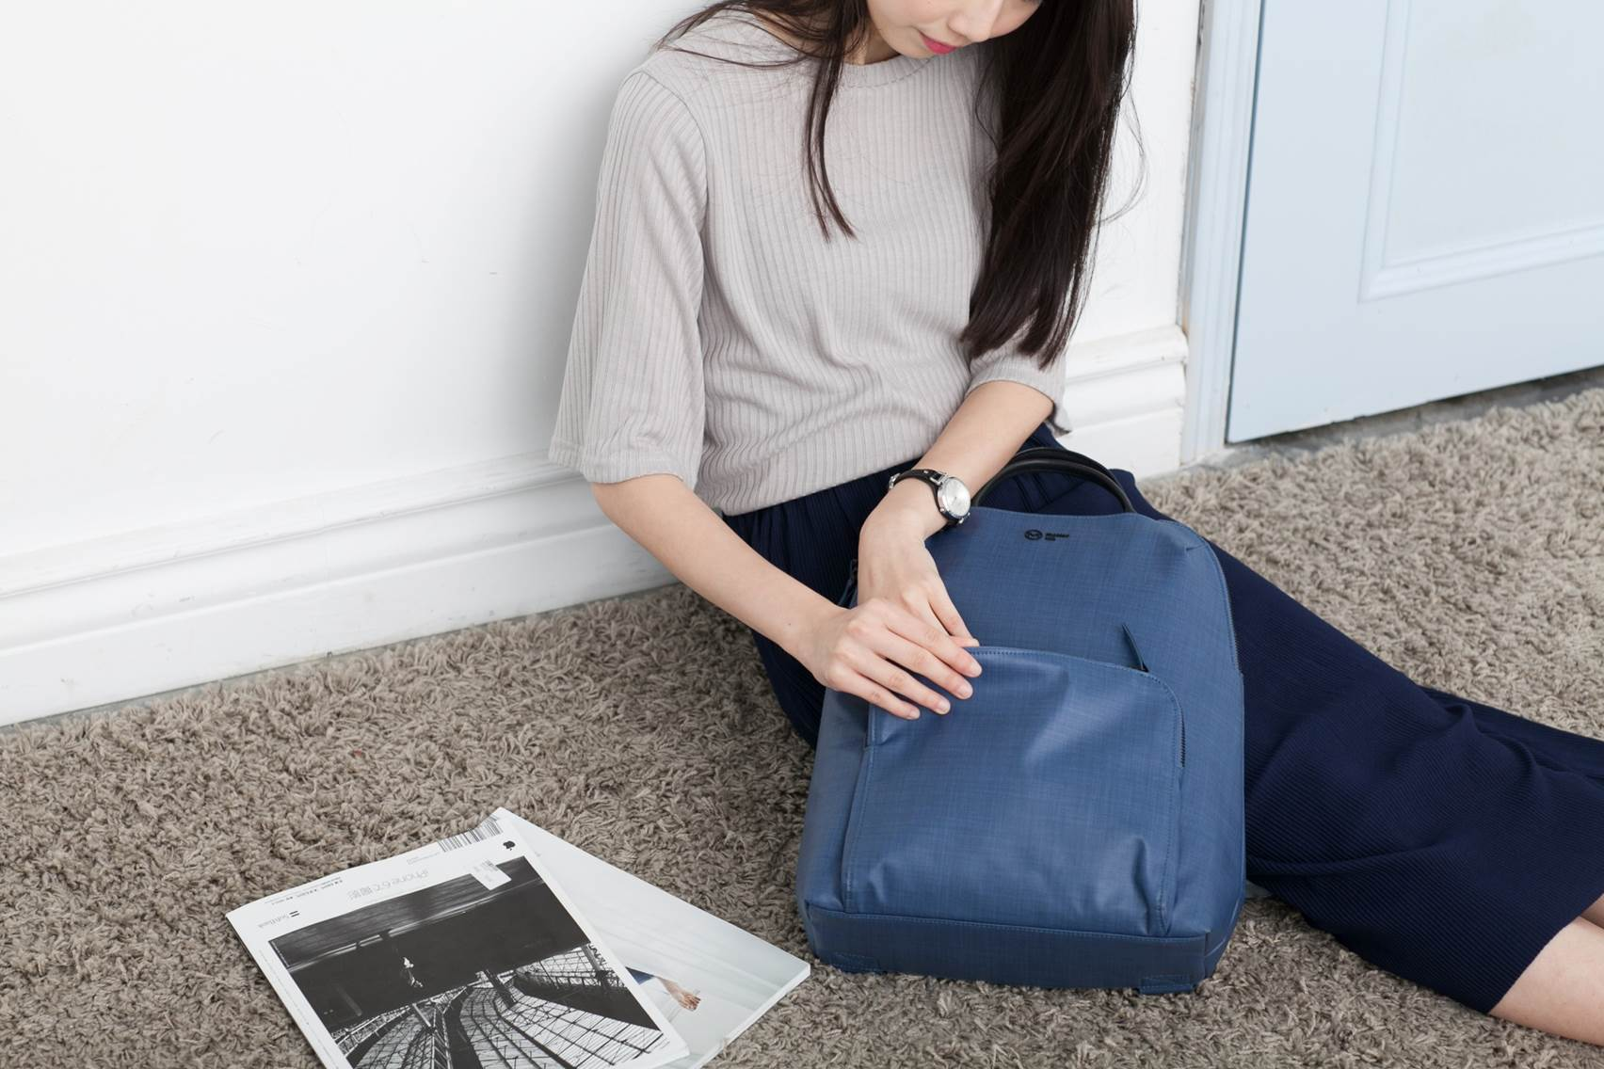
Brush Image Effects 016
The quick brown fox jumps over the lazy dog. The quick brown fox jumps over the lazy dog. The quick brown fox jumps over the lazy dog. The quick brown fox jumps over the lazy dog.

Slide 39

Brush Image Effects 017
The quick brown fox jumps over the lazy dog. The quick brown fox jumps over the lazy dog.
The quick brown fox jumps over the lazy dog. The quick brown fox jumps over the lazy dog.
The quick brown fox jumps over the lazy dog. The quick brown fox jumps over the lazy dog.
The quick brown fox jumps over the lazy dog. The quick brown fox jumps over the lazy dog.

Slide 41
Brush Image Effects 018
Agenda
The quick brown fox jumps over the lazy dog.
Process
The quick brown fox jumps over the lazy dog.
Security
The quick brown fox jumps over the lazy dog.
Success
The quick brown fox jumps over the lazy dog.

Slide 43
Brush Image Effects 019
The quick brown fox jumps over the lazy dog. The quick brown fox jumps over the lazy dog.
The quick brown fox jumps over the lazy dog. The quick brown fox jumps over the lazy dog.
The quick brown fox jumps over the lazy dog. The quick brown fox jumps over the lazy dog.
The quick brown fox jumps over the lazy dog. The quick brown fox jumps over the lazy dog.

Slide 45

Brush Image Effects 020
The quick brown fox jumps over the lazy dog. The quick brown fox jumps over the lazy dog.
The quick brown fox jumps over the lazy dog. The quick brown fox jumps over the lazy dog.
The quick brown fox jumps over the lazy dog. The quick brown fox jumps over the lazy dog.
The quick brown fox jumps over the lazy dog. The quick brown fox jumps over the lazy dog.

Slide 47
Brush Image Effects 021
The quick brown fox jumps over the lazy dog. The quick brown fox jumps over the lazy dog.
The quick brown fox jumps over the lazy dog. The quick brown fox jumps over the lazy dog.
The quick brown fox jumps over the lazy dog. The quick brown fox jumps over the lazy dog.
The quick brown fox jumps over the lazy dog. The quick brown fox jumps over the lazy dog.

Slide 49

Brush Image Effects 022
Agenda
The quick brown fox jumps over the lazy dog.
Process
The quick brown fox jumps over the lazy dog.
Security
The quick brown fox jumps over the lazy dog.
Success
The quick brown fox jumps over the lazy dog.

Slide 51
Brush Image Effects 023
01
The quick brown fox jumps over the lazy dog.
02
The quick brown fox jumps over the lazy dog.
03
The quick brown fox jumps over the lazy dog.
04
The quick brown fox jumps over the lazy dog.

Slide 53
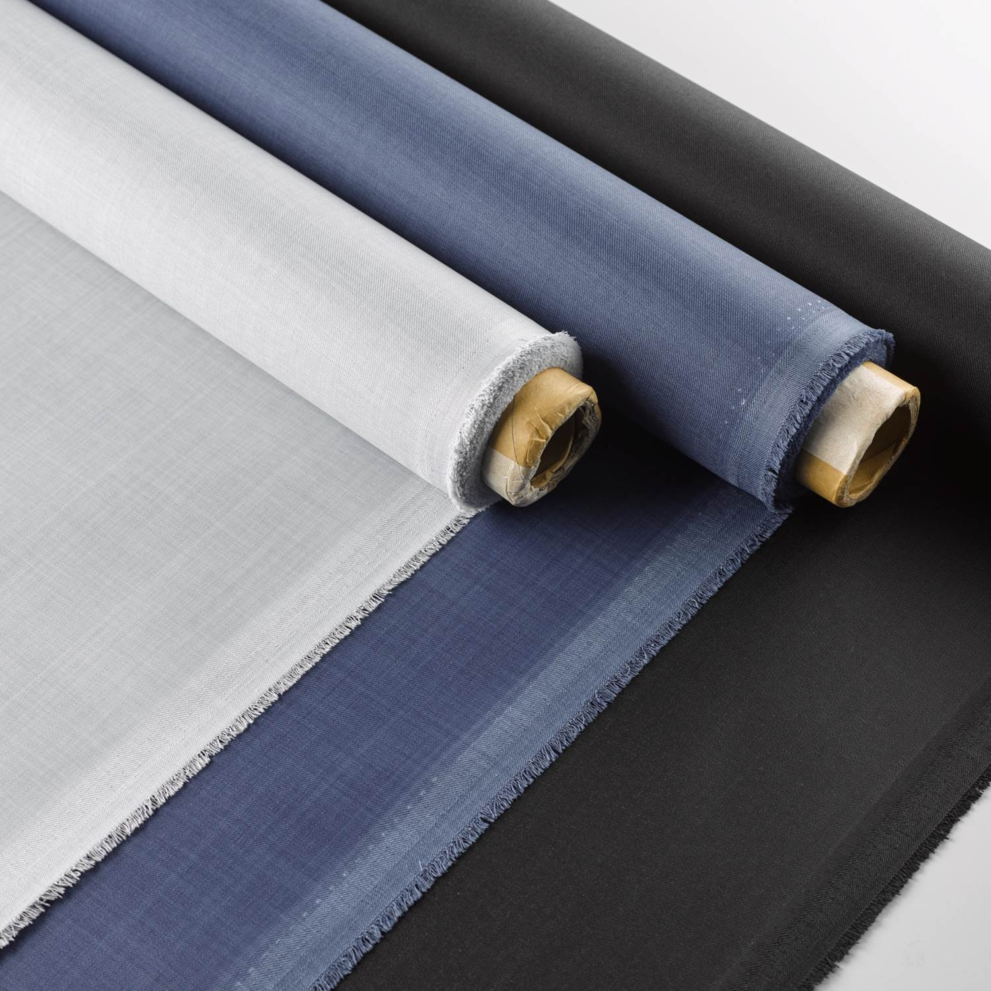
Brush Image Effects 024
The quick brown fox jumps over the lazy dog. The quick brown fox jumps over the lazy dog.
The quick brown fox jumps over the lazy dog. The quick brown fox jumps over the lazy dog.
The quick brown fox jumps over the lazy dog. The quick brown fox jumps over the lazy dog.

Slide 55
Brush Image Effects 025
The quick brown fox jumps over the lazy dog. The quick brown fox jumps over the lazy dog.
The quick brown fox jumps over the lazy dog. The quick brown fox jumps over the lazy dog.
The quick brown fox jumps over the lazy dog. The quick brown fox jumps over the lazy dog.
The quick brown fox jumps over the lazy dog. The quick brown fox jumps over the lazy dog.

Slide 57
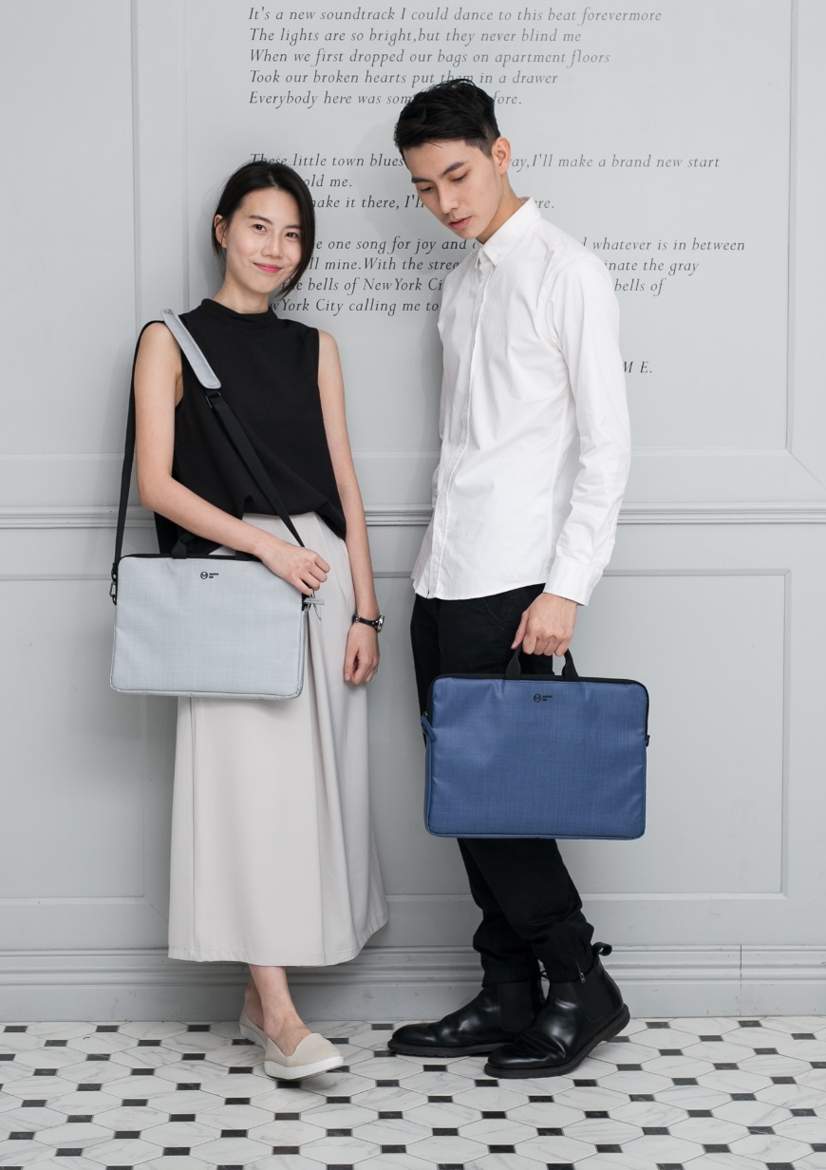
Brush Image Effects 026
Agenda
The quick brown fox jumps over the lazy dog.
Process
The quick brown fox jumps over the lazy dog.
Security
The quick brown fox jumps over the lazy dog.
Success
The quick brown fox jumps over the lazy dog.

Slide 59
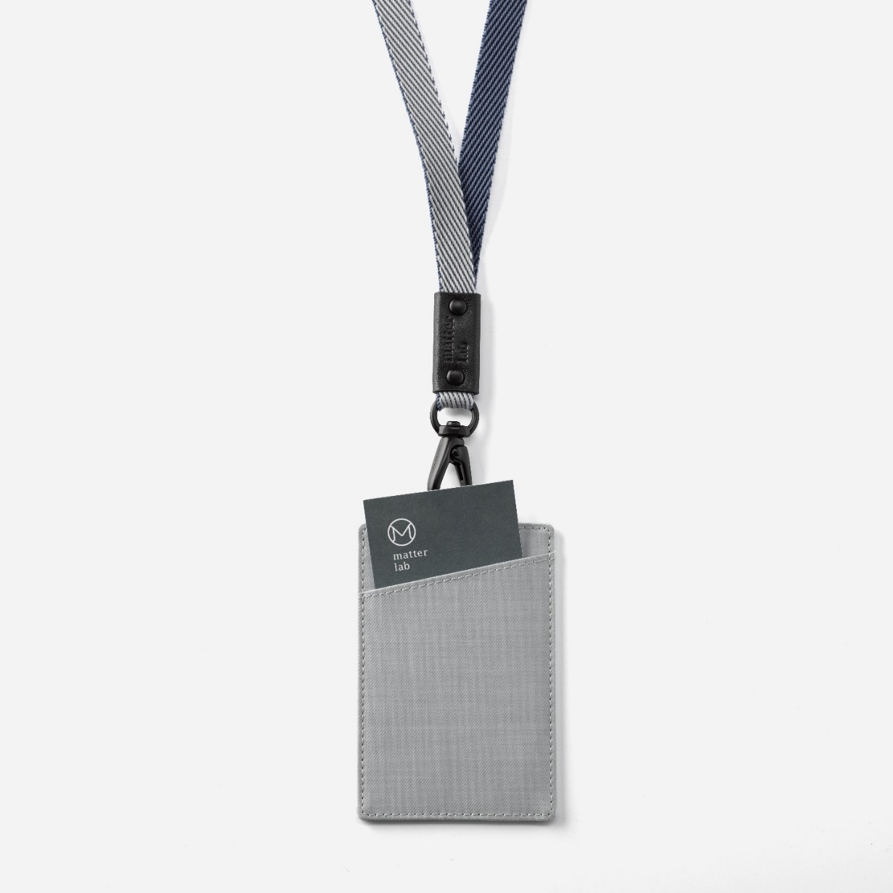
Brush Image Effects 027
The quick brown fox jumps over the lazy dog. The quick brown fox jumps over the lazy dog. The quick brown fox jumps over the lazy dog. The quick brown fox jumps over the lazy dog.

Slide 61
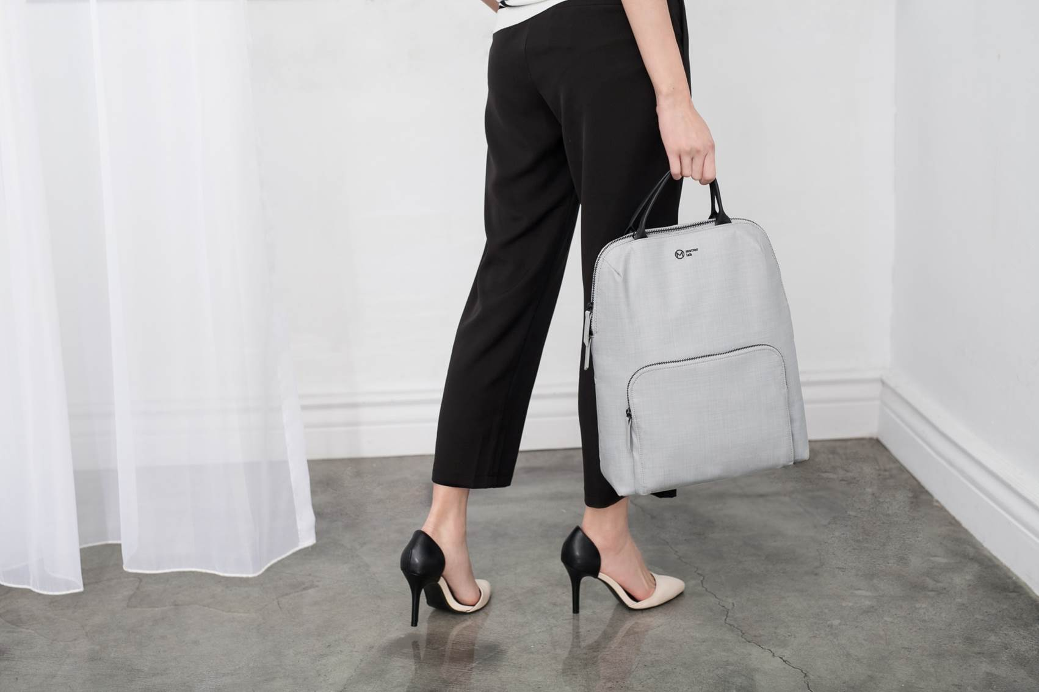
Brush Image Effects 028
The quick brown fox jumps over the lazy dog. The quick brown fox jumps over the lazy dog.
The quick brown fox jumps over the lazy dog. The quick brown fox jumps over the lazy dog.
The quick brown fox jumps over the lazy dog. The quick brown fox jumps over the lazy dog.

Slide 63
Brush Image Effects 029
The quick brown fox jumps over the lazy dog. The quick brown fox jumps over the lazy dog.
The quick brown fox jumps over the lazy dog. The quick brown fox jumps over the lazy dog.
The quick brown fox jumps over the lazy dog. The quick brown fox jumps over the lazy dog.
The quick brown fox jumps over the lazy dog. The quick brown fox jumps over the lazy dog.

Slide 65

Brush Image Effects 030
Agenda
The quick brown fox jumps over the lazy dog.
Process
The quick brown fox jumps over the lazy dog.
Security
The quick brown fox jumps over the lazy dog.
Success
The quick brown fox jumps over the lazy dog.

Slide 67

Brush Image Effects 031
The quick brown fox jumps over the lazy dog. The quick brown fox jumps over the lazy dog.
The quick brown fox jumps over the lazy dog. The quick brown fox jumps over the lazy dog.
The quick brown fox jumps over the lazy dog. The quick brown fox jumps over the lazy dog.
The quick brown fox jumps over the lazy dog. The quick brown fox jumps over the lazy dog.

Slide 69
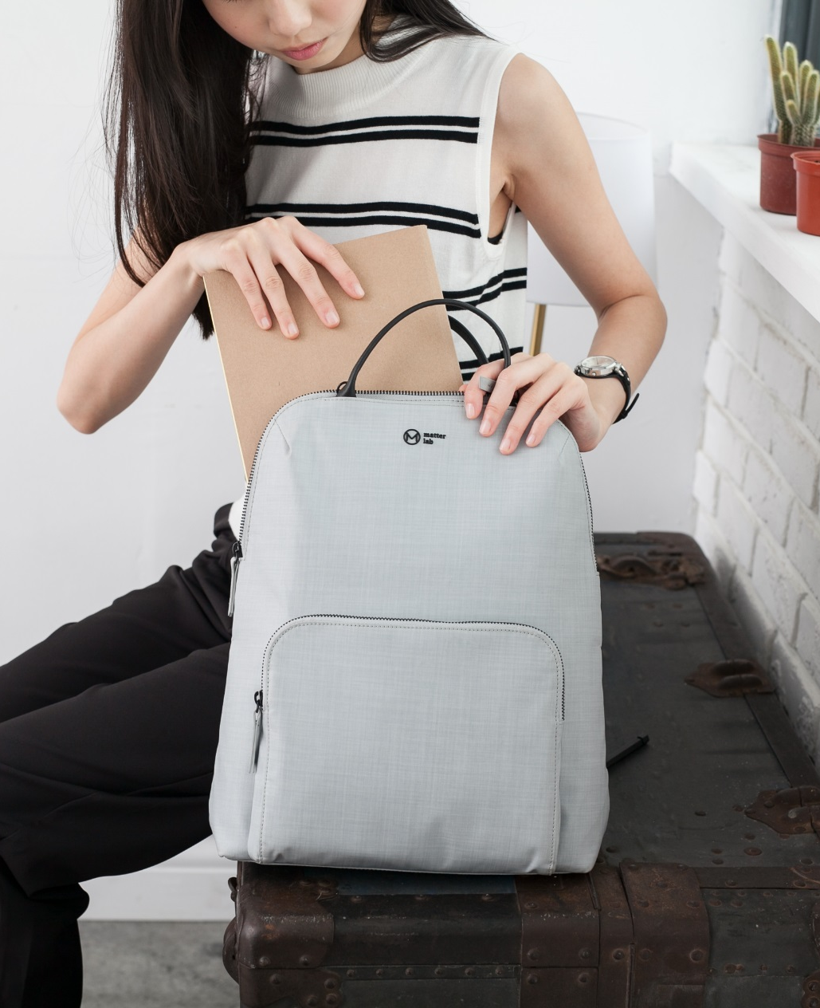
Brush Image Effects 032
The quick brown fox jumps over the lazy dog. The quick brown fox jumps over the lazy dog.
The quick brown fox jumps over the lazy dog. The quick brown fox jumps over the lazy dog.
The quick brown fox jumps over the lazy dog. The quick brown fox jumps over the lazy dog.

Slide 71
Brush Image Effects 033
The quick brown fox jumps over the lazy dog. The quick brown fox jumps over the lazy dog. The quick brown fox jumps over the lazy dog. The quick brown fox jumps over the lazy dog.

Slide 73
Brush Image Effects 034
The quick brown fox jumps over the lazy dog. The quick brown fox jumps over the lazy dog.
The quick brown fox jumps over the lazy dog. The quick brown fox jumps over the lazy dog.
The quick brown fox jumps over the lazy dog. The quick brown fox jumps over the lazy dog.
The quick brown fox jumps over the lazy dog. The quick brown fox jumps over the lazy dog.

Slide 75
Brush Image Effects 035
The quick brown fox jumps over the lazy dog. The quick brown fox jumps over the lazy dog.
The quick brown fox jumps over the lazy dog. The quick brown fox jumps over the lazy dog.
The quick brown fox jumps over the lazy dog. The quick brown fox jumps over the lazy dog.
The quick brown fox jumps over the lazy dog. The quick brown fox jumps over the lazy dog.

Slide 77

Brush Image Effects 036
The quick brown fox jumps over the lazy dog. The quick brown fox jumps over the lazy dog.
The quick brown fox jumps over the lazy dog. The quick brown fox jumps over the lazy dog.
The quick brown fox jumps over the lazy dog. The quick brown fox jumps over the lazy dog.
The quick brown fox jumps over the lazy dog. The quick brown fox jumps over the lazy dog.

Slide 79
Brush Image Effects 037
Agenda
The quick brown fox jumps over the lazy dog.
Process
The quick brown fox jumps over the lazy dog.
Security
The quick brown fox jumps over the lazy dog.
Success
The quick brown fox jumps over the lazy dog.

Slide 81

Brush Image Effects 038
01
The quick brown fox jumps over the lazy dog.
02
The quick brown fox jumps over the lazy dog.
03
The quick brown fox jumps over the lazy dog.
04
The quick brown fox jumps over the lazy dog.

Slide 83
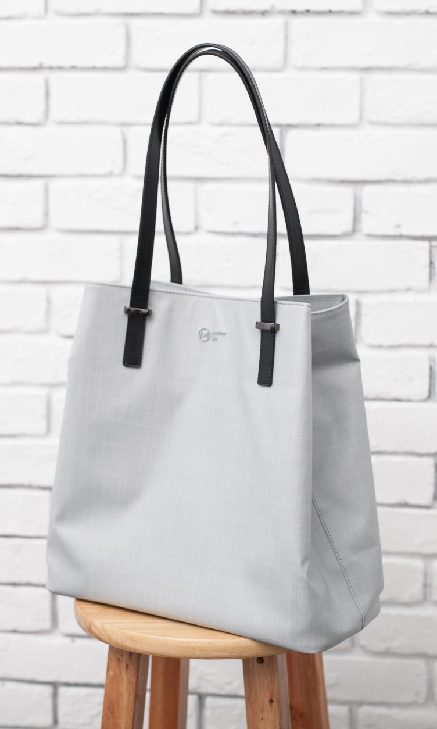
Brush Image Effects 039
Agenda
The quick brown fox jumps over the lazy dog.
Process
The quick brown fox jumps over the lazy dog.
Security
The quick brown fox jumps over the lazy dog.
Success
The quick brown fox jumps over the lazy dog.

Slide 85
Brush Image Effects 040
The quick brown fox jumps over the lazy dog. The quick brown fox jumps over the lazy dog.
The quick brown fox jumps over the lazy dog. The quick brown fox jumps over the lazy dog.
The quick brown fox jumps over the lazy dog. The quick brown fox jumps over the lazy dog.

Slide 87
Brush Image Effects 041
The quick brown fox jumps over the lazy dog. The quick brown fox jumps over the lazy dog.
The quick brown fox jumps over the lazy dog. The quick brown fox jumps over the lazy dog.
The quick brown fox jumps over the lazy dog. The quick brown fox jumps over the lazy dog.
The quick brown fox jumps over the lazy dog. The quick brown fox jumps over the lazy dog.

Slide 89
Brush Image Effects 042
The quick brown fox jumps over the lazy dog. The quick brown fox jumps over the lazy dog. The quick brown fox jumps over the lazy dog. The quick brown fox jumps over the lazy dog.

Slide 91

Brush Image Effects 043
The quick brown fox jumps over the lazy dog. The quick brown fox jumps over the lazy dog.
The quick brown fox jumps over the lazy dog. The quick brown fox jumps over the lazy dog.
The quick brown fox jumps over the lazy dog. The quick brown fox jumps over the lazy dog.
The quick brown fox jumps over the lazy dog. The quick brown fox jumps over the lazy dog.

Slide 93
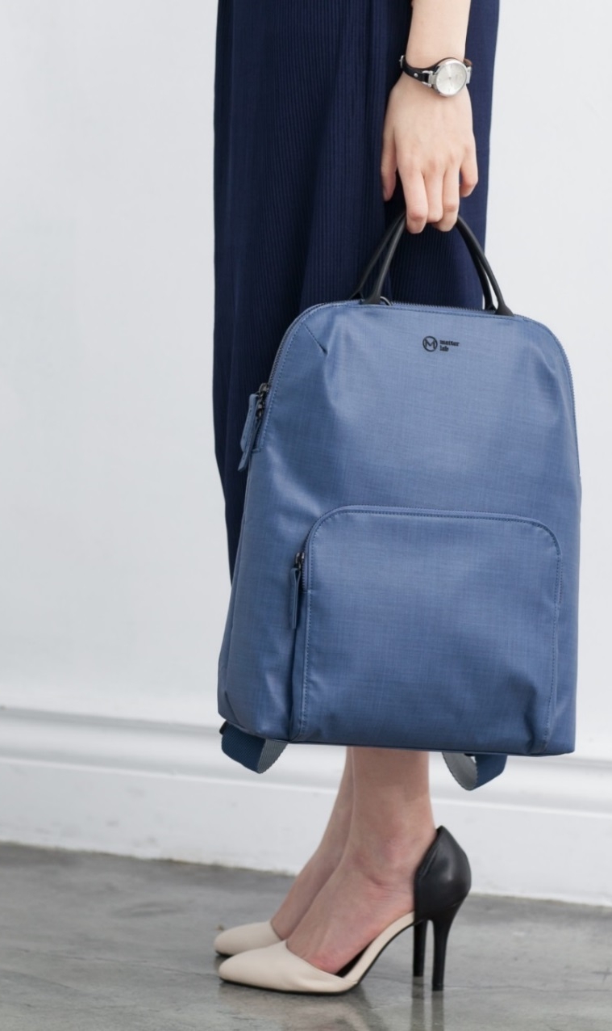
Brush Image Effects 044
The quick brown fox jumps over the lazy dog. The quick brown fox jumps over the lazy dog.
The quick brown fox jumps over the lazy dog. The quick brown fox jumps over the lazy dog.
The quick brown fox jumps over the lazy dog. The quick brown fox jumps over the lazy dog.
The quick brown fox jumps over the lazy dog. The quick brown fox jumps over the lazy dog.

Slide 95
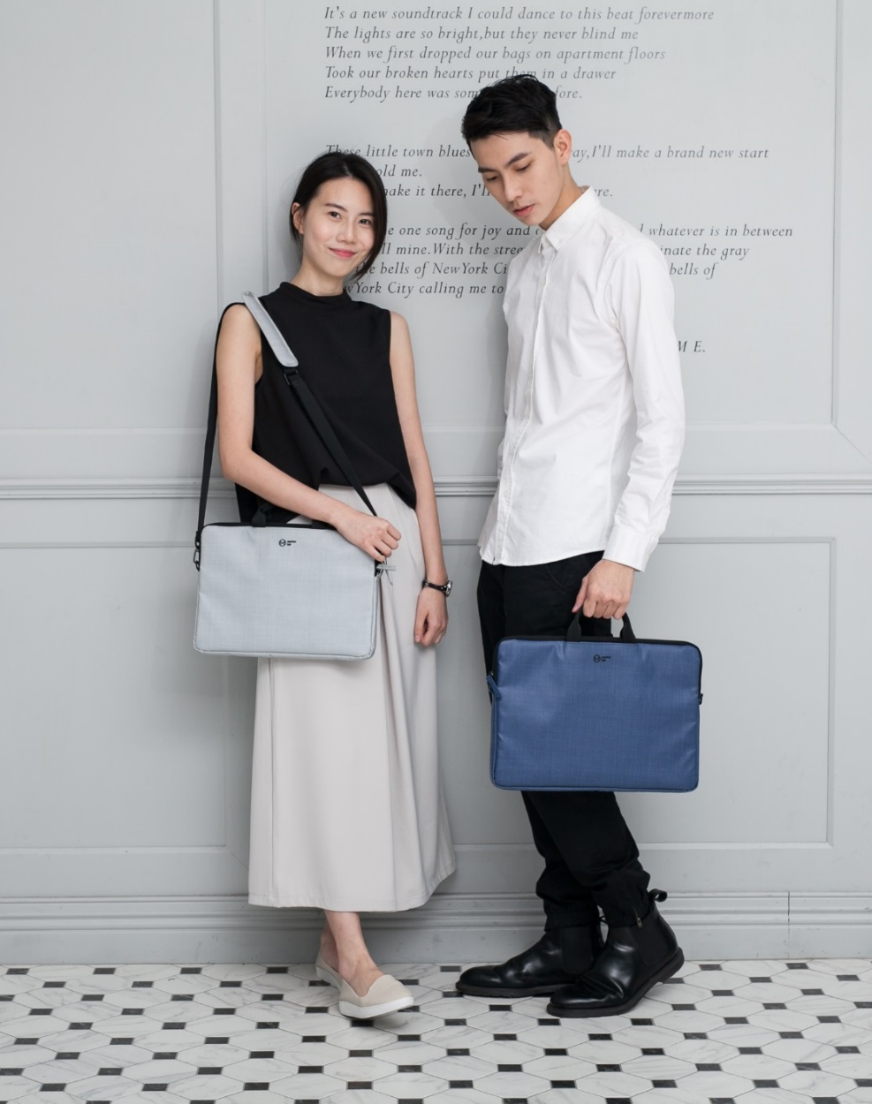
Brush Image Effects 045
The quick brown fox jumps over the lazy dog. The quick brown fox jumps over the lazy dog.
The quick brown fox jumps over the lazy dog. The quick brown fox jumps over the lazy dog.
The quick brown fox jumps over the lazy dog. The quick brown fox jumps over the lazy dog.

Slide 97

Brush Image Effects 046
The quick brown fox jumps over the lazy dog. The quick brown fox jumps over the lazy dog. The quick brown fox jumps over the lazy dog. The quick brown fox jumps over the lazy dog.

Slide 99
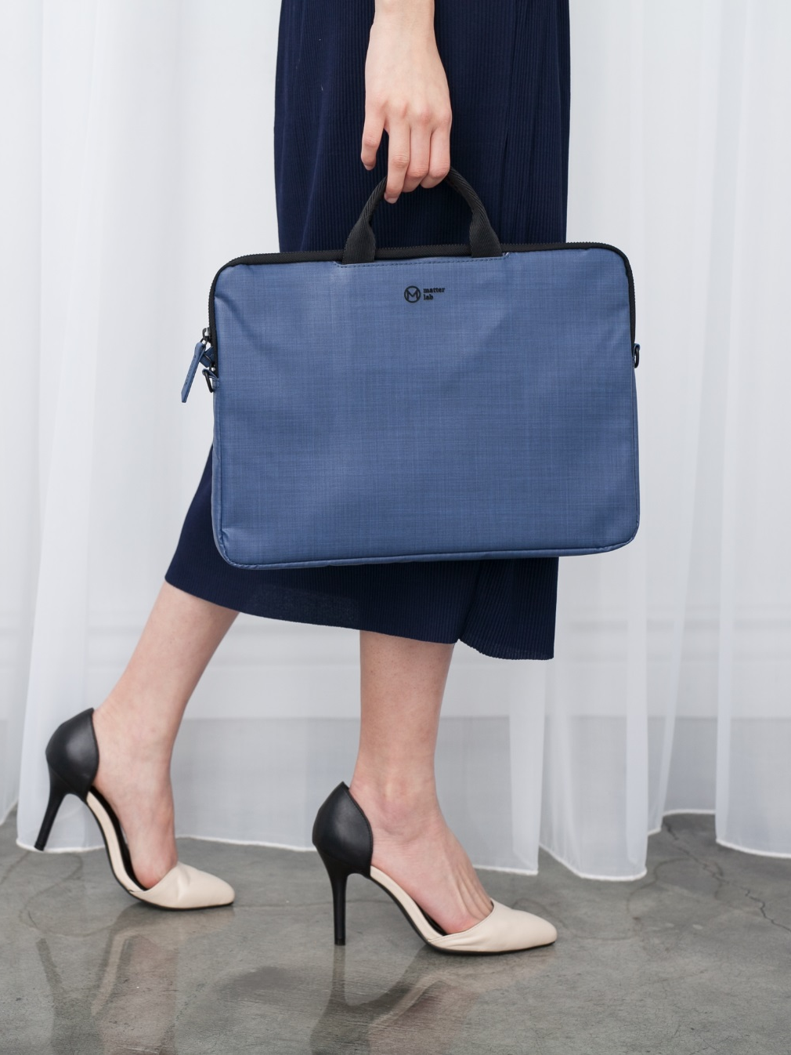
Brush Image Effects 047
The quick brown fox jumps over the lazy dog. The quick brown fox jumps over the lazy dog.
The quick brown fox jumps over the lazy dog. The quick brown fox jumps over the lazy dog.
The quick brown fox jumps over the lazy dog. The quick brown fox jumps over the lazy dog.
The quick brown fox jumps over the lazy dog. The quick brown fox jumps over the lazy dog.

Slide 101

Brush Image Effects 048
The quick brown fox jumps over the lazy dog. The quick brown fox jumps over the lazy dog.
The quick brown fox jumps over the lazy dog. The quick brown fox jumps over the lazy dog.
The quick brown fox jumps over the lazy dog. The quick brown fox jumps over the lazy dog.
The quick brown fox jumps over the lazy dog. The quick brown fox jumps over the lazy dog.

Slide 103
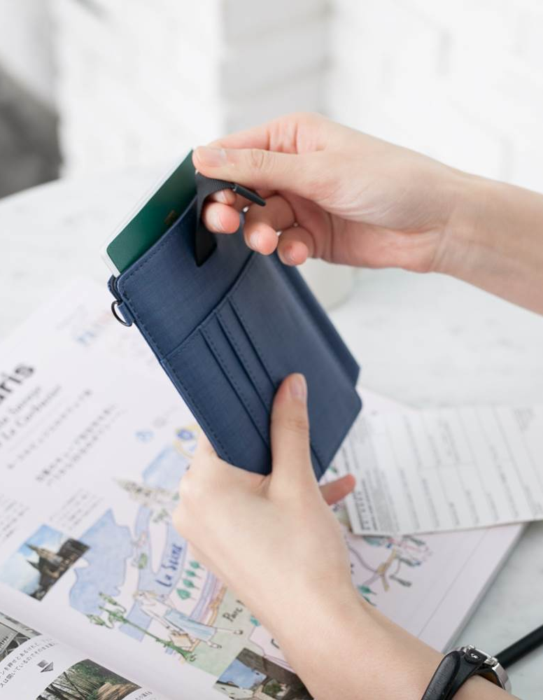
Brush Image Effects 049
01
The quick brown fox jumps over the lazy dog.
02
The quick brown fox jumps over the lazy dog.
03
The quick brown fox jumps over the lazy dog.
04
The quick brown fox jumps over the lazy dog.

Slide 105

Brush Image Effects 050
The quick brown fox jumps over the lazy dog. The quick brown fox jumps over the lazy dog.
The quick brown fox jumps over the lazy dog. The quick brown fox jumps over the lazy dog.
The quick brown fox jumps over the lazy dog. The quick brown fox jumps over the lazy dog.
The quick brown fox jumps over the lazy dog. The quick brown fox jumps over the lazy dog.

Slide 107

Brush Image Effects 051
The quick brown fox jumps over the lazy dog. The quick brown fox jumps over the lazy dog.
The quick brown fox jumps over the lazy dog. The quick brown fox jumps over the lazy dog.
The quick brown fox jumps over the lazy dog. The quick brown fox jumps over the lazy dog.
The quick brown fox jumps over the lazy dog. The quick brown fox jumps over the lazy dog.

Slide 109


歡迎加入商業簡報網粉絲專頁

Slide 110


Slide 111


Slide 112


