Slide 1


Slide 2


獨家贊助
Make Organizing Fun!
讓收納更有趣!
www.matter-lab.com
www.facebook.com/matterlab.taiwan

Slide 3


Before
After

Slide 4

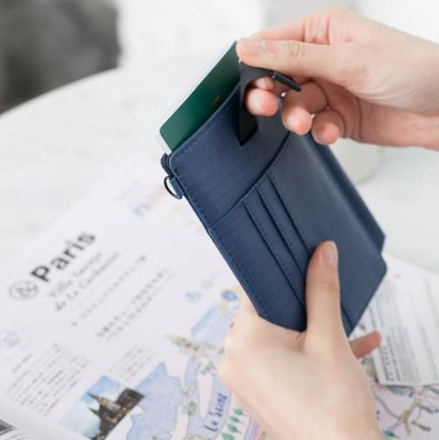
Before
After

Slide 5
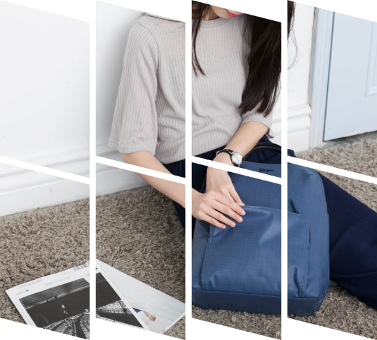
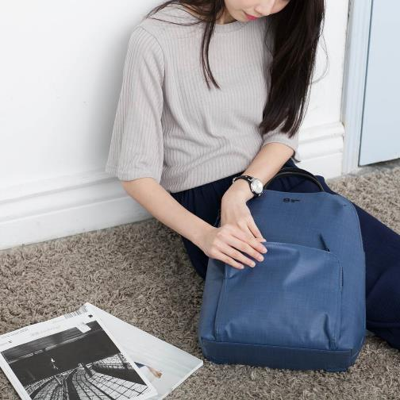
Before
After

Slide 6


Before
After

Slide 7

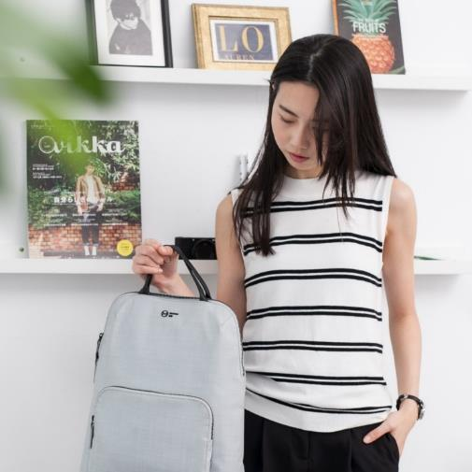
Before
After

Slide 8

Grille Image Effects 001
The quick brown fox jumps over the lazy dog. The quick brown fox jumps over the lazy dog.
The quick brown fox jumps over the lazy dog. The quick brown fox jumps over the lazy dog.
The quick brown fox jumps over the lazy dog. The quick brown fox jumps over the lazy dog.
The quick brown fox jumps over the lazy dog. The quick brown fox jumps over the lazy dog.

Slide 10
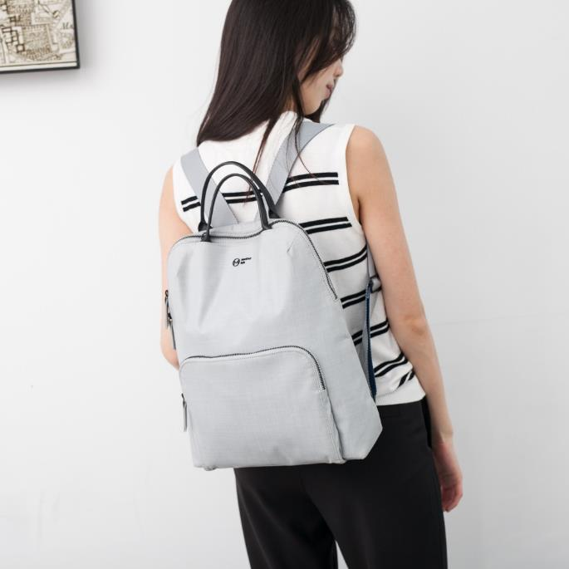
Grille Image Effects 002
The quick brown fox jumps over the lazy dog. The quick brown fox jumps over the lazy dog.
The quick brown fox jumps over the lazy dog. The quick brown fox jumps over the lazy dog.
The quick brown fox jumps over the lazy dog. The quick brown fox jumps over the lazy dog.
The quick brown fox jumps over the lazy dog. The quick brown fox jumps over the lazy dog.

Slide 12
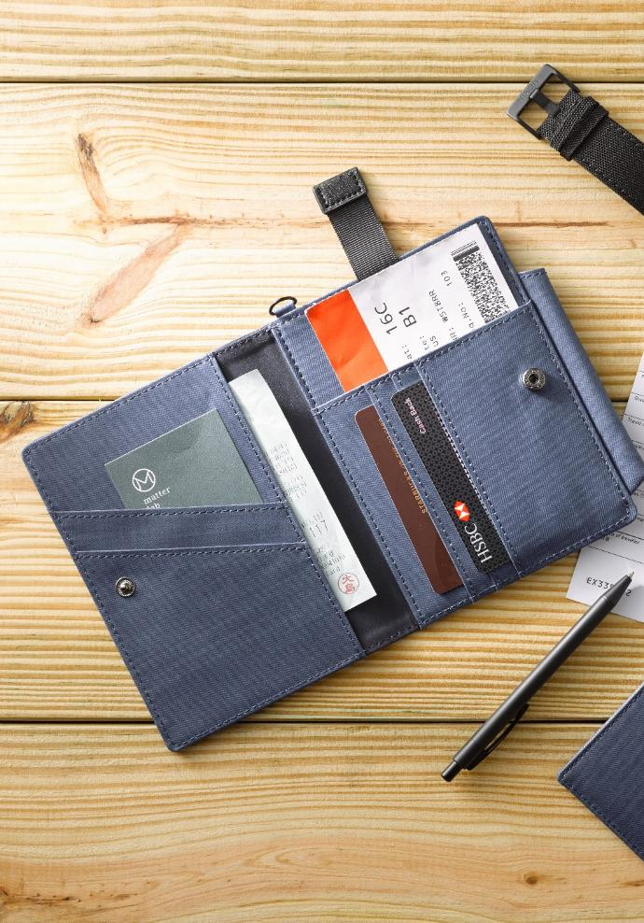
Grille Image Effects 003
The quick brown fox jumps over the lazy dog. The quick brown fox jumps over the lazy dog.
The quick brown fox jumps over the lazy dog. The quick brown fox jumps over the lazy dog.
The quick brown fox jumps over the lazy dog. The quick brown fox jumps over the lazy dog.
The quick brown fox jumps over the lazy dog. The quick brown fox jumps over the lazy dog.

Slide 14
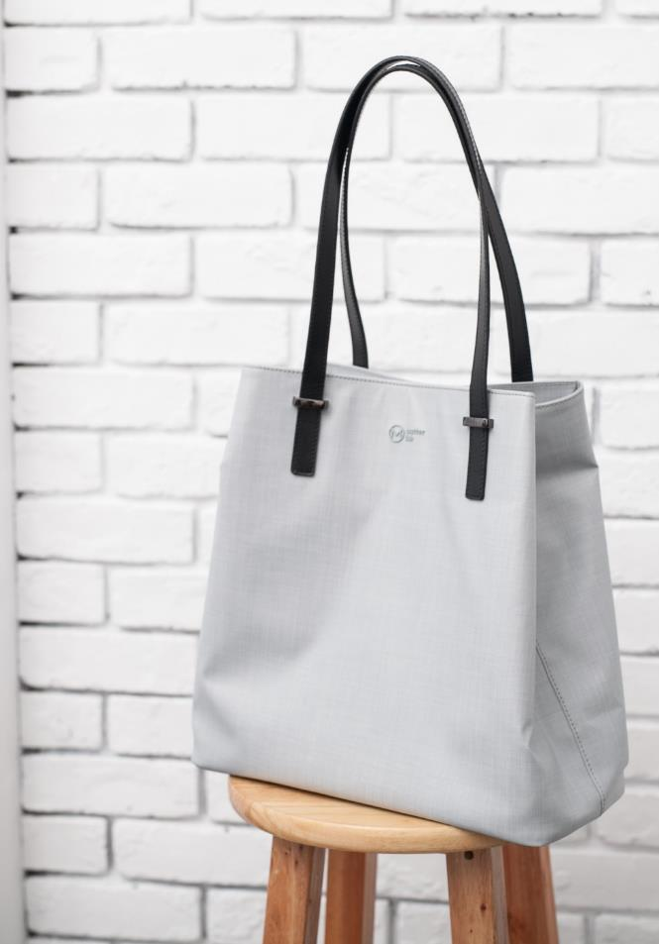
Grille Image Effects 004
The quick brown fox jumps over the lazy dog. The quick brown fox jumps over the lazy dog.
The quick brown fox jumps over the lazy dog. The quick brown fox jumps over the lazy dog.
The quick brown fox jumps over the lazy dog. The quick brown fox jumps over the lazy dog.
The quick brown fox jumps over the lazy dog. The quick brown fox jumps over the lazy dog.

Slide 16
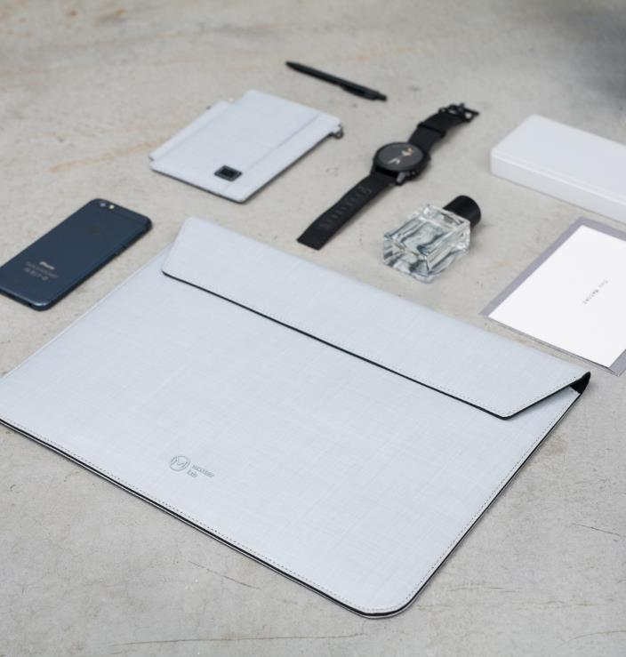
Grille Image Effects 005
01
The quick brown fox jumps over the lazy dog.
02
The quick brown fox jumps over the lazy dog.
03
The quick brown fox jumps over the lazy dog.
04
The quick brown fox jumps over the lazy dog.

Slide 18
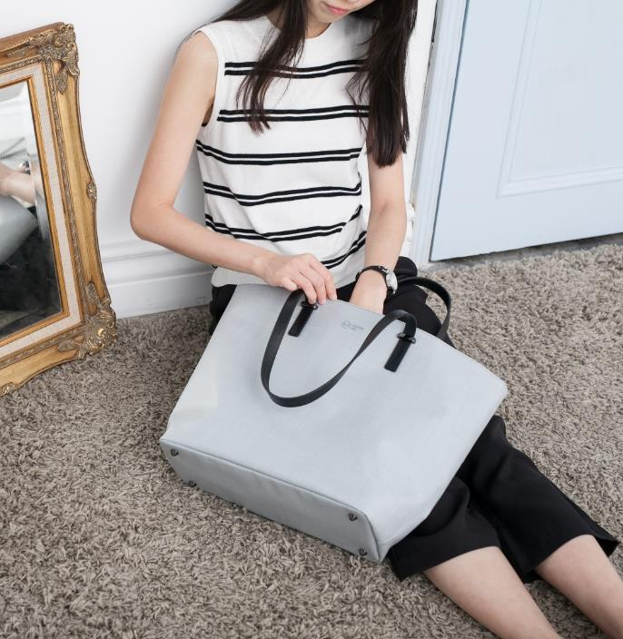
Grille Image Effects 006
The quick brown fox jumps over the lazy dog. The quick brown fox jumps over the lazy dog.
The quick brown fox jumps over the lazy dog. The quick brown fox jumps over the lazy dog.
The quick brown fox jumps over the lazy dog. The quick brown fox jumps over the lazy dog.
The quick brown fox jumps over the lazy dog. The quick brown fox jumps over the lazy dog.

Slide 20

Grille Image Effects 007
The quick brown fox jumps over the lazy dog. The quick brown fox jumps over the lazy dog.
The quick brown fox jumps over the lazy dog. The quick brown fox jumps over the lazy dog.
The quick brown fox jumps over the lazy dog. The quick brown fox jumps over the lazy dog.

Slide 22
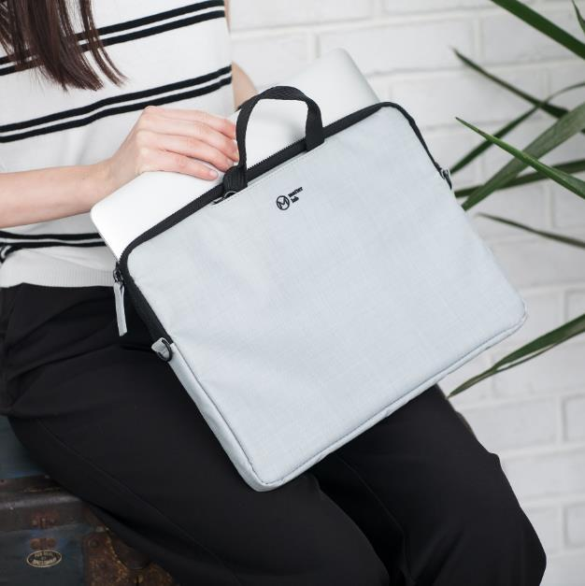
Grille Image Effects 008
The quick brown fox jumps over the lazy dog. The quick brown fox jumps over the lazy dog.
The quick brown fox jumps over the lazy dog. The quick brown fox jumps over the lazy dog.
The quick brown fox jumps over the lazy dog. The quick brown fox jumps over the lazy dog.
The quick brown fox jumps over the lazy dog. The quick brown fox jumps over the lazy dog.

Slide 24

Grille Image Effects 009
The quick brown fox jumps over the lazy dog. The quick brown fox jumps over the lazy dog.
The quick brown fox jumps over the lazy dog. The quick brown fox jumps over the lazy dog.
The quick brown fox jumps over the lazy dog. The quick brown fox jumps over the lazy dog.
The quick brown fox jumps over the lazy dog. The quick brown fox jumps over the lazy dog.

Slide 26
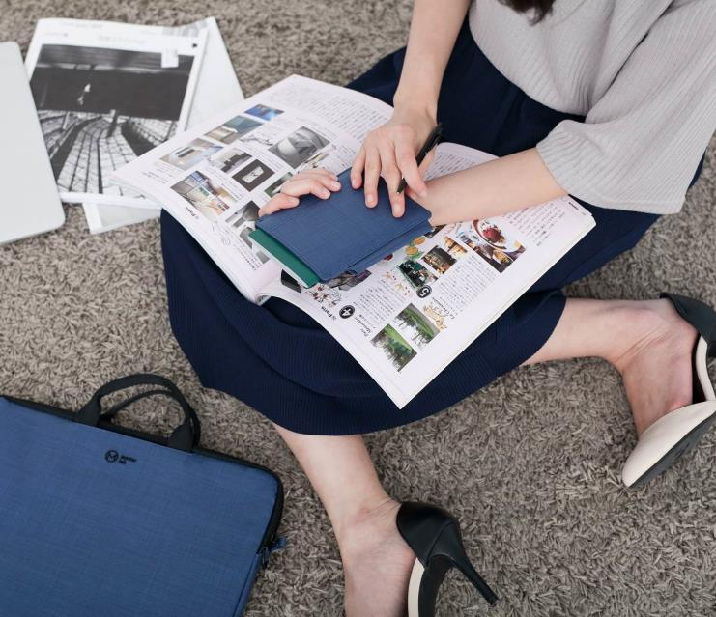
Grille Image Effects 010
The quick brown fox jumps over the lazy dog. The quick brown fox jumps over the lazy dog.
The quick brown fox jumps over the lazy dog. The quick brown fox jumps over the lazy dog.
The quick brown fox jumps over the lazy dog. The quick brown fox jumps over the lazy dog.
The quick brown fox jumps over the lazy dog. The quick brown fox jumps over the lazy dog.

Slide 28

Grille Image Effects 011
The quick brown fox jumps over the lazy dog. The quick brown fox jumps over the lazy dog.
The quick brown fox jumps over the lazy dog. The quick brown fox jumps over the lazy dog.
The quick brown fox jumps over the lazy dog. The quick brown fox jumps over the lazy dog.
The quick brown fox jumps over the lazy dog. The quick brown fox jumps over the lazy dog.

Slide 30

Grille Image Effects 012
01
The quick brown fox jumps over the lazy dog.
02
The quick brown fox jumps over the lazy dog.
03
The quick brown fox jumps over the lazy dog.
04
The quick brown fox jumps over the lazy dog.

Slide 32
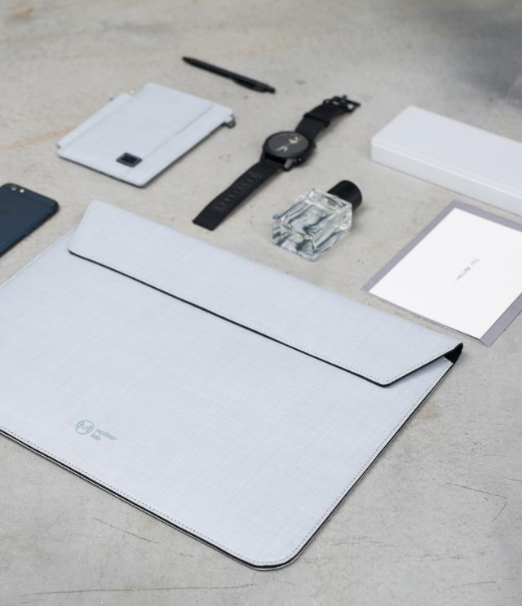
Grille Image Effects 013
Business
The quick brown fox jumps over the lazy dog. The quick brown fox jumps over the lazy dog.
Business
The quick brown fox jumps over the lazy dog. The quick brown fox jumps over the lazy dog.
Business
The quick brown fox jumps over the lazy dog. The quick brown fox jumps over the lazy dog.
Business
The quick brown fox jumps over the lazy dog. The quick brown fox jumps over the lazy dog.

Slide 34

Grille Image Effects 014
The quick brown fox jumps over the lazy dog. The quick brown fox jumps over the lazy dog.
The quick brown fox jumps over the lazy dog. The quick brown fox jumps over the lazy dog.
The quick brown fox jumps over the lazy dog. The quick brown fox jumps over the lazy dog.
The quick brown fox jumps over the lazy dog. The quick brown fox jumps over the lazy dog.

Slide 36
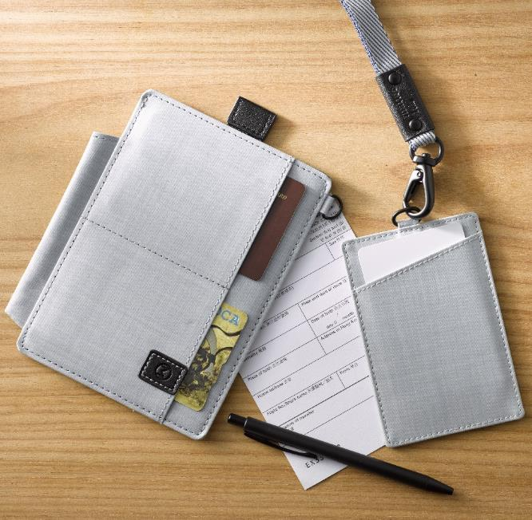
Grille Image Effects 015
The quick brown fox jumps over the lazy dog. The quick brown fox jumps over the lazy dog.
The quick brown fox jumps over the lazy dog. The quick brown fox jumps over the lazy dog.
The quick brown fox jumps over the lazy dog. The quick brown fox jumps over the lazy dog.

Slide 38
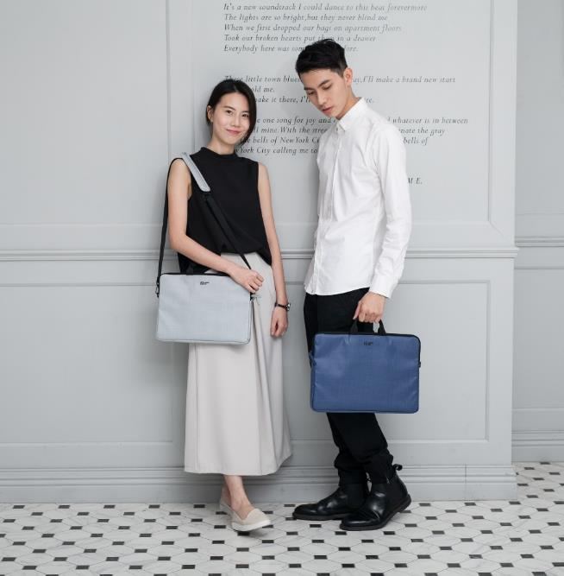
Grille Image Effects 016
The quick brown fox jumps over the lazy dog. The quick brown fox jumps over the lazy dog.
The quick brown fox jumps over the lazy dog. The quick brown fox jumps over the lazy dog.
The quick brown fox jumps over the lazy dog. The quick brown fox jumps over the lazy dog.
The quick brown fox jumps over the lazy dog. The quick brown fox jumps over the lazy dog.

Slide 40

Grille Image Effects 017
The quick brown fox jumps over the lazy dog. The quick brown fox jumps over the lazy dog.
The quick brown fox jumps over the lazy dog. The quick brown fox jumps over the lazy dog.
The quick brown fox jumps over the lazy dog. The quick brown fox jumps over the lazy dog.
The quick brown fox jumps over the lazy dog. The quick brown fox jumps over the lazy dog.

Slide 42
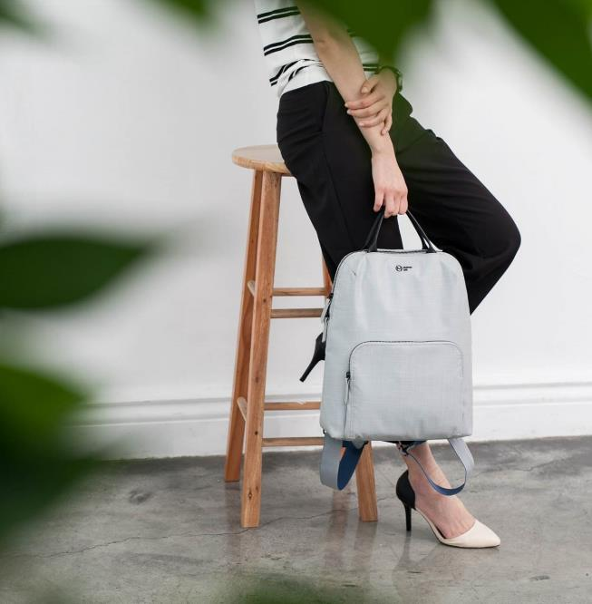
Grille Image Effects 018
01
The quick brown fox jumps over the lazy dog.
02
The quick brown fox jumps over the lazy dog.
03
The quick brown fox jumps over the lazy dog.
04
The quick brown fox jumps over the lazy dog.

Slide 44
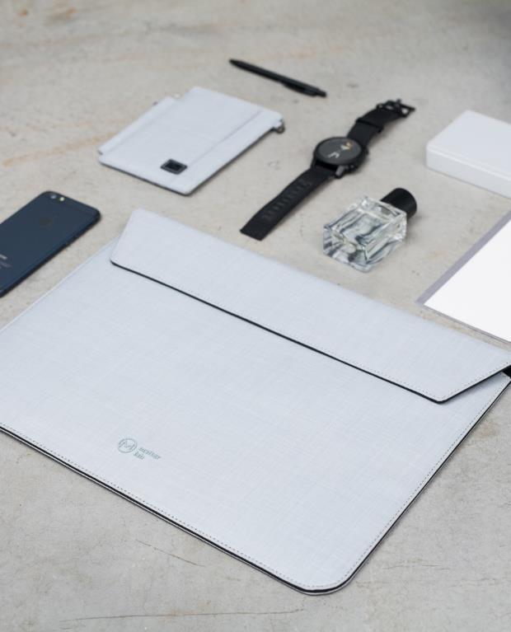
Grille Image Effects 019
The quick brown fox jumps over the lazy dog. The quick brown fox jumps over the lazy dog.
The quick brown fox jumps over the lazy dog. The quick brown fox jumps over the lazy dog.
The quick brown fox jumps over the lazy dog. The quick brown fox jumps over the lazy dog.
The quick brown fox jumps over the lazy dog. The quick brown fox jumps over the lazy dog.

Slide 46
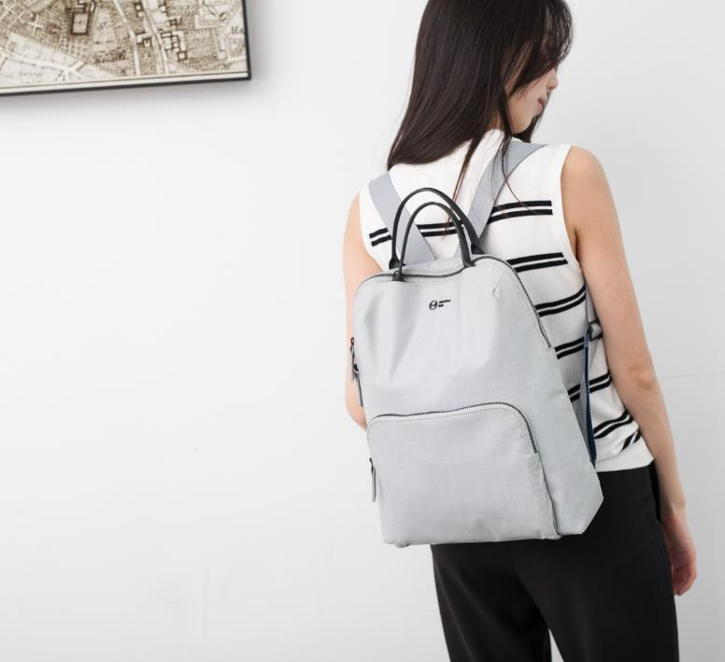
Grille Image Effects 020
The quick brown fox jumps over the lazy dog. The quick brown fox jumps over the lazy dog.
The quick brown fox jumps over the lazy dog. The quick brown fox jumps over the lazy dog.
The quick brown fox jumps over the lazy dog. The quick brown fox jumps over the lazy dog.
The quick brown fox jumps over the lazy dog. The quick brown fox jumps over the lazy dog.

Slide 48

Grille Image Effects 021
Business
The quick brown fox jumps over the lazy dog. The quick brown fox jumps over the lazy dog.
Business
The quick brown fox jumps over the lazy dog. The quick brown fox jumps over the lazy dog.
Business
The quick brown fox jumps over the lazy dog. The quick brown fox jumps over the lazy dog.
Business
The quick brown fox jumps over the lazy dog. The quick brown fox jumps over the lazy dog.

Slide 50
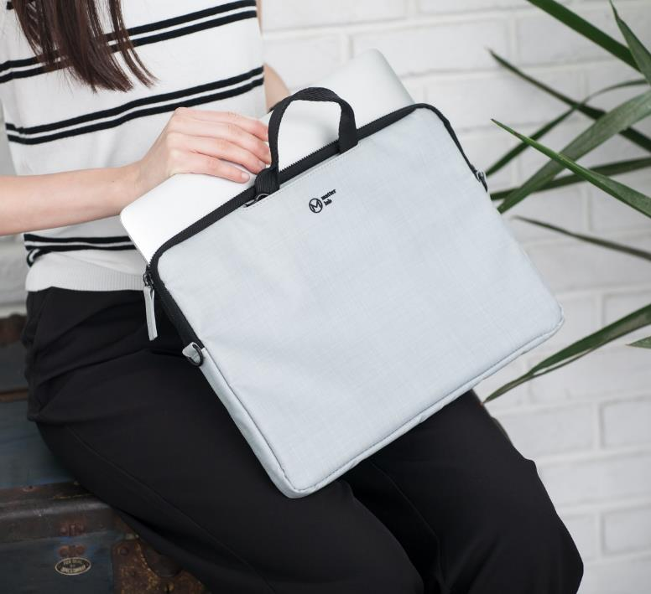
Grille Image Effects 022
The quick brown fox jumps over the lazy dog. The quick brown fox jumps over the lazy dog.
The quick brown fox jumps over the lazy dog. The quick brown fox jumps over the lazy dog.
The quick brown fox jumps over the lazy dog. The quick brown fox jumps over the lazy dog.
The quick brown fox jumps over the lazy dog. The quick brown fox jumps over the lazy dog.

Slide 52

Grille Image Effects 023
The quick brown fox jumps over the lazy dog. The quick brown fox jumps over the lazy dog.
The quick brown fox jumps over the lazy dog. The quick brown fox jumps over the lazy dog.
The quick brown fox jumps over the lazy dog. The quick brown fox jumps over the lazy dog.
The quick brown fox jumps over the lazy dog. The quick brown fox jumps over the lazy dog.

Slide 54

Grille Image Effects 024
The quick brown fox jumps over the lazy dog. The quick brown fox jumps over the lazy dog.
The quick brown fox jumps over the lazy dog. The quick brown fox jumps over the lazy dog.
The quick brown fox jumps over the lazy dog. The quick brown fox jumps over the lazy dog.
The quick brown fox jumps over the lazy dog. The quick brown fox jumps over the lazy dog.

Slide 56
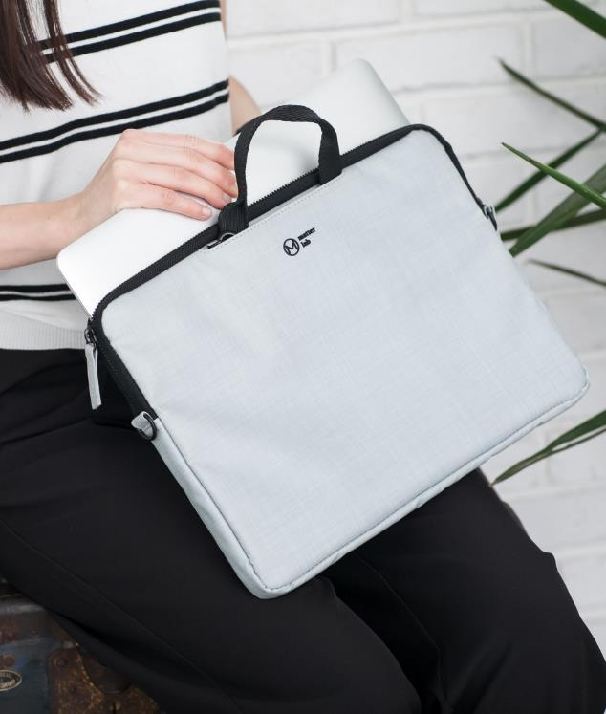
Grille Image Effects 025
The quick brown fox jumps over the lazy dog. The quick brown fox jumps over the lazy dog.
The quick brown fox jumps over the lazy dog. The quick brown fox jumps over the lazy dog.
The quick brown fox jumps over the lazy dog. The quick brown fox jumps over the lazy dog.
The quick brown fox jumps over the lazy dog. The quick brown fox jumps over the lazy dog.

Slide 58
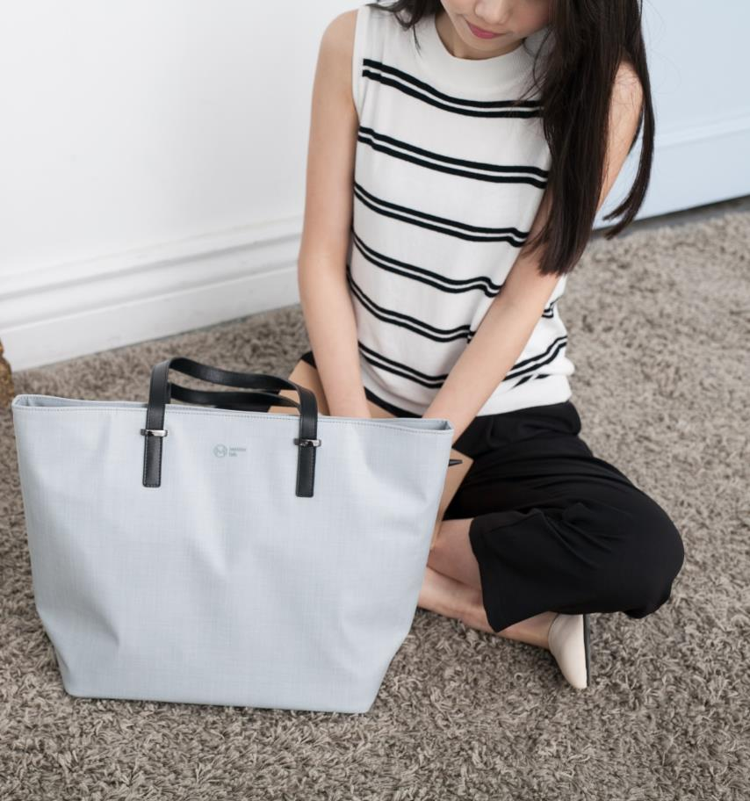
Grille Image Effects 026
The quick brown fox jumps over the lazy dog. The quick brown fox jumps over the lazy dog.
The quick brown fox jumps over the lazy dog. The quick brown fox jumps over the lazy dog.
The quick brown fox jumps over the lazy dog. The quick brown fox jumps over the lazy dog.

Slide 60

Grille Image Effects 027
The quick brown fox jumps over the lazy dog. The quick brown fox jumps over the lazy dog.
The quick brown fox jumps over the lazy dog. The quick brown fox jumps over the lazy dog.
The quick brown fox jumps over the lazy dog. The quick brown fox jumps over the lazy dog.
The quick brown fox jumps over the lazy dog. The quick brown fox jumps over the lazy dog.

Slide 62
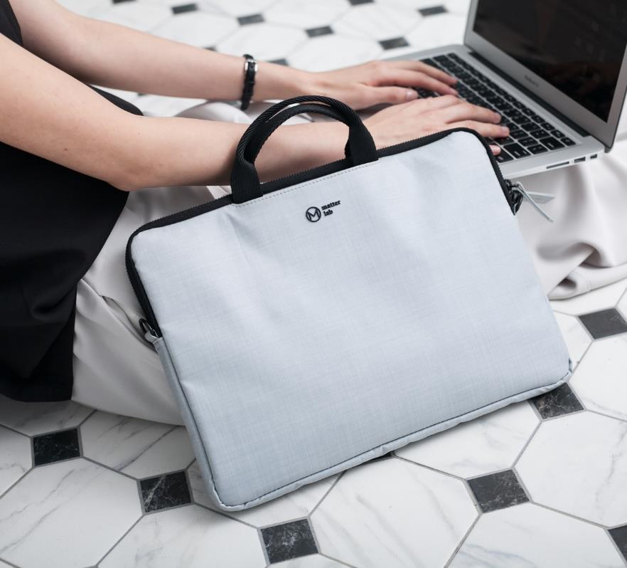
Grille Image Effects 028
The quick brown fox jumps over the lazy dog. The quick brown fox jumps over the lazy dog. The quick brown fox jumps over the lazy dog. The quick brown fox jumps over the lazy dog.

Slide 64
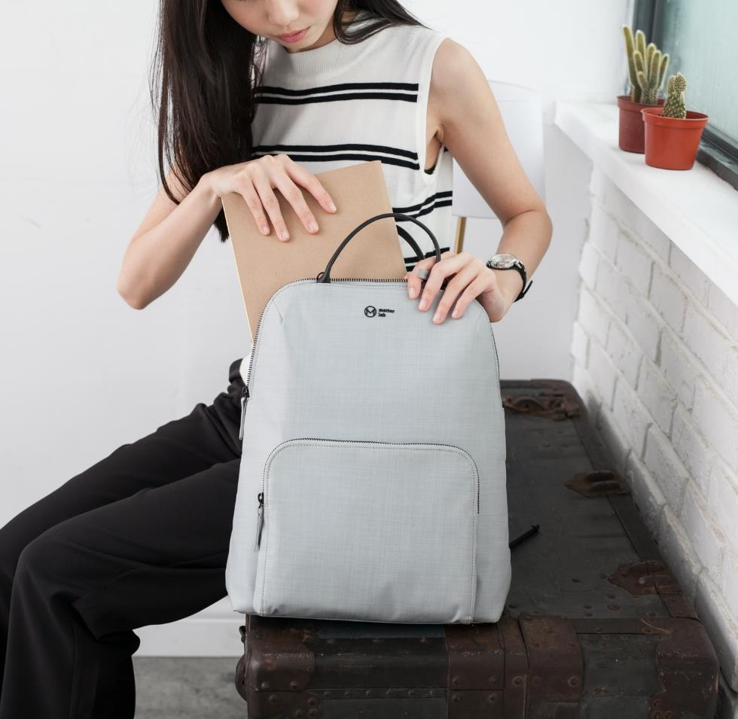
Grille Image Effects 029
The quick brown fox jumps over the lazy dog. The quick brown fox jumps over the lazy dog.
The quick brown fox jumps over the lazy dog. The quick brown fox jumps over the lazy dog.
The quick brown fox jumps over the lazy dog. The quick brown fox jumps over the lazy dog.
The quick brown fox jumps over the lazy dog. The quick brown fox jumps over the lazy dog.

Slide 66
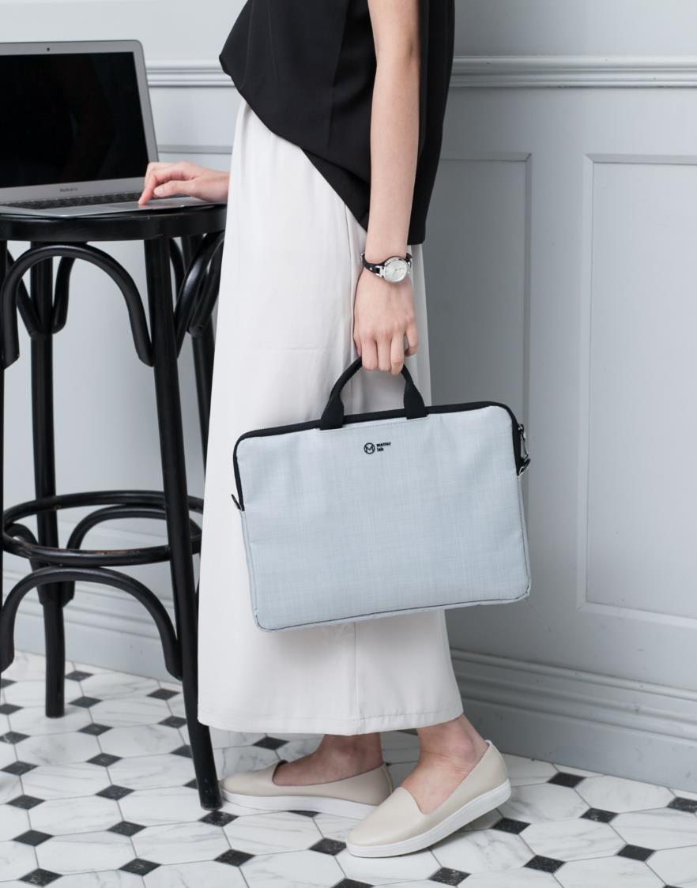
The quick brown fox jumps over the lazy dog. The quick brown fox jumps over the lazy dog.
The quick brown fox jumps over the lazy dog. The quick brown fox jumps over the lazy dog.
The quick brown fox jumps over the lazy dog. The quick brown fox jumps over the lazy dog.
The quick brown fox jumps over the lazy dog. The quick brown fox jumps over the lazy dog.
Grille Image Effects 030

Slide 68

Business
The quick brown fox jumps over the lazy dog. The quick brown fox jumps over the lazy dog.
Business
The quick brown fox jumps over the lazy dog. The quick brown fox jumps over the lazy dog.
Business
The quick brown fox jumps over the lazy dog. The quick brown fox jumps over the lazy dog.
Business
The quick brown fox jumps over the lazy dog. The quick brown fox jumps over the lazy dog.
Grille Image Effects 031

Slide 70

Grille Image Effects
032
The quick brown fox jumps over the lazy dog. The quick brown fox jumps over the lazy dog. The quick brown fox jumps over the lazy dog. The quick brown fox jumps over the lazy dog.

Slide 72

The quick brown fox jumps over the lazy dog. The quick brown fox jumps over the lazy dog. The quick brown fox jumps over the lazy dog. The quick brown fox jumps over the lazy dog.
Grille Image Effects
033

Slide 74

Grille Image Effects 034
The quick brown fox jumps over the lazy dog. The quick brown fox jumps over the lazy dog.
The quick brown fox jumps over the lazy dog. The quick brown fox jumps over the lazy dog.
The quick brown fox jumps over the lazy dog. The quick brown fox jumps over the lazy dog.
The quick brown fox jumps over the lazy dog. The quick brown fox jumps over the lazy dog.

Slide 76
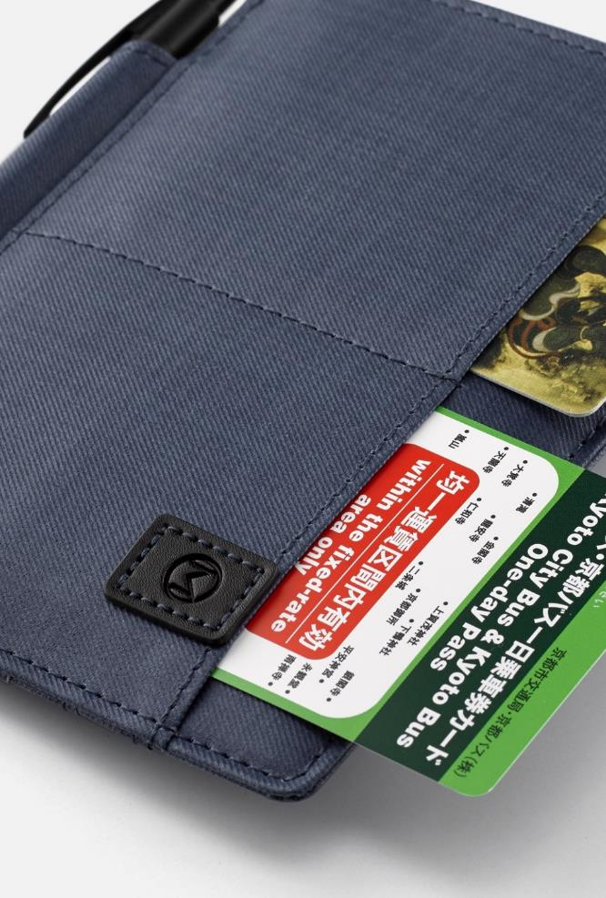
Grille Image Effects 035
The quick brown fox jumps over the lazy dog. The quick brown fox jumps over the lazy dog.
The quick brown fox jumps over the lazy dog. The quick brown fox jumps over the lazy dog.
The quick brown fox jumps over the lazy dog. The quick brown fox jumps over the lazy dog.
The quick brown fox jumps over the lazy dog. The quick brown fox jumps over the lazy dog.

Slide 78
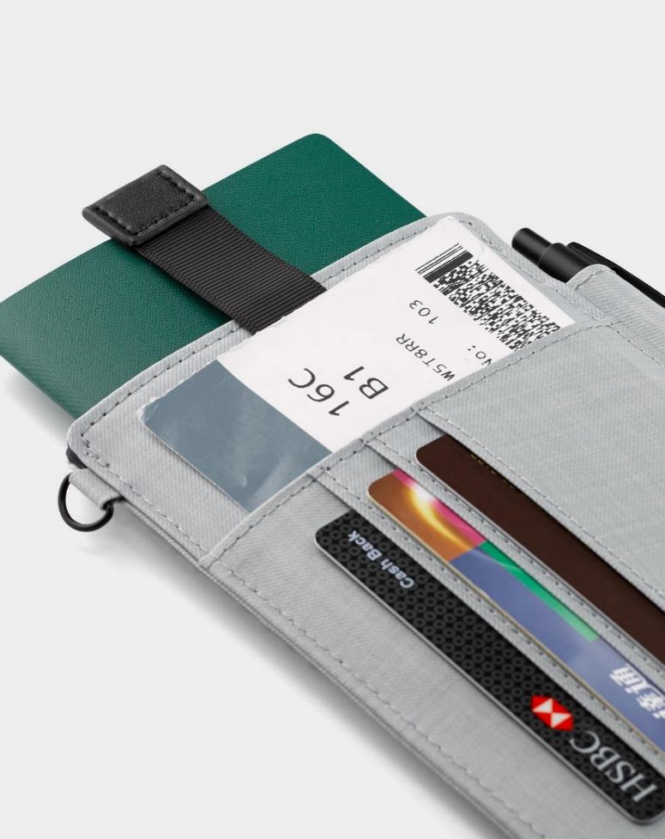
Grille Image Effects 036
The quick brown fox jumps over the lazy dog. The quick brown fox jumps over the lazy dog.
The quick brown fox jumps over the lazy dog. The quick brown fox jumps over the lazy dog.
The quick brown fox jumps over the lazy dog. The quick brown fox jumps over the lazy dog.
The quick brown fox jumps over the lazy dog. The quick brown fox jumps over the lazy dog.

Slide 80
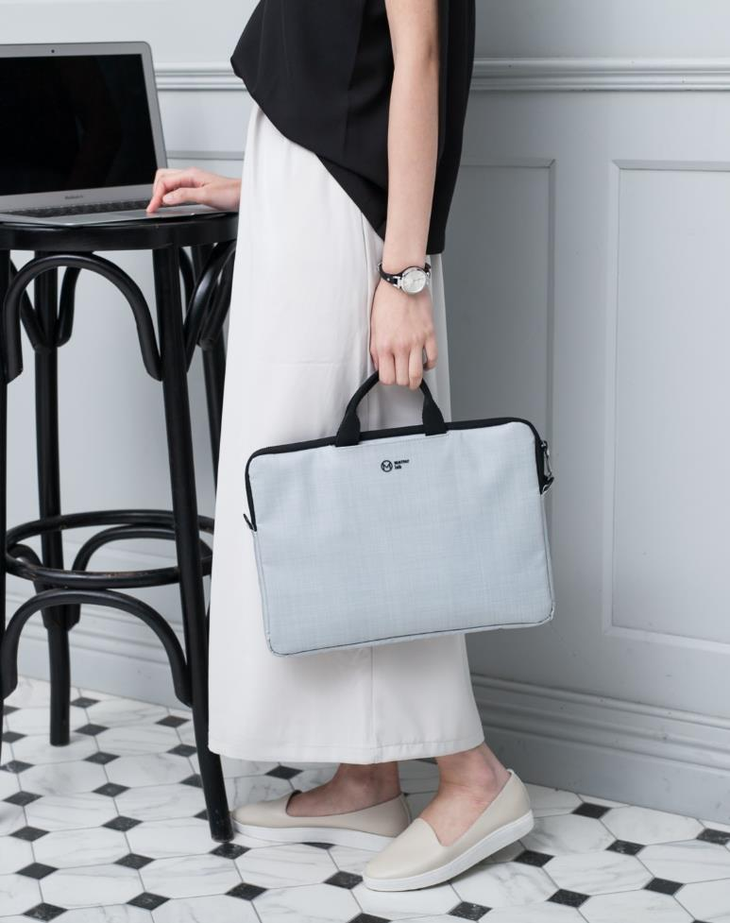
Grille Image Effects 037
The quick brown fox jumps over the lazy dog. The quick brown fox jumps over the lazy dog.
The quick brown fox jumps over the lazy dog. The quick brown fox jumps over the lazy dog.
The quick brown fox jumps over the lazy dog. The quick brown fox jumps over the lazy dog.
The quick brown fox jumps over the lazy dog. The quick brown fox jumps over the lazy dog.

Slide 82

Grille Image Effects 038
01
The quick brown fox jumps over the lazy dog.
02
The quick brown fox jumps over the lazy dog.
03
The quick brown fox jumps over the lazy dog.
04
The quick brown fox jumps over the lazy dog.

Slide 84
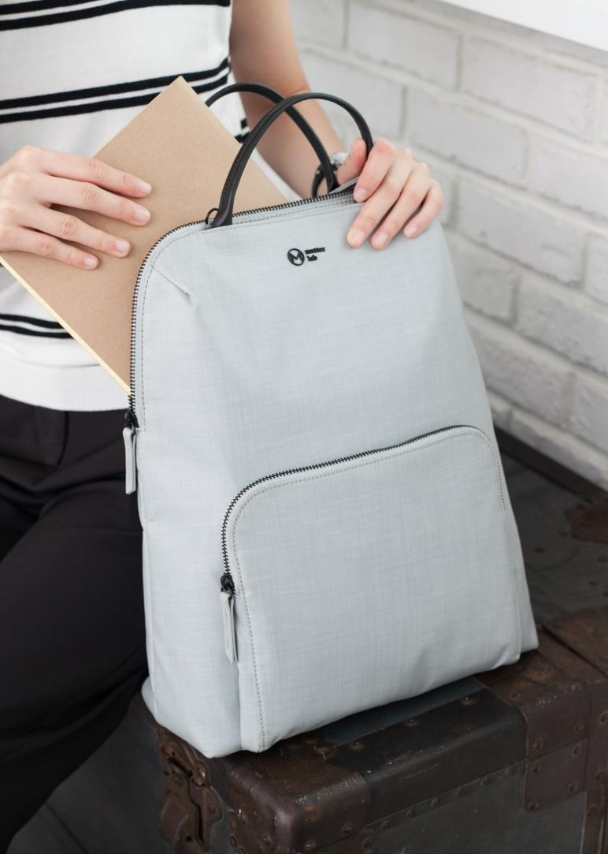
Grille Image Effects 039
The quick brown fox jumps over the lazy dog. The quick brown fox jumps over the lazy dog.
The quick brown fox jumps over the lazy dog. The quick brown fox jumps over the lazy dog.
The quick brown fox jumps over the lazy dog. The quick brown fox jumps over the lazy dog.
The quick brown fox jumps over the lazy dog. The quick brown fox jumps over the lazy dog.

Slide 86

Grille Image Effects 040
The quick brown fox jumps over the lazy dog. The quick brown fox jumps over the lazy dog.
The quick brown fox jumps over the lazy dog. The quick brown fox jumps over the lazy dog.
The quick brown fox jumps over the lazy dog. The quick brown fox jumps over the lazy dog.

Slide 88
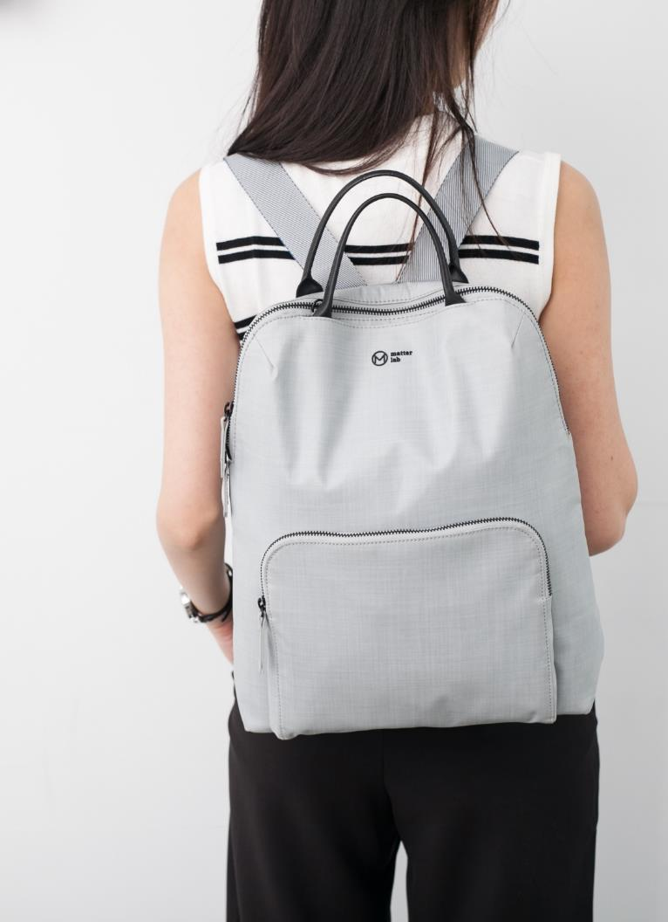
Grille Image Effects 041
The quick brown fox jumps over the lazy dog. The quick brown fox jumps over the lazy dog.
The quick brown fox jumps over the lazy dog. The quick brown fox jumps over the lazy dog.
The quick brown fox jumps over the lazy dog. The quick brown fox jumps over the lazy dog.
The quick brown fox jumps over the lazy dog. The quick brown fox jumps over the lazy dog.

Slide 90
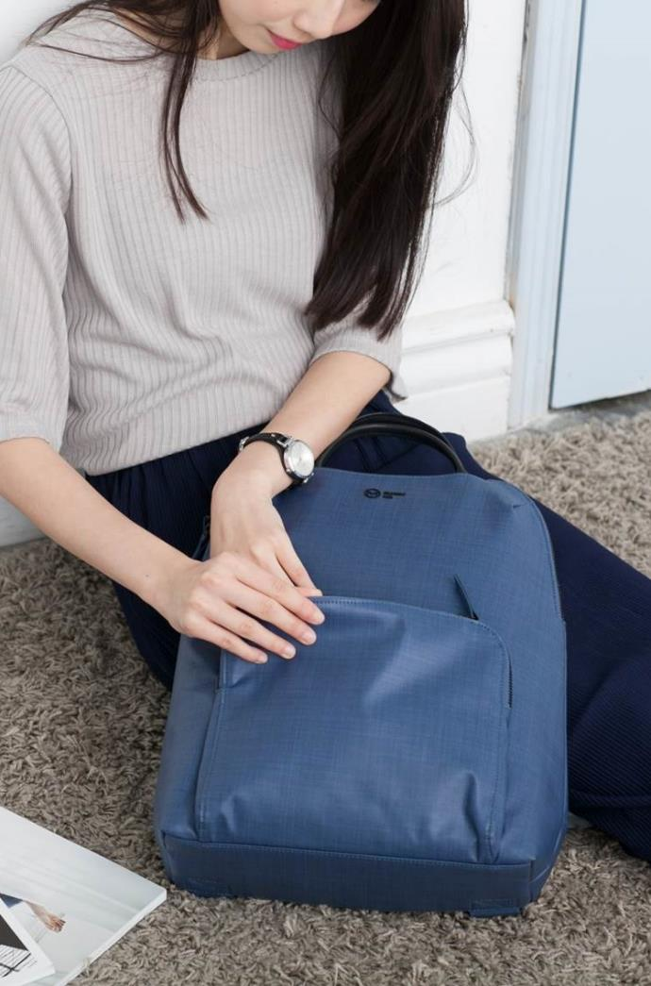
Grille Image Effects 042
Business
The quick brown fox jumps over the lazy dog. The quick brown fox jumps over the lazy dog.
Business
The quick brown fox jumps over the lazy dog. The quick brown fox jumps over the lazy dog.
Business
The quick brown fox jumps over the lazy dog. The quick brown fox jumps over the lazy dog.
Business
The quick brown fox jumps over the lazy dog. The quick brown fox jumps over the lazy dog.

Slide 92
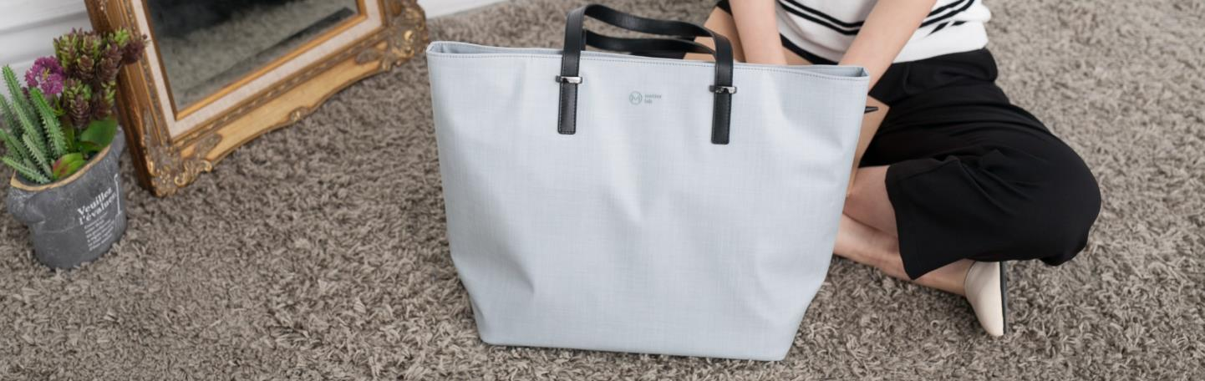
Grille Image Effects 043
The quick brown fox jumps over the lazy dog. The quick brown fox jumps over the lazy dog.
The quick brown fox jumps over the lazy dog. The quick brown fox jumps over the lazy dog.
The quick brown fox jumps over the lazy dog. The quick brown fox jumps over the lazy dog.
The quick brown fox jumps over the lazy dog. The quick brown fox jumps over the lazy dog.

Slide 94

Grille Image Effects 044
The quick brown fox jumps over the lazy dog. The quick brown fox jumps over the lazy dog.
The quick brown fox jumps over the lazy dog. The quick brown fox jumps over the lazy dog.
The quick brown fox jumps over the lazy dog. The quick brown fox jumps over the lazy dog.
The quick brown fox jumps over the lazy dog. The quick brown fox jumps over the lazy dog.

Slide 96

Grille Image Effects 045
01
The quick brown fox jumps over the lazy dog.
03
The quick brown fox jumps over the lazy dog.
02
The quick brown fox jumps over the lazy dog.
04
The quick brown fox jumps over the lazy dog.

Slide 98

Grille Image Effects 046
The quick brown fox jumps over the lazy dog. The quick brown fox jumps over the lazy dog.
The quick brown fox jumps over the lazy dog. The quick brown fox jumps over the lazy dog.
The quick brown fox jumps over the lazy dog. The quick brown fox jumps over the lazy dog.
The quick brown fox jumps over the lazy dog. The quick brown fox jumps over the lazy dog.

Slide 100
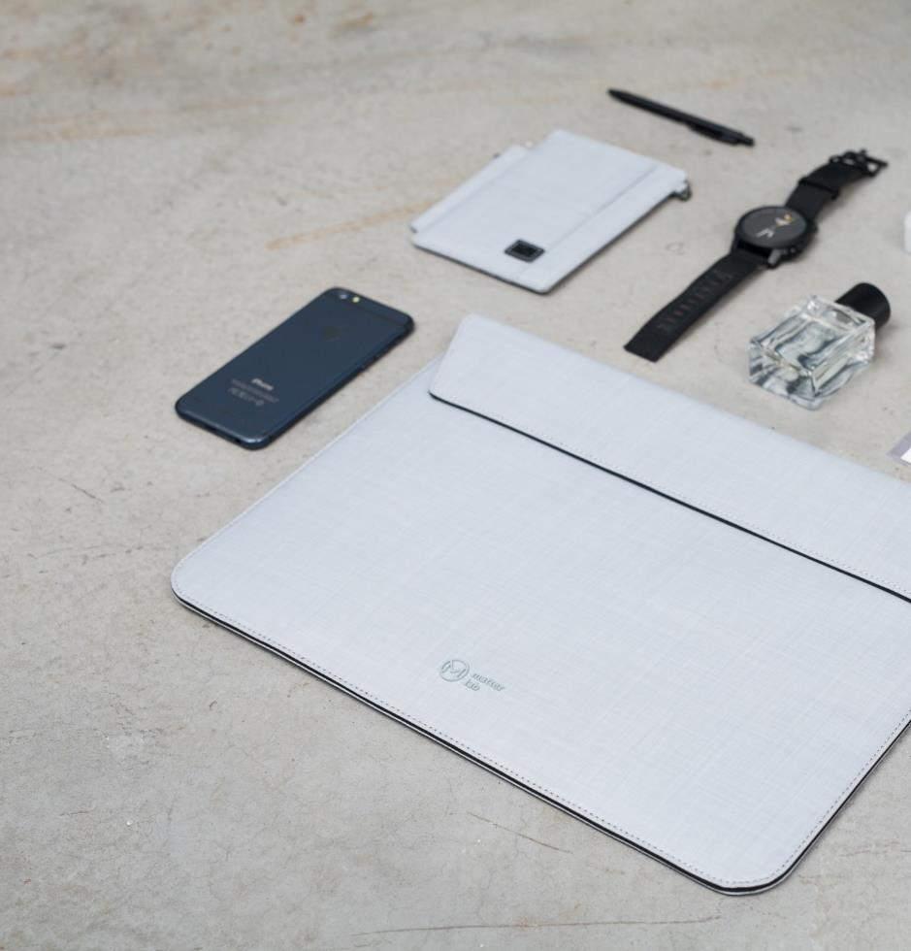
Grille Image Effects 047
The quick brown fox jumps over the lazy dog. The quick brown fox jumps over the lazy dog.
The quick brown fox jumps over the lazy dog. The quick brown fox jumps over the lazy dog.
The quick brown fox jumps over the lazy dog. The quick brown fox jumps over the lazy dog.
The quick brown fox jumps over the lazy dog. The quick brown fox jumps over the lazy dog.

Slide 102
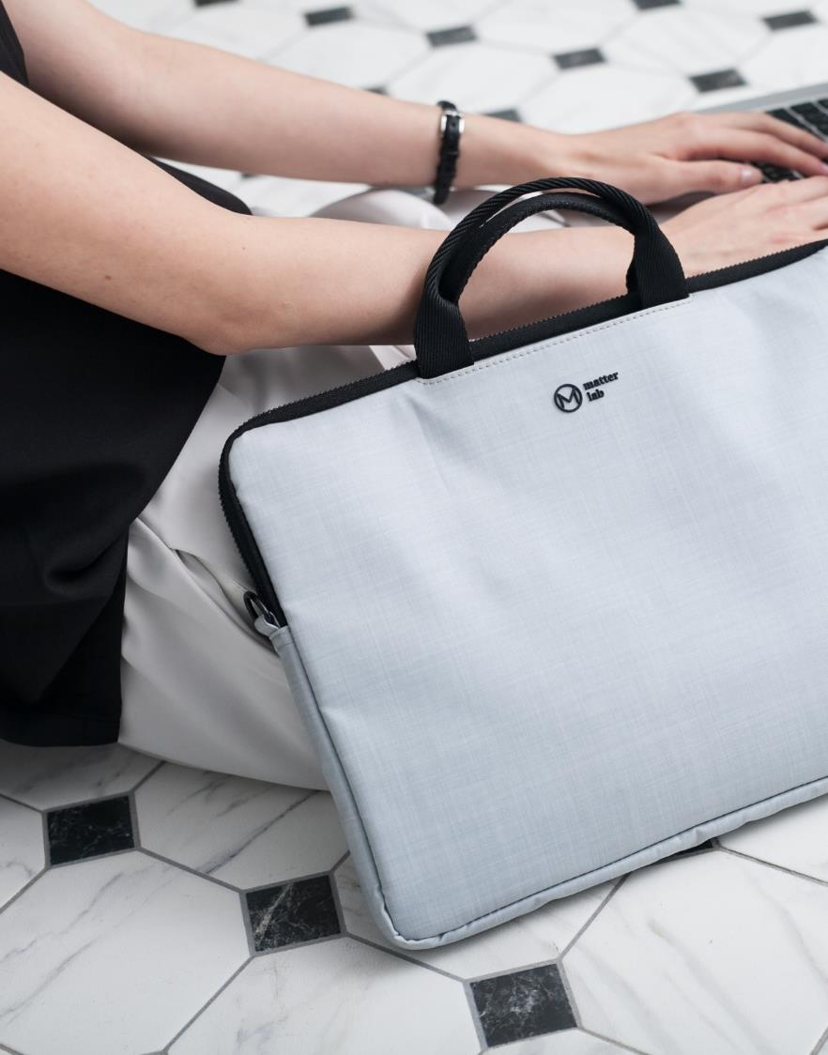
Grille Image Effects 048
The quick brown fox jumps over the lazy dog. The quick brown fox jumps over the lazy dog.
The quick brown fox jumps over the lazy dog. The quick brown fox jumps over the lazy dog.
The quick brown fox jumps over the lazy dog. The quick brown fox jumps over the lazy dog.
The quick brown fox jumps over the lazy dog. The quick brown fox jumps over the lazy dog.

Slide 104

Grille Image Effects 049
The quick brown fox jumps over the lazy dog. The quick brown fox jumps over the lazy dog. The quick brown fox jumps over the lazy dog. The quick brown fox jumps over the lazy dog.

Slide 106
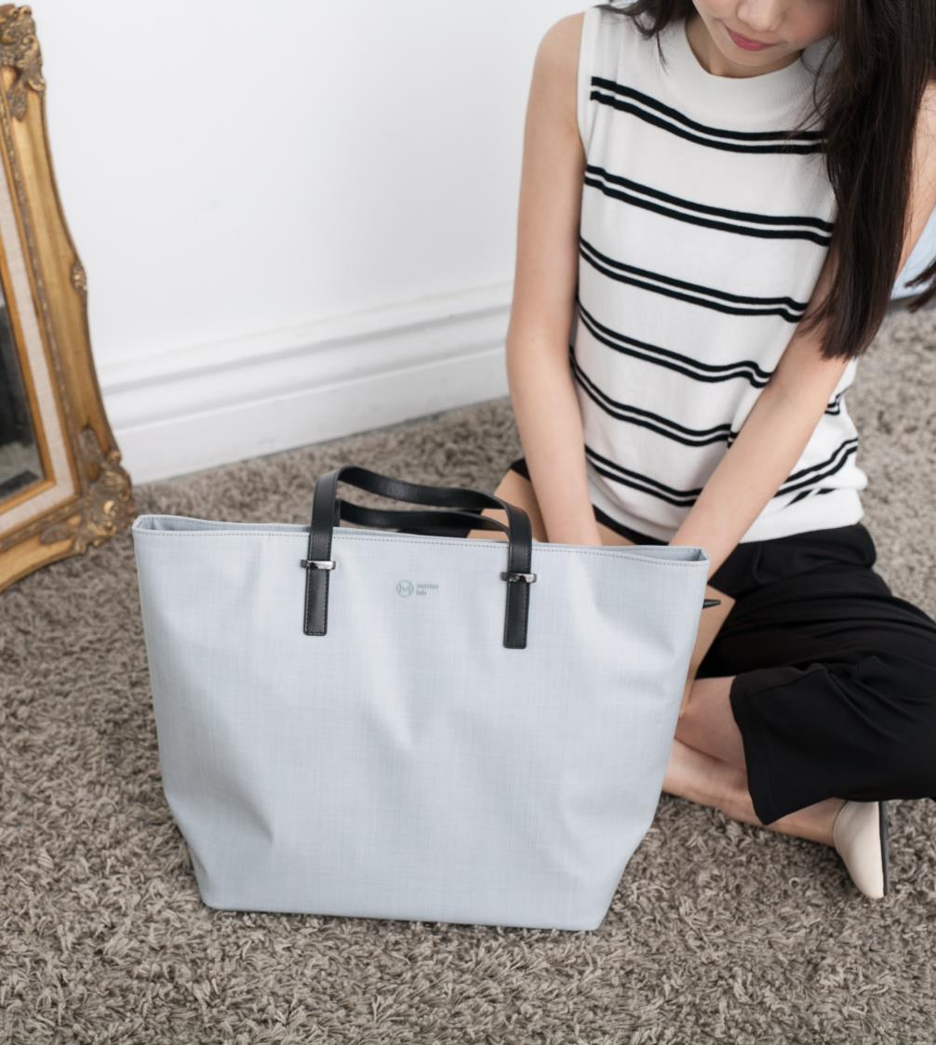
The quick brown fox jumps over the lazy dog. The quick brown fox jumps over the lazy dog.
The quick brown fox jumps over the lazy dog. The quick brown fox jumps over the lazy dog.
The quick brown fox jumps over the lazy dog. The quick brown fox jumps over the lazy dog.
Grille Image Effects 050

Slide 108

Grille Image Effects 051
The quick brown fox jumps over the lazy dog. The quick brown fox jumps over the lazy dog.
The quick brown fox jumps over the lazy dog. The quick brown fox jumps over the lazy dog.
The quick brown fox jumps over the lazy dog. The quick brown fox jumps over the lazy dog.
The quick brown fox jumps over the lazy dog. The quick brown fox jumps over the lazy dog.

Slide 110
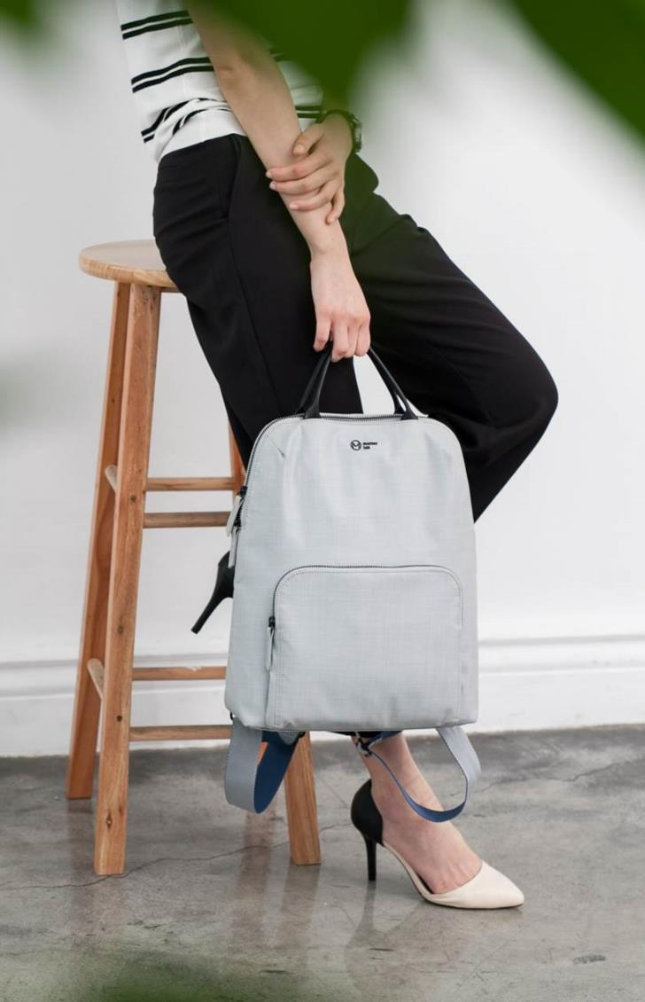
Grille Image Effects 052
The quick brown fox jumps over the lazy dog. The quick brown fox jumps over the lazy dog.
The quick brown fox jumps over the lazy dog. The quick brown fox jumps over the lazy dog.
The quick brown fox jumps over the lazy dog. The quick brown fox jumps over the lazy dog.
The quick brown fox jumps over the lazy dog. The quick brown fox jumps over the lazy dog.

Slide 112

Grille Image Effects 053
Business
The quick brown fox jumps over the lazy dog. The quick brown fox jumps over the lazy dog.
Business
The quick brown fox jumps over the lazy dog. The quick brown fox jumps over the lazy dog.
Business
The quick brown fox jumps over the lazy dog. The quick brown fox jumps over the lazy dog.
Business
The quick brown fox jumps over the lazy dog. The quick brown fox jumps over the lazy dog.

Slide 114
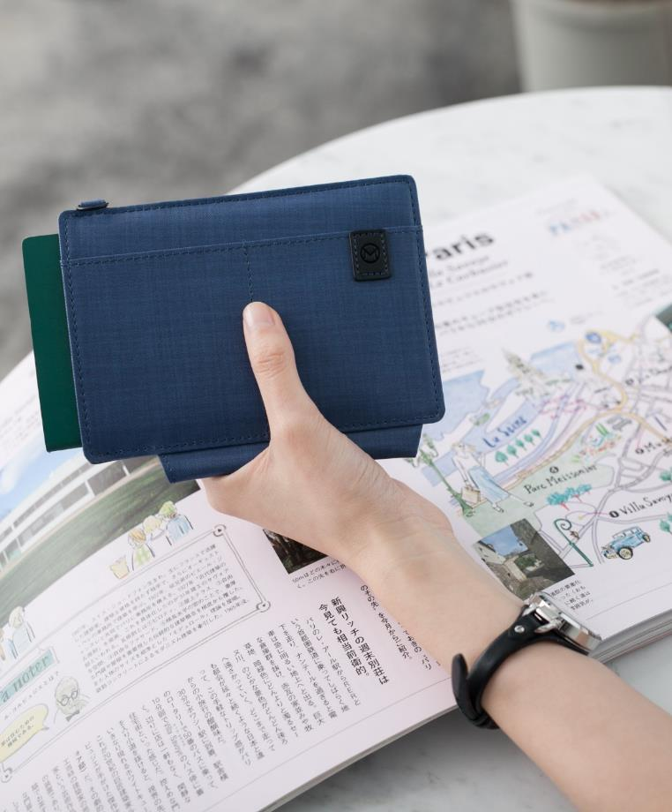
Grille Image Effects 054
01
The quick brown fox jumps over the lazy dog.
02
The quick brown fox jumps over the lazy dog.
03
The quick brown fox jumps over the lazy dog.
04
The quick brown fox jumps over the lazy dog.

Slide 116
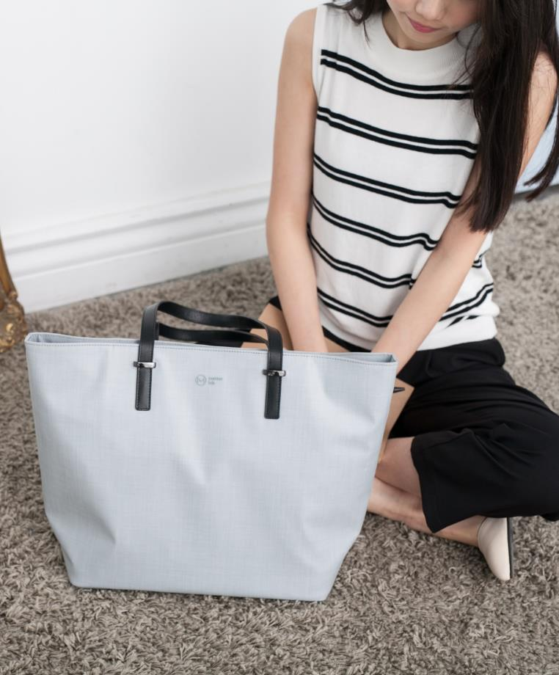
Grille Image Effects 055
The quick brown fox jumps over the lazy dog. The quick brown fox jumps over the lazy dog.
The quick brown fox jumps over the lazy dog. The quick brown fox jumps over the lazy dog.
The quick brown fox jumps over the lazy dog. The quick brown fox jumps over the lazy dog.
The quick brown fox jumps over the lazy dog. The quick brown fox jumps over the lazy dog.

Slide 118

Grille Image Effects 056
The quick brown fox jumps over the lazy dog. The quick brown fox jumps over the lazy dog.
The quick brown fox jumps over the lazy dog. The quick brown fox jumps over the lazy dog.
The quick brown fox jumps over the lazy dog. The quick brown fox jumps over the lazy dog.
The quick brown fox jumps over the lazy dog. The quick brown fox jumps over the lazy dog.

Slide 120

Grille Image Effects 057
The quick brown fox jumps over the lazy dog. The quick brown fox jumps over the lazy dog.
The quick brown fox jumps over the lazy dog. The quick brown fox jumps over the lazy dog.
The quick brown fox jumps over the lazy dog. The quick brown fox jumps over the lazy dog.

Slide 122
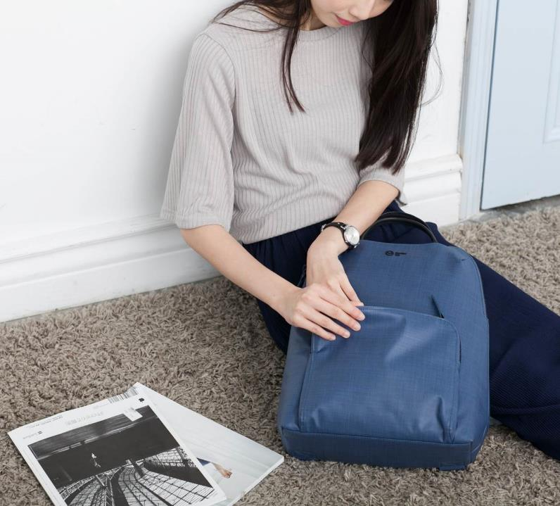
Grille Image Effects 058
Business
The quick brown fox jumps over the lazy dog. The quick brown fox jumps over the lazy dog.
Business
The quick brown fox jumps over the lazy dog. The quick brown fox jumps over the lazy dog.
Business
The quick brown fox jumps over the lazy dog. The quick brown fox jumps over the lazy dog.
Business
The quick brown fox jumps over the lazy dog. The quick brown fox jumps over the lazy dog.

Slide 124

Grille Image Effects 059
The quick brown fox jumps over the lazy dog. The quick brown fox jumps over the lazy dog.
The quick brown fox jumps over the lazy dog. The quick brown fox jumps over the lazy dog.
The quick brown fox jumps over the lazy dog. The quick brown fox jumps over the lazy dog.
The quick brown fox jumps over the lazy dog. The quick brown fox jumps over the lazy dog.

Slide 126
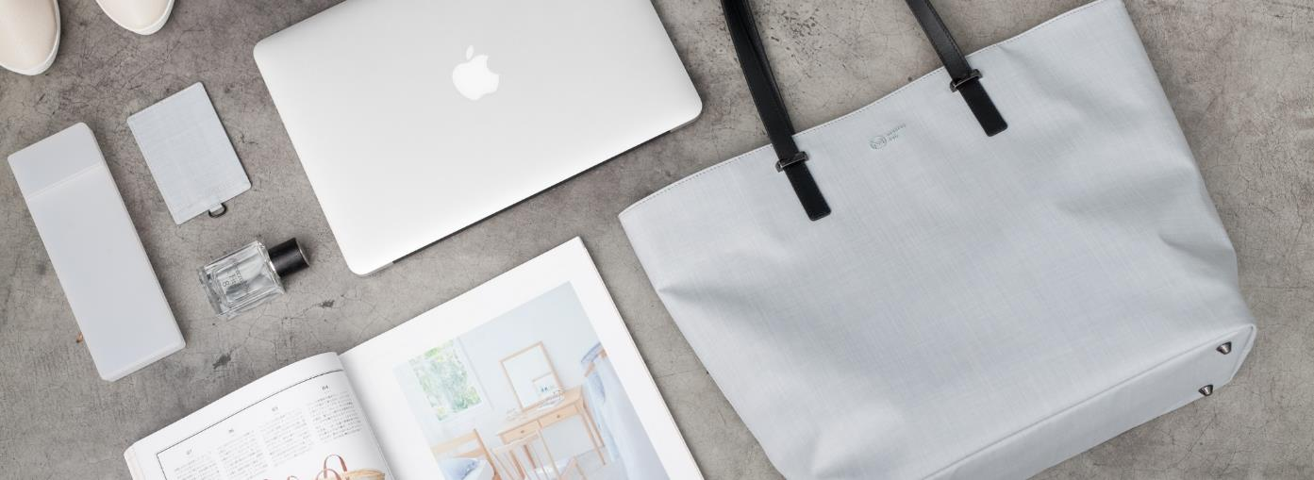
Grille Image Effects 060
Business
Business
The quick brown fox jumps over the lazy dog. The quick brown fox jumps over the lazy dog.
The quick brown fox jumps over the lazy dog. The quick brown fox jumps over the lazy dog.
Business
Business
The quick brown fox jumps over the lazy dog. The quick brown fox jumps over the lazy dog.
The quick brown fox jumps over the lazy dog. The quick brown fox jumps over the lazy dog.

Slide 128

Grille Image Effects 061
The quick brown fox jumps over the lazy dog. The quick brown fox jumps over the lazy dog.
The quick brown fox jumps over the lazy dog. The quick brown fox jumps over the lazy dog.
The quick brown fox jumps over the lazy dog. The quick brown fox jumps over the lazy dog.
The quick brown fox jumps over the lazy dog. The quick brown fox jumps over the lazy dog.

Slide 130

Grille Image Effects 062
The quick brown fox jumps over the lazy dog. The quick brown fox jumps over the lazy dog.
The quick brown fox jumps over the lazy dog. The quick brown fox jumps over the lazy dog.
The quick brown fox jumps over the lazy dog. The quick brown fox jumps over the lazy dog.
The quick brown fox jumps over the lazy dog. The quick brown fox jumps over the lazy dog.

Slide 132
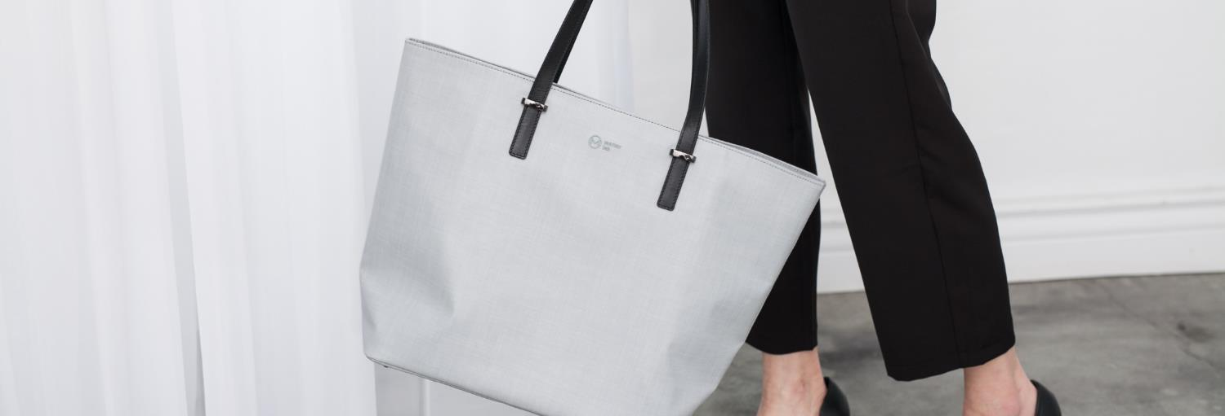
Grille Image Effects 063
The quick brown fox jumps over the lazy dog. The quick brown fox jumps over the lazy dog.
The quick brown fox jumps over the lazy dog. The quick brown fox jumps over the lazy dog.
The quick brown fox jumps over the lazy dog. The quick brown fox jumps over the lazy dog.
The quick brown fox jumps over the lazy dog. The quick brown fox jumps over the lazy dog.

Slide 134

Grille Image Effects 064
01
The quick brown fox jumps over the lazy dog.
03
The quick brown fox jumps over the lazy dog.
02
The quick brown fox jumps over the lazy dog.
04
The quick brown fox jumps over the lazy dog.

Slide 136
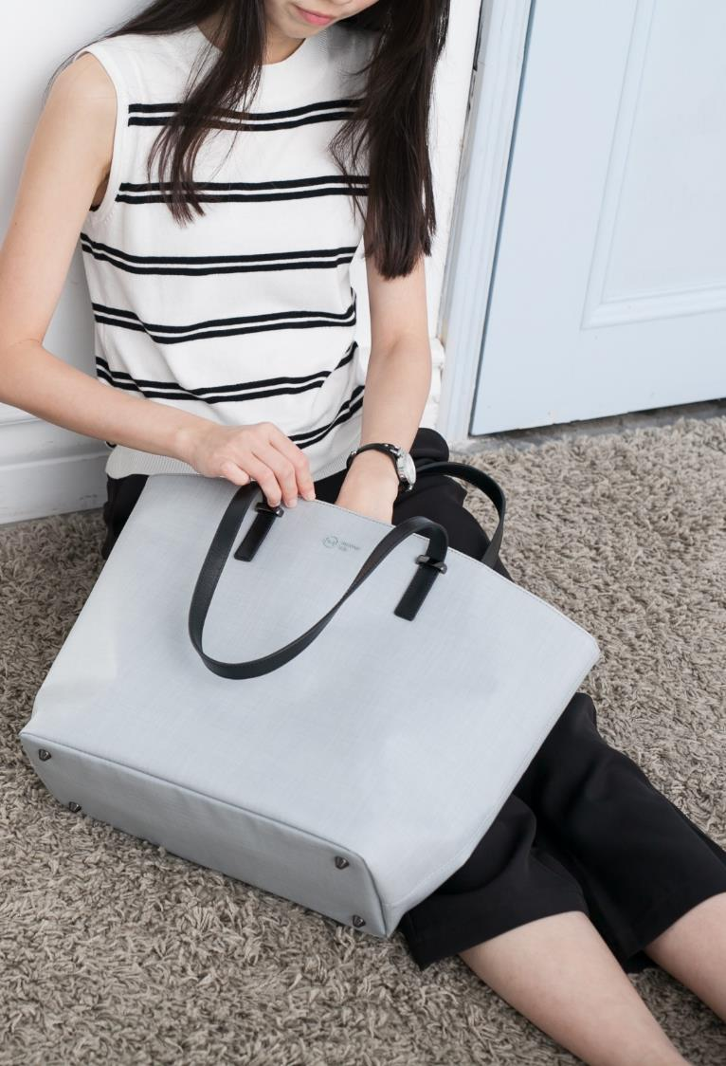
Grille Image Effects 065
The quick brown fox jumps over the lazy dog. The quick brown fox jumps over the lazy dog.
The quick brown fox jumps over the lazy dog. The quick brown fox jumps over the lazy dog.
The quick brown fox jumps over the lazy dog. The quick brown fox jumps over the lazy dog.
The quick brown fox jumps over the lazy dog. The quick brown fox jumps over the lazy dog.

Slide 138
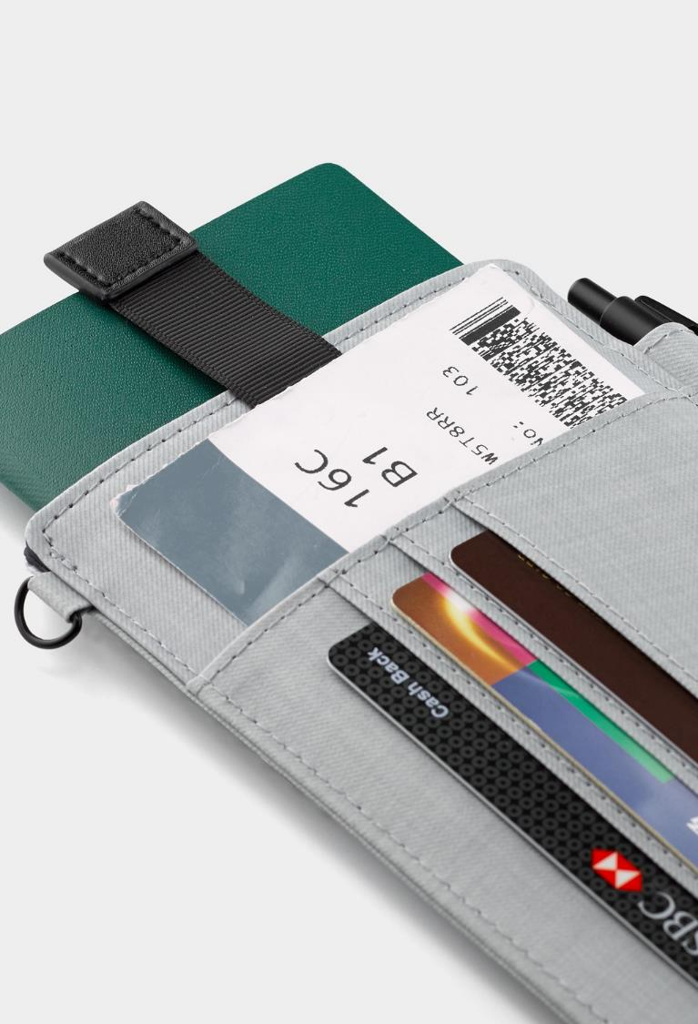
Grille Image Effects 066
The quick brown fox jumps over the lazy dog. The quick brown fox jumps over the lazy dog.
The quick brown fox jumps over the lazy dog. The quick brown fox jumps over the lazy dog.
The quick brown fox jumps over the lazy dog. The quick brown fox jumps over the lazy dog.
The quick brown fox jumps over the lazy dog. The quick brown fox jumps over the lazy dog.

Slide 140
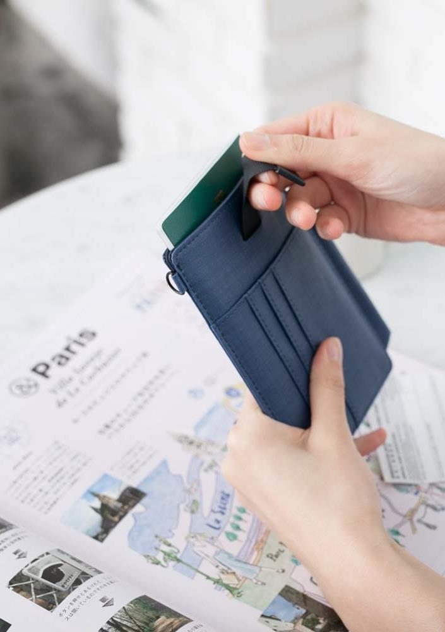
Grille Image Effects
067
The quick brown fox jumps over the lazy dog. The quick brown fox jumps over the lazy dog. The quick brown fox jumps over the lazy dog. The quick brown fox jumps over the lazy dog.

Slide 142
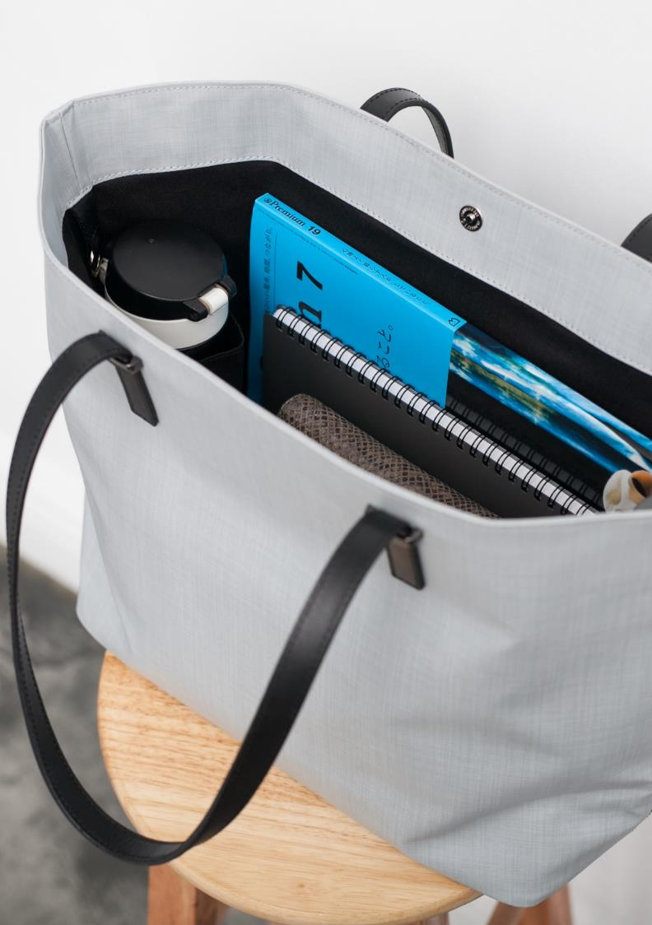
Grille Image Effects
068
The quick brown fox jumps over the lazy dog. The quick brown fox jumps over the lazy dog.
The quick brown fox jumps over the lazy dog. The quick brown fox jumps over the lazy dog.
The quick brown fox jumps over the lazy dog. The quick brown fox jumps over the lazy dog.

Slide 144
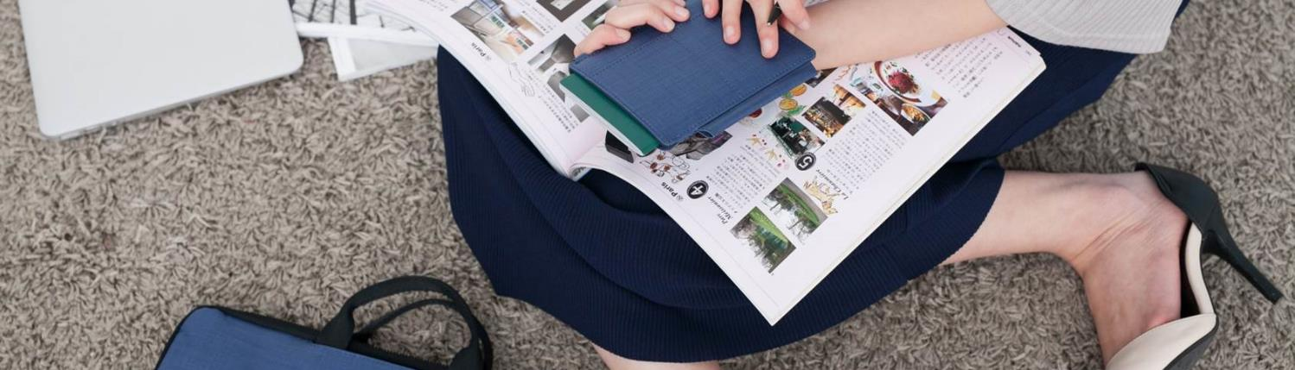
Grille Image Effects 069
The quick brown fox jumps over the lazy dog. The quick brown fox jumps over the lazy dog.
The quick brown fox jumps over the lazy dog. The quick brown fox jumps over the lazy dog.
The quick brown fox jumps over the lazy dog. The quick brown fox jumps over the lazy dog.
The quick brown fox jumps over the lazy dog. The quick brown fox jumps over the lazy dog.

Slide 146

Grille Image Effects 070
The quick brown fox jumps over the lazy dog. The quick brown fox jumps over the lazy dog.
The quick brown fox jumps over the lazy dog. The quick brown fox jumps over the lazy dog.
The quick brown fox jumps over the lazy dog. The quick brown fox jumps over the lazy dog.
The quick brown fox jumps over the lazy dog. The quick brown fox jumps over the lazy dog.

Slide 148
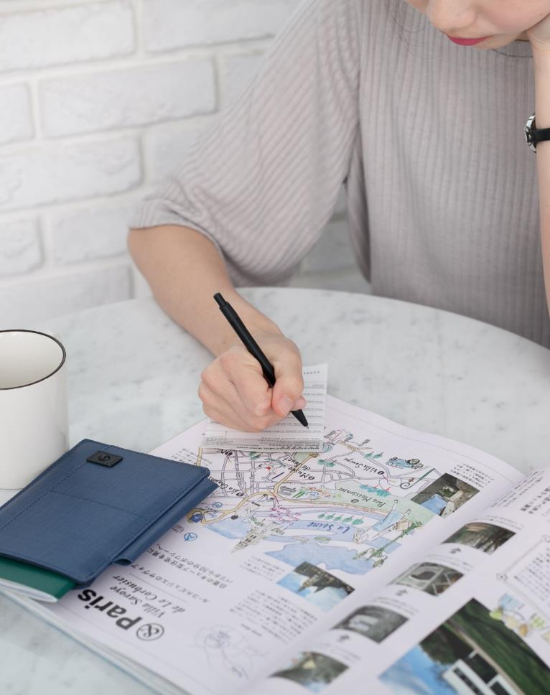
Grille Image Effects 071
The quick brown fox jumps over the lazy dog. The quick brown fox jumps over the lazy dog.
The quick brown fox jumps over the lazy dog. The quick brown fox jumps over the lazy dog.
The quick brown fox jumps over the lazy dog. The quick brown fox jumps over the lazy dog.
The quick brown fox jumps over the lazy dog. The quick brown fox jumps over the lazy dog.

Slide 150

Grille Image Effects 072
The quick brown fox jumps over the lazy dog. The quick brown fox jumps over the lazy dog.
The quick brown fox jumps over the lazy dog. The quick brown fox jumps over the lazy dog.
The quick brown fox jumps over the lazy dog. The quick brown fox jumps over the lazy dog.
The quick brown fox jumps over the lazy dog. The quick brown fox jumps over the lazy dog.

Slide 152
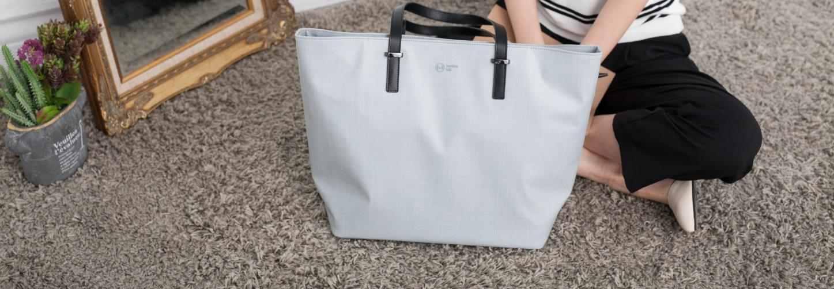
Grille Image Effects 073
The quick brown fox jumps over the lazy dog. The quick brown fox jumps over the lazy dog.
The quick brown fox jumps over the lazy dog. The quick brown fox jumps over the lazy dog.
The quick brown fox jumps over the lazy dog. The quick brown fox jumps over the lazy dog.
The quick brown fox jumps over the lazy dog. The quick brown fox jumps over the lazy dog.

Slide 154
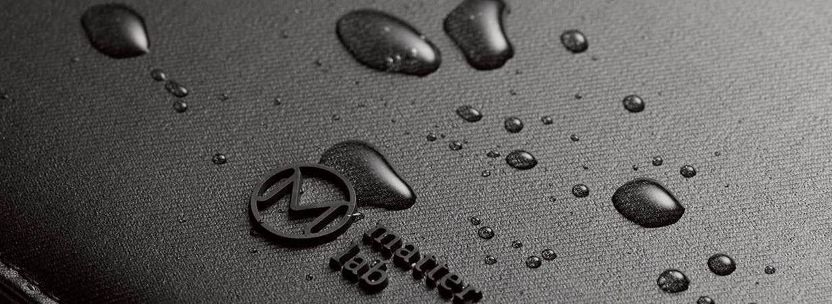
Grille Image Effects 074
Business
Business
The quick brown fox jumps over the lazy dog. The quick brown fox jumps over the lazy dog.
The quick brown fox jumps over the lazy dog. The quick brown fox jumps over the lazy dog.
Business
Business
The quick brown fox jumps over the lazy dog. The quick brown fox jumps over the lazy dog.
The quick brown fox jumps over the lazy dog. The quick brown fox jumps over the lazy dog.

Slide 156
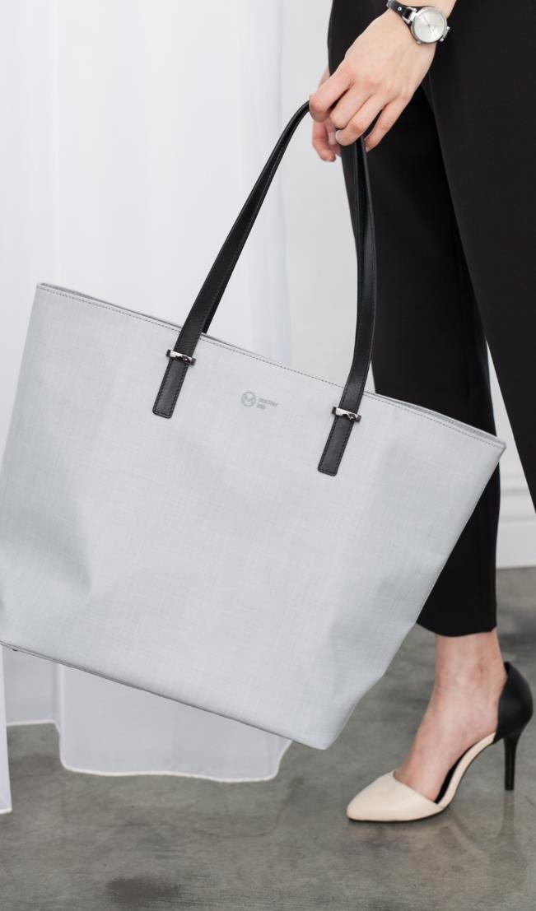
Grille Image Effects 075
The quick brown fox jumps over the lazy dog. The quick brown fox jumps over the lazy dog.
The quick brown fox jumps over the lazy dog. The quick brown fox jumps over the lazy dog.
The quick brown fox jumps over the lazy dog. The quick brown fox jumps over the lazy dog.
The quick brown fox jumps over the lazy dog. The quick brown fox jumps over the lazy dog.

Slide 158
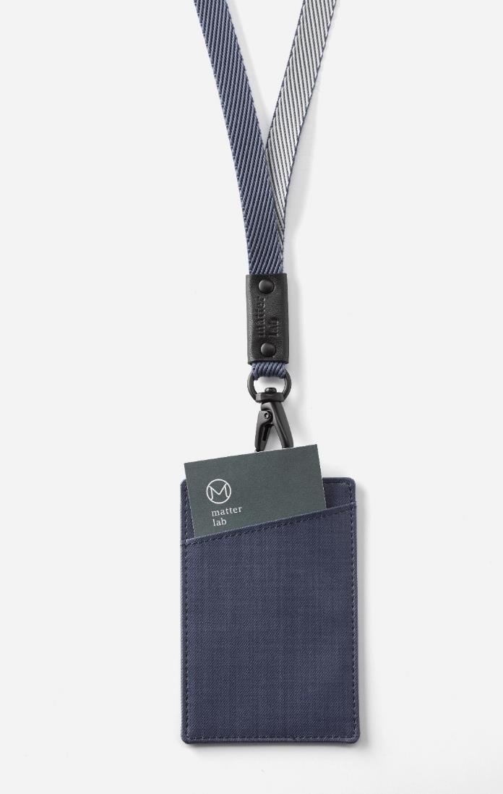
Grille Image Effects 076
The quick brown fox jumps over the lazy dog. The quick brown fox jumps over the lazy dog.
The quick brown fox jumps over the lazy dog. The quick brown fox jumps over the lazy dog.
The quick brown fox jumps over the lazy dog. The quick brown fox jumps over the lazy dog.
The quick brown fox jumps over the lazy dog. The quick brown fox jumps over the lazy dog.

Slide 160

Grille Image Effects 077
The quick brown fox jumps over the lazy dog. The quick brown fox jumps over the lazy dog. The quick brown fox jumps over the lazy dog. The quick brown fox jumps over the lazy dog.

Slide 162

Grille Image Effects 078
The quick brown fox jumps over the lazy dog. The quick brown fox jumps over the lazy dog.
The quick brown fox jumps over the lazy dog. The quick brown fox jumps over the lazy dog.
The quick brown fox jumps over the lazy dog. The quick brown fox jumps over the lazy dog.

Slide 164

Grille Image Effects 079
The quick brown fox jumps over the lazy dog. The quick brown fox jumps over the lazy dog.
The quick brown fox jumps over the lazy dog. The quick brown fox jumps over the lazy dog.

Slide 166
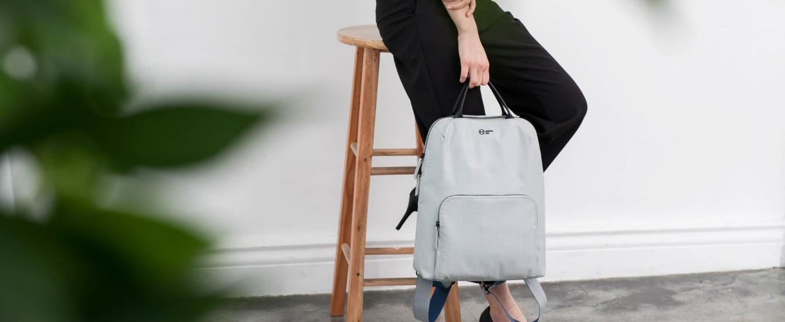
Grille Image Effects 080
Business
Business
The quick brown fox jumps over the lazy dog. The quick brown fox jumps over the lazy dog.
The quick brown fox jumps over the lazy dog. The quick brown fox jumps over the lazy dog.
Business
Business
The quick brown fox jumps over the lazy dog. The quick brown fox jumps over the lazy dog.
The quick brown fox jumps over the lazy dog. The quick brown fox jumps over the lazy dog.

Slide 168

Grille Image Effects 081
The quick brown fox jumps over the lazy dog. The quick brown fox jumps over the lazy dog.
The quick brown fox jumps over the lazy dog. The quick brown fox jumps over the lazy dog.
The quick brown fox jumps over the lazy dog. The quick brown fox jumps over the lazy dog.
The quick brown fox jumps over the lazy dog. The quick brown fox jumps over the lazy dog.

Slide 170

Grille Image Effects 082
The quick brown fox jumps over the lazy dog. The quick brown fox jumps over the lazy dog.
The quick brown fox jumps over the lazy dog. The quick brown fox jumps over the lazy dog.
The quick brown fox jumps over the lazy dog. The quick brown fox jumps over the lazy dog.
The quick brown fox jumps over the lazy dog. The quick brown fox jumps over the lazy dog.

Slide 172

Grille Image Effects 083
The quick brown fox jumps over the lazy dog. The quick brown fox jumps over the lazy dog.
The quick brown fox jumps over the lazy dog. The quick brown fox jumps over the lazy dog.
The quick brown fox jumps over the lazy dog. The quick brown fox jumps over the lazy dog.
The quick brown fox jumps over the lazy dog. The quick brown fox jumps over the lazy dog.

Slide 174

Grille Image Effects 084
01
The quick brown fox jumps over the lazy dog.
02
The quick brown fox jumps over the lazy dog.
03
The quick brown fox jumps over the lazy dog.
04
The quick brown fox jumps over the lazy dog.

Slide 176

Grille Image Effects 085
The quick brown fox jumps over the lazy dog. The quick brown fox jumps over the lazy dog.
The quick brown fox jumps over the lazy dog. The quick brown fox jumps over the lazy dog.
The quick brown fox jumps over the lazy dog. The quick brown fox jumps over the lazy dog.
The quick brown fox jumps over the lazy dog. The quick brown fox jumps over the lazy dog.

Slide 178

Grille Image Effects 086
The quick brown fox jumps over the lazy dog. The quick brown fox jumps over the lazy dog.
The quick brown fox jumps over the lazy dog. The quick brown fox jumps over the lazy dog.
The quick brown fox jumps over the lazy dog. The quick brown fox jumps over the lazy dog.

Slide 180

Grille Image Effects 087
Business
The quick brown fox jumps over the lazy dog. The quick brown fox jumps over the lazy dog.
Business
The quick brown fox jumps over the lazy dog. The quick brown fox jumps over the lazy dog.
Business
The quick brown fox jumps over the lazy dog. The quick brown fox jumps over the lazy dog.
Business
The quick brown fox jumps over the lazy dog. The quick brown fox jumps over the lazy dog.

Slide 182

Grille Image Effects 088
The quick brown fox jumps over the lazy dog. The quick brown fox jumps over the lazy dog. The quick brown fox jumps over the lazy dog. The quick brown fox jumps over the lazy dog.

Slide 184

Grille Image Effects 089
The quick brown fox jumps over the lazy dog. The quick brown fox jumps over the lazy dog.
The quick brown fox jumps over the lazy dog. The quick brown fox jumps over the lazy dog.
The quick brown fox jumps over the lazy dog. The quick brown fox jumps over the lazy dog.
The quick brown fox jumps over the lazy dog. The quick brown fox jumps over the lazy dog.

Slide 186

Grille Image Effects 90
The quick brown fox jumps over the lazy dog. The quick brown fox jumps over the lazy dog.
The quick brown fox jumps over the lazy dog. The quick brown fox jumps over the lazy dog.
The quick brown fox jumps over the lazy dog. The quick brown fox jumps over the lazy dog.
The quick brown fox jumps over the lazy dog. The quick brown fox jumps over the lazy dog.

Slide 188

Grille Image Effects 091
The quick brown fox jumps over the lazy dog. The quick brown fox jumps over the lazy dog. The quick brown fox jumps over the lazy dog. The quick brown fox jumps over the lazy dog.

Slide 190

Grille Image Effects 092
The quick brown fox jumps over the lazy dog. The quick brown fox jumps over the lazy dog.
The quick brown fox jumps over the lazy dog. The quick brown fox jumps over the lazy dog.
The quick brown fox jumps over the lazy dog. The quick brown fox jumps over the lazy dog.
The quick brown fox jumps over the lazy dog. The quick brown fox jumps over the lazy dog.

Slide 192

Grille Image Effects 093
01
The quick brown fox jumps over the lazy dog.
02
The quick brown fox jumps over the lazy dog.
03
The quick brown fox jumps over the lazy dog.
04
The quick brown fox jumps over the lazy dog.

Slide 194

Grille Image Effects 094
The quick brown fox jumps over the lazy dog. The quick brown fox jumps over the lazy dog.
The quick brown fox jumps over the lazy dog. The quick brown fox jumps over the lazy dog.
The quick brown fox jumps over the lazy dog. The quick brown fox jumps over the lazy dog.
The quick brown fox jumps over the lazy dog. The quick brown fox jumps over the lazy dog.

Slide 196

Grille Image Effects 095
The quick brown fox jumps over the lazy dog. The quick brown fox jumps over the lazy dog.
The quick brown fox jumps over the lazy dog. The quick brown fox jumps over the lazy dog.
The quick brown fox jumps over the lazy dog. The quick brown fox jumps over the lazy dog.
The quick brown fox jumps over the lazy dog. The quick brown fox jumps over the lazy dog.

Slide 198

Grille Image Effects 096
The quick brown fox jumps over the lazy dog. The quick brown fox jumps over the lazy dog.
The quick brown fox jumps over the lazy dog. The quick brown fox jumps over the lazy dog.
The quick brown fox jumps over the lazy dog. The quick brown fox jumps over the lazy dog.
The quick brown fox jumps over the lazy dog. The quick brown fox jumps over the lazy dog.

Slide 200

Grille Image Effects 097
The quick brown fox jumps over the lazy dog. The quick brown fox jumps over the lazy dog.
The quick brown fox jumps over the lazy dog. The quick brown fox jumps over the lazy dog.
The quick brown fox jumps over the lazy dog. The quick brown fox jumps over the lazy dog.

Slide 202

Grille Image Effects 098
The quick brown fox jumps over the lazy dog. The quick brown fox jumps over the lazy dog.
The quick brown fox jumps over the lazy dog. The quick brown fox jumps over the lazy dog.
The quick brown fox jumps over the lazy dog. The quick brown fox jumps over the lazy dog.
The quick brown fox jumps over the lazy dog. The quick brown fox jumps over the lazy dog.

Slide 204

Grille Image Effects 099
The quick brown fox jumps over the lazy dog. The quick brown fox jumps over the lazy dog.
The quick brown fox jumps over the lazy dog. The quick brown fox jumps over the lazy dog.
The quick brown fox jumps over the lazy dog. The quick brown fox jumps over the lazy dog.
The quick brown fox jumps over the lazy dog. The quick brown fox jumps over the lazy dog.

Slide 206

Grille Image Effects 100
The quick brown fox jumps over the lazy dog. The quick brown fox jumps over the lazy dog.
The quick brown fox jumps over the lazy dog. The quick brown fox jumps over the lazy dog.
The quick brown fox jumps over the lazy dog. The quick brown fox jumps over the lazy dog.
The quick brown fox jumps over the lazy dog. The quick brown fox jumps over the lazy dog.

Slide 208

Grille Image Effects 101
Business
The quick brown fox jumps over the lazy dog. The quick brown fox jumps over the lazy dog.
Business
The quick brown fox jumps over the lazy dog. The quick brown fox jumps over the lazy dog.
Business
The quick brown fox jumps over the lazy dog. The quick brown fox jumps over the lazy dog.
Business
The quick brown fox jumps over the lazy dog. The quick brown fox jumps over the lazy dog.

Slide 210

Grille Image Effects 102
01
The quick brown fox jumps over the lazy dog.
02
The quick brown fox jumps over the lazy dog.
03
The quick brown fox jumps over the lazy dog.
04
The quick brown fox jumps over the lazy dog.

Slide 212

Grille Image Effects 103
The quick brown fox jumps over the lazy dog. The quick brown fox jumps over the lazy dog.
The quick brown fox jumps over the lazy dog. The quick brown fox jumps over the lazy dog.
The quick brown fox jumps over the lazy dog. The quick brown fox jumps over the lazy dog.
The quick brown fox jumps over the lazy dog. The quick brown fox jumps over the lazy dog.

Slide 214


歡迎加入商業簡報網粉絲專頁

Slide 215


Slide 216


Slide 217


