Slide 1
PowerPoint Morph Template
1
商業簡報網 / www.pook.com.tw
Microsoft PowerPoint MVP
韓明文 講師

Slide 2
Morph Template 01
1
Title 01
The quick brown fox jumps over the lazy dog. The quick brown fox jumps over the lazy dog.
Title 02
The quick brown fox jumps over the lazy dog. The quick brown fox jumps over the lazy dog.
Title 03
The quick brown fox jumps over the lazy dog. The quick brown fox jumps over the lazy dog.

Slide 3
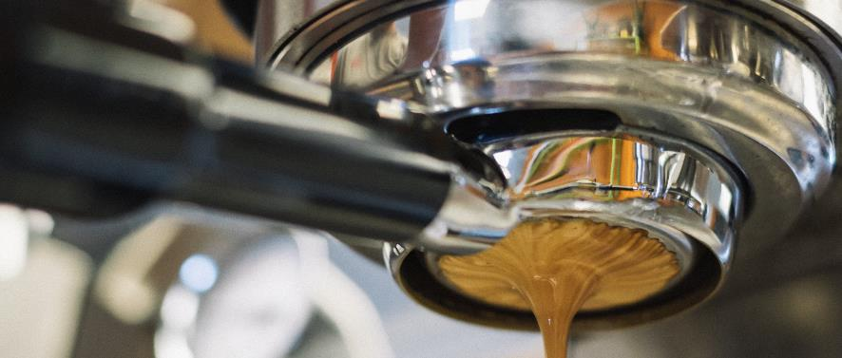
Morph Template 02
The quick brown fox jumps over the lazy dog. The quick brown fox jumps over the lazy dog.
1
1
The quick brown fox jumps over the lazy dog. The quick brown fox jumps over the lazy dog.
The quick brown fox jumps over the lazy dog. The quick brown fox jumps over the lazy dog.

Slide 4
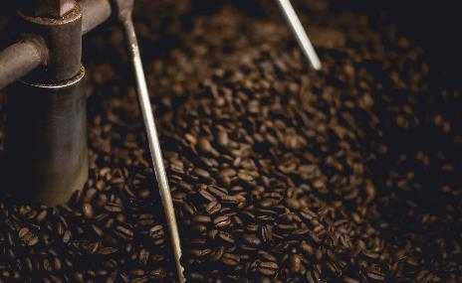
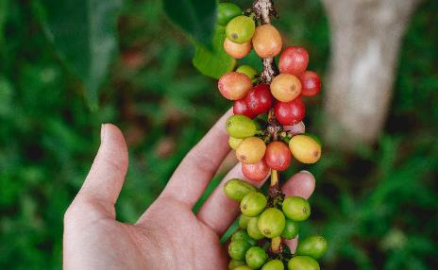
Morph Template 03
The quick brown fox jumps over the lazy dog. The quick brown fox jumps over the lazy dog.
1
1
The quick brown fox jumps over the lazy dog. The quick brown fox jumps over the lazy dog.
The quick brown fox jumps over the lazy dog. The quick brown fox jumps over the lazy dog.

Slide 5
Morph Template 04
The quick brown fox jumps over the lazy dog. The quick brown fox jumps over the lazy dog.
The quick brown fox jumps over the lazy dog. The quick brown fox jumps over the lazy dog.
The quick brown fox jumps over the lazy dog. The quick brown fox jumps over the lazy dog.

Slide 6
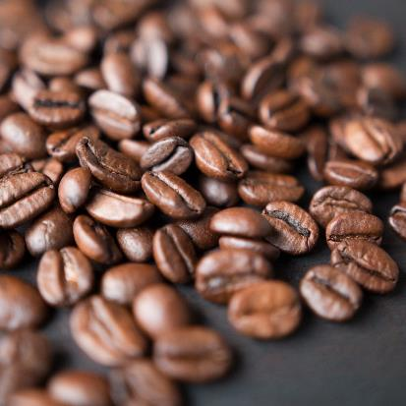
2
Morph Template 05
1
The quick brown fox jumps over the lazy dog. The quick brown fox jumps over the lazy dog.
The quick brown fox jumps over the lazy dog. The quick brown fox jumps over the lazy dog.
The quick brown fox jumps over the lazy dog. The quick brown fox jumps over the lazy dog.
The quick brown fox jumps over the lazy dog. The quick brown fox jumps over the lazy dog.

Slide 7
1
1
Morph Template 06
The quick brown fox jumps over the lazy dog.
The quick brown fox jumps over the lazy dog.
The quick brown fox jumps over the lazy dog.
The quick brown fox jumps over the lazy dog.
The quick brown fox jumps over the lazy dog.
The quick brown fox jumps over the lazy dog.
The quick brown fox jumps over the lazy dog.
The quick brown fox jumps over the lazy dog.
2

Slide 8
1
Morph Template 07
The quick brown fox jumps over the lazy dog. The quick brown fox jumps over the lazy dog.
The quick brown fox jumps over the lazy dog. The quick brown fox jumps over the lazy dog.
The quick brown fox jumps over the lazy dog. The quick brown fox jumps over the lazy dog.
The quick brown fox jumps over the lazy dog. The quick brown fox jumps over the lazy dog.
The quick brown fox jumps over the lazy dog. The quick brown fox jumps over the lazy dog.
The quick brown fox jumps over the lazy dog. The quick brown fox jumps over the lazy dog.
1

Slide 9
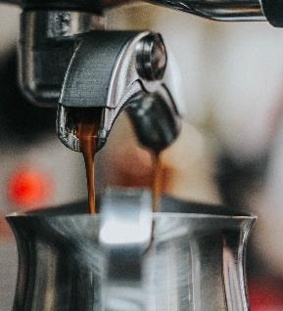
1
Morph Template 08
The quick brown fox jumps over the lazy dog. The quick brown fox jumps over the lazy dog.
The quick brown fox jumps over the lazy dog. The quick brown fox jumps over the lazy dog.
The quick brown fox jumps over the lazy dog. The quick brown fox jumps over the lazy dog.
The quick brown fox jumps over the lazy dog. The quick brown fox jumps over the lazy dog.
The quick brown fox jumps over the lazy dog. The quick brown fox jumps over the lazy dog.
The quick brown fox jumps over the lazy dog. The quick brown fox jumps over the lazy dog.

Slide 10
1
1
2
Morph Template 09
The quick brown fox jumps over the lazy dog. The quick brown fox jumps over the lazy dog. The quick brown fox jumps over the lazy dog. The quick brown fox jumps over the lazy dog.

Slide 11
2
1
Morph Template 10
Title
Title
The quick brown fox jumps over the lazy dog. The quick brown fox jumps over the lazy dog.
The quick brown fox jumps over the lazy dog. The quick brown fox jumps over the lazy dog.
The quick brown fox jumps over the lazy dog. The quick brown fox jumps over the lazy dog.

Slide 12
Morph Template 11
2
1
The quick brown fox jumps over the lazy dog. The quick brown fox jumps over the lazy dog.
The quick brown fox jumps over the lazy dog. The quick brown fox jumps over the lazy dog.
The quick brown fox jumps over the lazy dog. The quick brown fox jumps over the lazy dog.
The quick brown fox jumps over the lazy dog. The quick brown fox jumps over the lazy dog.

Slide 13
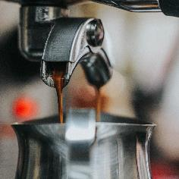
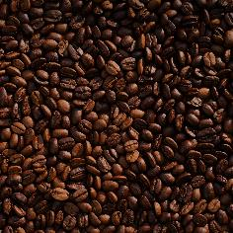
Morph Template 12
Title
Title
The quick brown fox jumps over the lazy dog. The quick brown fox jumps over the lazy dog.
The quick brown fox jumps over the lazy dog. The quick brown fox jumps over the lazy dog.

Slide 14
Morph Template 13
The quick brown fox jumps over the lazy dog. The quick brown fox jumps over the lazy dog.
The quick brown fox jumps over the lazy dog. The quick brown fox jumps over the lazy dog.
The quick brown fox jumps over the lazy dog. The quick brown fox jumps over the lazy dog.

Slide 15
Morph Template 14
The quick brown fox jumps over the lazy dog. The quick brown fox jumps over the lazy dog.
The quick brown fox jumps over the lazy dog. The quick brown fox jumps over the lazy dog.
The quick brown fox jumps over the lazy dog. The quick brown fox jumps over the lazy dog.

Slide 16
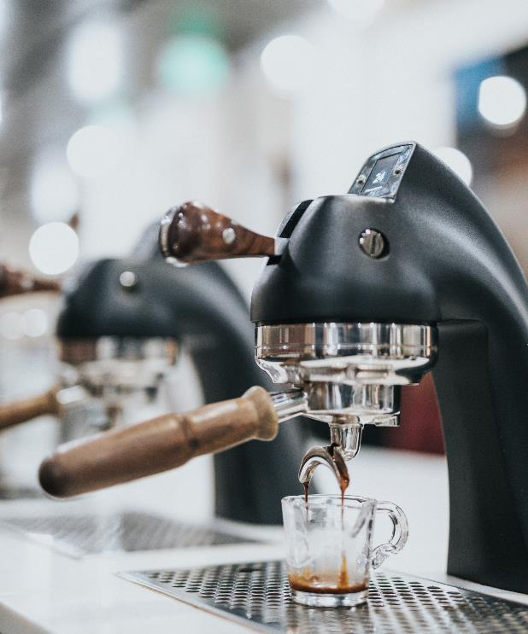
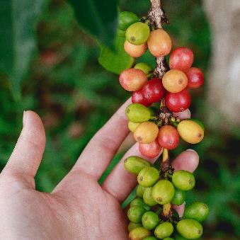
Morph Template 15
The quick brown fox jumps over the lazy dog. The quick brown fox jumps over the lazy dog.
The quick brown fox jumps over the lazy dog. The quick brown fox jumps over the lazy dog.
1
The quick brown fox jumps over the lazy dog. The quick brown fox jumps over the lazy dog.
The quick brown fox jumps over the lazy dog. The quick brown fox jumps over the lazy dog.

Slide 17
Morph Template 16
The quick brown fox jumps over the lazy dog.
The quick brown fox jumps over the lazy dog.
The quick brown fox jumps over the lazy dog.
The quick brown fox jumps over the lazy dog.
The quick brown fox jumps over the lazy dog.
The quick brown fox jumps over the lazy dog.

Slide 18
Morph Template 17
The quick brown fox jumps over the lazy dog. The quick brown fox jumps over the lazy dog.
The quick brown fox jumps over the lazy dog. The quick brown fox jumps over the lazy dog.
The quick brown fox jumps over the lazy dog. The quick brown fox jumps over the lazy dog.
The quick brown fox jumps over the lazy dog. The quick brown fox jumps over the lazy dog.

Slide 19
Morph Template 18
The quick brown fox jumps over the lazy dog. The quick brown fox jumps over the lazy dog.
The quick brown fox jumps over the lazy dog. The quick brown fox jumps over the lazy dog.
The quick brown fox jumps over the lazy dog. The quick brown fox jumps over the lazy dog.
The quick brown fox jumps over the lazy dog. The quick brown fox jumps over the lazy dog.
The quick brown fox jumps over the lazy dog. The quick brown fox jumps over the lazy dog.
The quick brown fox jumps over the lazy dog. The quick brown fox jumps over the lazy dog.

Slide 20
Morph Template 19
The quick brown fox jumps over the lazy dog. The quick brown fox jumps over the lazy dog.
The quick brown fox jumps over the lazy dog. The quick brown fox jumps over the lazy dog.
The quick brown fox jumps over the lazy dog. The quick brown fox jumps over the lazy dog.
The quick brown fox jumps over the lazy dog. The quick brown fox jumps over the lazy dog.

Slide 21
Morph Template 20
The quick brown fox jumps over the lazy dog. The quick brown fox jumps over the lazy dog.
The quick brown fox jumps over the lazy dog. The quick brown fox jumps over the lazy dog.
The quick brown fox jumps over the lazy dog. The quick brown fox jumps over the lazy dog.
The quick brown fox jumps over the lazy dog. The quick brown fox jumps over the lazy dog.

Slide 22
The quick brown fox jumps over the lazy dog. The quick brown fox jumps over the lazy dog.
The quick brown fox jumps over the lazy dog. The quick brown fox jumps over the lazy dog.
Morph Template 21
The quick brown fox jumps over the lazy dog.
The quick brown fox jumps over the lazy dog.
The quick brown fox jumps over the lazy dog.
The quick brown fox jumps over the lazy dog. The quick brown fox jumps over the lazy dog.
The quick brown fox jumps over the lazy dog.
The quick brown fox jumps over the lazy dog. The quick brown fox jumps over the lazy dog.
Title
The quick brown fox jumps over the lazy dog. The quick brown fox jumps over the lazy dog.
The quick brown fox jumps over the lazy dog. The quick brown fox jumps over the lazy dog.
The quick brown fox jumps over the lazy dog. The quick brown fox jumps over the lazy dog.

Slide 23
Morph Template 22
The quick brown fox jumps over the lazy dog. The quick brown fox jumps over the lazy dog.
The quick brown fox jumps over the lazy dog. The quick brown fox jumps over the lazy dog.
The quick brown fox jumps over the lazy dog. The quick brown fox jumps over the lazy dog.
The quick brown fox jumps over the lazy dog. The quick brown fox jumps over the lazy dog.
The quick brown fox jumps over the lazy dog. The quick brown fox jumps over the lazy dog.
The quick brown fox jumps over the lazy dog. The quick brown fox jumps over the lazy dog.

Slide 24
Morph Template 23
Title 01
The quick brown fox jumps over the lazy dog. The quick brown fox jumps over the lazy dog.
Title 02
The quick brown fox jumps over the lazy dog. The quick brown fox jumps over the lazy dog.
Title 03
The quick brown fox jumps over the lazy dog. The quick brown fox jumps over the lazy dog.

Slide 25
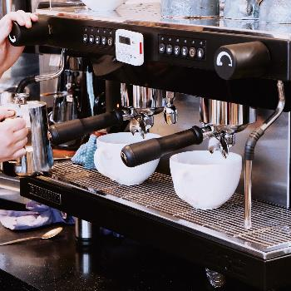
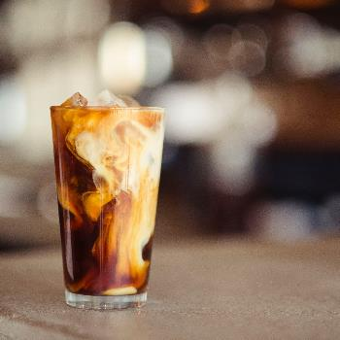
Morph Template 24
The quick brown fox jumps over the lazy dog. The quick brown fox jumps over the lazy dog.
The quick brown fox jumps over the lazy dog. The quick brown fox jumps over the lazy dog.
The quick brown fox jumps over the lazy dog. The quick brown fox jumps over the lazy dog.

Slide 26
Morph Template 25
The quick brown fox jumps over the lazy dog. The quick brown fox jumps over the lazy dog.
The quick brown fox jumps over the lazy dog. The quick brown fox jumps over the lazy dog.
The quick brown fox jumps over the lazy dog. The quick brown fox jumps over the lazy dog.

Slide 27
Morph Template 26
Title
The quick brown fox jumps over the lazy dog. The quick brown fox jumps over the lazy dog.

Slide 28
Morph Template 27
The quick brown fox jumps over the lazy dog. The quick brown fox jumps over the lazy dog.
The quick brown fox jumps over the lazy dog. The quick brown fox jumps over the lazy dog.
The quick brown fox jumps over the lazy dog. The quick brown fox jumps over the lazy dog.
The quick brown fox jumps over the lazy dog. The quick brown fox jumps over the lazy dog.

Slide 29
Morph Template 28
Title
Title
Title
Title
The quick brown fox jumps over the lazy dog. The quick brown fox jumps over the lazy dog.
The quick brown fox jumps over the lazy dog. The quick brown fox jumps over the lazy dog.
The quick brown fox jumps over the lazy dog. The quick brown fox jumps over the lazy dog.
The quick brown fox jumps over the lazy dog. The quick brown fox jumps over the lazy dog.

Slide 30
Morph Template 29
The quick brown fox jumps over the lazy dog. The quick brown fox jumps over the lazy dog.
The quick brown fox jumps over the lazy dog. The quick brown fox jumps over the lazy dog.
The quick brown fox jumps over the lazy dog. The quick brown fox jumps over the lazy dog.
The quick brown fox jumps over the lazy dog. The quick brown fox jumps over the lazy dog.
The quick brown fox jumps over the lazy dog. The quick brown fox jumps over the lazy dog.
The quick brown fox jumps over the lazy dog. The quick brown fox jumps over the lazy dog.

Slide 31
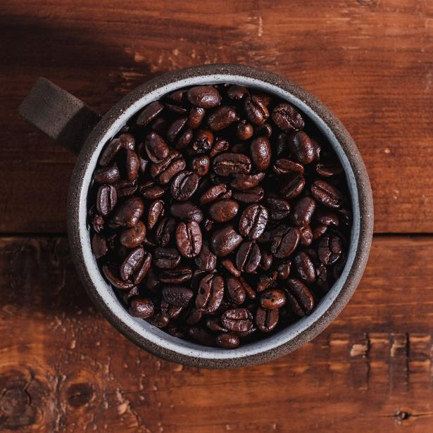
Morph Template 30
The quick brown fox jumps over the lazy dog. The quick brown fox jumps over the lazy dog.
The quick brown fox jumps over the lazy dog. The quick brown fox jumps over the lazy dog.
The quick brown fox jumps over the lazy dog. The quick brown fox jumps over the lazy dog.

Slide 32
Morph Template 31
The quick brown fox jumps over the lazy dog. The quick brown fox jumps over the lazy dog.

Slide 33
Morph Template 32
The quick brown fox jumps over the lazy dog. The quick brown fox jumps over the lazy dog.
The quick brown fox jumps over the lazy dog. The quick brown fox jumps over the lazy dog.
The quick brown fox jumps over the lazy dog. The quick brown fox jumps over the lazy dog.
The quick brown fox jumps over the lazy dog. The quick brown fox jumps over the lazy dog.
The quick brown fox jumps over the lazy dog. The quick brown fox jumps over the lazy dog.

Slide 34
Morph Template 33
Title
Title
The quick brown fox jumps over the lazy dog. The quick brown fox jumps over the lazy dog.
The quick brown fox jumps over the lazy dog. The quick brown fox jumps over the lazy dog.

Slide 35
Morph Template 34
The quick brown fox jumps over the lazy dog. The quick brown fox jumps over the lazy dog. The quick brown fox jumps over the lazy dog. The quick brown fox jumps over the lazy dog.

Slide 36
Morph Template 35
The quick brown fox jumps over the lazy dog. The quick brown fox jumps over the lazy dog.
The quick brown fox jumps over the lazy dog. The quick brown fox jumps over the lazy dog.
The quick brown fox jumps over the lazy dog. The quick brown fox jumps over the lazy dog.
The quick brown fox jumps over the lazy dog. The quick brown fox jumps over the lazy dog.
The quick brown fox jumps over the lazy dog. The quick brown fox jumps over the lazy dog.
The quick brown fox jumps over the lazy dog. The quick brown fox jumps over the lazy dog.

Slide 37
Morph Template 36
The quick brown fox jumps over the lazy dog. The quick brown fox jumps over the lazy dog.
The quick brown fox jumps over the lazy dog. The quick brown fox jumps over the lazy dog.
The quick brown fox jumps over the lazy dog. The quick brown fox jumps over the lazy dog.

Slide 38
Morph Template 37
The quick brown fox jumps over the lazy dog. The quick brown fox jumps over the lazy dog.
The quick brown fox jumps over the lazy dog. The quick brown fox jumps over the lazy dog.
The quick brown fox jumps over the lazy dog. The quick brown fox jumps over the lazy dog.

Slide 39
Morph Template 38
The quick brown fox jumps over the lazy dog. The quick brown fox jumps over the lazy dog.
The quick brown fox jumps over the lazy dog. The quick brown fox jumps over the lazy dog.
The quick brown fox jumps over the lazy dog. The quick brown fox jumps over the lazy dog.
The quick brown fox jumps over the lazy dog. The quick brown fox jumps over the lazy dog.
The quick brown fox jumps over the lazy dog. The quick brown fox jumps over the lazy dog.
The quick brown fox jumps over the lazy dog. The quick brown fox jumps over the lazy dog.
The quick brown fox jumps over the lazy dog. The quick brown fox jumps over the lazy dog.

Slide 40
Morph Template 39
The quick brown fox jumps over the lazy dog. The quick brown fox jumps over the lazy dog.
The quick brown fox jumps over the lazy dog. The quick brown fox jumps over the lazy dog.
The quick brown fox jumps over the lazy dog. The quick brown fox jumps over the lazy dog.
The quick brown fox jumps over the lazy dog. The quick brown fox jumps over the lazy dog.

Slide 41
Morph Template 40
The quick brown fox jumps over the lazy dog. The quick brown fox jumps over the lazy dog.
The quick brown fox jumps over the lazy dog. The quick brown fox jumps over the lazy dog.
The quick brown fox jumps over the lazy dog. The quick brown fox jumps over the lazy dog.
The quick brown fox jumps over the lazy dog. The quick brown fox jumps over the lazy dog.

Slide 42
Morph Template 41
The quick brown fox jumps over the lazy dog. The quick brown fox jumps over the lazy dog. The quick brown fox jumps over the lazy dog. The quick brown fox jumps over the lazy dog.
The quick brown fox jumps over the lazy dog. The quick brown fox jumps over the lazy dog.
The quick brown fox jumps over the lazy dog. The quick brown fox jumps over the lazy dog.
The quick brown fox jumps over the lazy dog. The quick brown fox jumps over the lazy dog.
The quick brown fox jumps over the lazy dog. The quick brown fox jumps over the lazy dog.

Slide 43
Morph Template 42
The quick brown fox jumps over the lazy dog. The quick brown fox jumps over the lazy dog.
The quick brown fox jumps over the lazy dog. The quick brown fox jumps over the lazy dog.
The quick brown fox jumps over the lazy dog. The quick brown fox jumps over the lazy dog.

Slide 44
Morph Template 43
The quick brown fox jumps over the lazy dog. The quick brown fox jumps over the lazy dog.
The quick brown fox jumps over the lazy dog. The quick brown fox jumps over the lazy dog.
The quick brown fox jumps over the lazy dog. The quick brown fox jumps over the lazy dog.

Slide 45
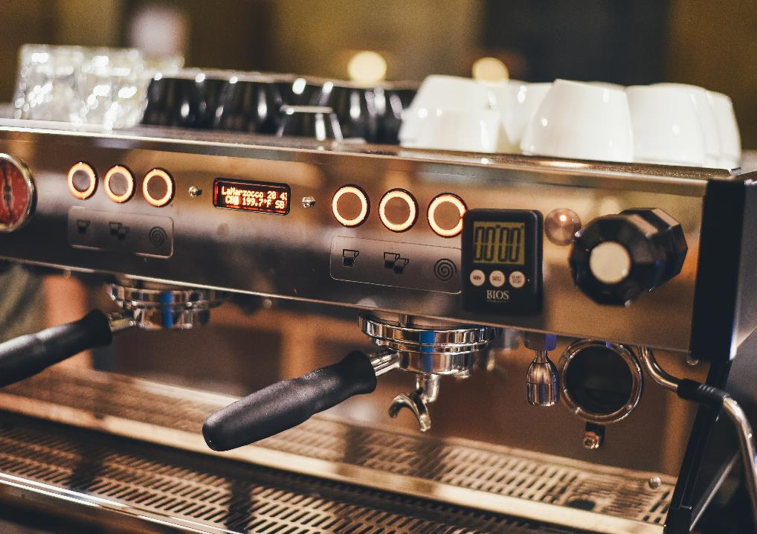
Morph Template 44
The quick brown fox jumps over the lazy dog. The quick brown fox jumps over the lazy dog.
The quick brown fox jumps over the lazy dog. The quick brown fox jumps over the lazy dog.
The quick brown fox jumps over the lazy dog. The quick brown fox jumps over the lazy dog.

Slide 46
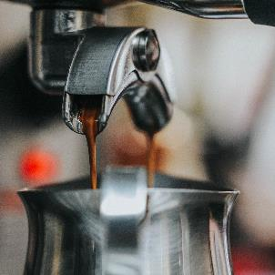
Morph Template 45
Title
The quick brown fox jumps over the lazy dog. The quick brown fox jumps over the lazy dog.
Title
The quick brown fox jumps over the lazy dog. The quick brown fox jumps over the lazy dog.
Title
The quick brown fox jumps over the lazy dog. The quick brown fox jumps over the lazy dog.

Slide 47
Morph Template 46
Title
Title
Title
Title
The quick brown fox jumps over the lazy dog. The quick brown fox jumps over the lazy dog.
The quick brown fox jumps over the lazy dog. The quick brown fox jumps over the lazy dog.
The quick brown fox jumps over the lazy dog. The quick brown fox jumps over the lazy dog.
The quick brown fox jumps over the lazy dog. The quick brown fox jumps over the lazy dog.

Slide 48
Morph Template 47
The quick brown fox jumps over the lazy dog. The quick brown fox jumps over the lazy dog.
The quick brown fox jumps over the lazy dog. The quick brown fox jumps over the lazy dog.
The quick brown fox jumps over the lazy dog. The quick brown fox jumps over the lazy dog.
The quick brown fox jumps over the lazy dog. The quick brown fox jumps over the lazy dog.
The quick brown fox jumps over the lazy dog. The quick brown fox jumps over the lazy dog.
The quick brown fox jumps over the lazy dog. The quick brown fox jumps over the lazy dog.

