Slide 2
獨家贊助
Make Organizing Fun!
讓收納更有趣!
www.matter-lab.com
www.facebook.com/matterlab.taiwan

Slide 4
16:9 Layout 001
TITLE 01
TITLE 02
TITLE 03
The quick brown fox jumps over the lazy dog. The quick brown fox jumps over the lazy dog. The quick brown fox jumps over the lazy dog. The quick brown fox jumps over the lazy dog.
The quick brown fox jumps over the lazy dog. The quick brown fox jumps over the lazy dog. The quick brown fox jumps over the lazy dog. The quick brown fox jumps over the lazy dog.
The quick brown fox jumps over the lazy dog. The quick brown fox jumps over the lazy dog. The quick brown fox jumps over the lazy dog. The quick brown fox jumps over the lazy dog.

Slide 5
16:9 Layout 002
TITLE 01
The quick brown fox jumps over the lazy dog.
About Us
The quick brown fox jumps over the lazy dog. The quick brown fox jumps over the lazy dog. The quick brown fox jumps over the lazy dog. The quick brown fox jumps over the lazy dog.
TITLE 02
The quick brown fox jumps over the lazy dog.
TITLE 03
The quick brown fox jumps over the lazy dog.

Slide 6
16:9 Layout 003
The quick brown fox jumps over the lazy dog. The quick brown fox jumps over the lazy dog.
The quick brown fox jumps over the lazy dog. The quick brown fox jumps over the lazy dog. The quick brown fox jumps over the lazy dog. The quick brown fox jumps over the lazy dog.
The quick brown fox jumps over the lazy dog. The quick brown fox jumps over the lazy dog.
The quick brown fox jumps over the lazy dog. The quick brown fox jumps over the lazy dog.

Slide 7
16:9 Layout 004
App Features
TITLE 01
TITLE 02
TITLE 03
The quick brown fox jumps over the lazy dog. The quick brown fox jumps over the lazy dog.
The quick brown fox jumps over the lazy dog. The quick brown fox jumps over the lazy dog.
The quick brown fox jumps over the lazy dog. The quick brown fox jumps over the lazy dog.

Slide 8
16:9 Layout 005
The quick brown fox jumps over the lazy dog. The quick brown fox jumps over the lazy dog. The quick brown fox jumps over the lazy dog. The quick brown fox jumps over the lazy dog.
Our Works
ABC 01
80%
ABC 02
60%
ABC 03
40%

Slide 9
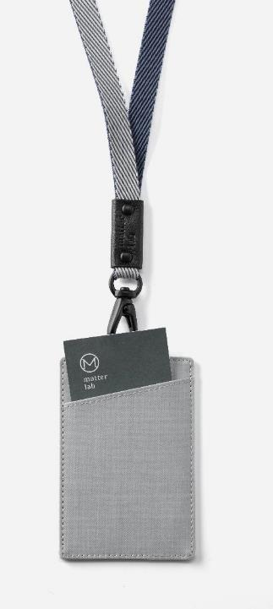
16:9 Layout 006
The quick brown fox jumps over the lazy dog. The quick brown fox jumps over the lazy dog.
Business
The quick brown fox jumps over the lazy dog. The quick brown fox jumps over the lazy dog.
The quick brown fox jumps over the lazy dog. The quick brown fox jumps over the lazy dog. The quick brown fox jumps over the lazy dog. The quick brown fox jumps over the lazy dog. The quick brown fox jumps over the lazy dog. The quick brown fox jumps over the lazy dog.
The quick brown fox jumps over the lazy dog. The quick brown fox jumps over the lazy dog.
The quick brown fox jumps over the lazy dog. The quick brown fox jumps over the lazy dog.

Slide 10
16:9 Layout 007
The quick brown fox jumps over the lazy dog. The quick brown fox jumps over the lazy dog.
The quick brown fox jumps over the lazy dog. The quick brown fox jumps over the lazy dog.
The quick brown fox jumps over the lazy dog. The quick brown fox jumps over the lazy dog.
The quick brown fox jumps over the lazy dog. The quick brown fox jumps over the lazy dog.

Slide 11
16:9 Layout 008
TITLE 01
TITLE 02
TITLE 03
The quick brown fox jumps over the lazy dog. The quick brown fox jumps over the lazy dog.
The quick brown fox jumps over the lazy dog. The quick brown fox jumps over the lazy dog.
The quick brown fox jumps over the lazy dog. The quick brown fox jumps over the lazy dog.

Slide 12
16:9 Layout 009
TITLE 01
TITLE 02
TITLE 03
The quick brown fox jumps over the lazy dog. The quick brown fox jumps over the lazy dog.
The quick brown fox jumps over the lazy dog. The quick brown fox jumps over the lazy dog.
The quick brown fox jumps over the lazy dog. The quick brown fox jumps over the lazy dog.

Slide 13
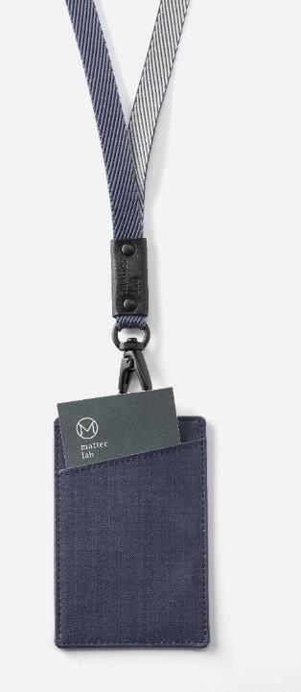
16:9 Layout 010
Customer Testimonials
The quick brown fox jumps over the lazy dog. The quick brown fox jumps over the lazy dog. The quick brown fox jumps over the lazy dog. The quick brown fox jumps over the lazy dog. The quick brown fox jumps over the lazy dog.
TITLE 02
The quick brown fox jumps over the lazy dog. The quick brown fox jumps over the lazy dog.

Slide 14
16:9 Layout 011
The quick brown fox jumps over the lazy dog. The quick brown fox jumps over the lazy dog.
Business Elements
The quick brown fox jumps over the lazy dog. The quick brown fox jumps over the lazy dog.
The quick brown fox jumps over the lazy dog. The quick brown fox jumps over the lazy dog.
The quick brown fox jumps over the lazy dog. The quick brown fox jumps over the lazy dog.

Slide 15
16:9 Layout 012
The quick brown fox jumps over the lazy dog. The quick brown fox jumps over the lazy dog.
The quick brown fox jumps over the lazy dog. The quick brown fox jumps over the lazy dog. The quick brown fox jumps over the lazy dog. The quick brown fox jumps over the lazy dog. The quick brown fox jumps over the lazy dog.
The quick brown fox jumps over the lazy dog. The quick brown fox jumps over the lazy dog.
The quick brown fox jumps over the lazy dog. The quick brown fox jumps over the lazy dog.

Slide 16
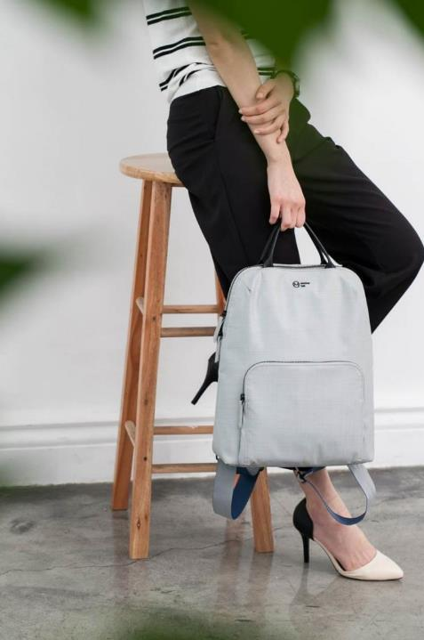
The quick brown fox jumps over the lazy dog. The quick brown fox jumps over the lazy dog.
16:9 Layout 013
The quick brown fox jumps over the lazy dog. The quick brown fox jumps over the lazy dog.
The quick brown fox jumps over the lazy dog. The quick brown fox jumps over the lazy dog. The quick brown fox jumps over the lazy dog. The quick brown fox jumps over the lazy dog. The quick brown fox jumps over the lazy dog.
The quick brown fox jumps over the lazy dog. The quick brown fox jumps over the lazy dog.
The quick brown fox jumps over the lazy dog. The quick brown fox jumps over the lazy dog.

Slide 17
The quick brown fox jumps over the lazy dog. The quick brown fox jumps over the lazy dog. The quick brown fox jumps over the lazy dog. The quick brown fox jumps over the lazy dog. The quick brown fox jumps over the lazy dog.
16:9 Layout 014
Business Elements
The quick brown fox jumps over the lazy dog. The quick brown fox jumps over the lazy dog. The quick brown fox jumps over the lazy dog. The quick brown fox jumps over the lazy dog. The quick brown fox jumps over the lazy dog.
The quick brown fox jumps over the lazy dog. The quick brown fox jumps over the lazy dog.
The quick brown fox jumps over the lazy dog. The quick brown fox jumps over the lazy dog.

Slide 18
16:9 Layout 015
The quick brown fox jumps over the lazy dog. The quick brown fox jumps over the lazy dog. The quick brown fox jumps over the lazy dog. The quick brown fox jumps over the lazy dog. The quick brown fox jumps over the lazy dog.
What We Do
The quick brown fox jumps over the lazy dog. The quick brown fox jumps over the lazy dog.

Slide 19
16:9 Layout 016
01.
03.
The quick brown fox jumps over the lazy dog.
The quick brown fox jumps over the lazy dog.
2018 Trend Keyboard
02.
04.
The quick brown fox jumps over the lazy dog.
The quick brown fox jumps over the lazy dog.

Slide 20
16:9 Layout 017
The quick brown fox jumps over the lazy dog. The quick brown fox jumps over the lazy dog. The quick brown fox jumps over the lazy dog. The quick brown fox jumps over the lazy dog. The quick brown fox jumps over the lazy dog.
Item
Item
The quick brown fox jumps over the lazy dog.
The quick brown fox jumps over the lazy dog.
Item
Item
The quick brown fox jumps over the lazy dog.
The quick brown fox jumps over the lazy dog.

Slide 21
16:9 Layout 018
The quick brown fox jumps over the lazy dog. The quick brown fox jumps over the lazy dog. The quick brown fox jumps over the lazy dog. The quick brown fox jumps over the lazy dog.
Agenda
Business
Security
The quick brown fox jumps over the lazy dog.
The quick brown fox jumps over the lazy dog.
The quick brown fox jumps over the lazy dog.

Slide 22
16:9 Layout 019
Business Elements
The quick brown fox jumps over the lazy dog. The quick brown fox jumps over the lazy dog. The quick brown fox jumps over the lazy dog. The quick brown fox jumps over the lazy dog. The quick brown fox jumps over the lazy dog.
Keys To Success
Agenda
Business
Security
The quick brown fox jumps over the lazy dog. The quick brown fox jumps over the lazy dog.
The quick brown fox jumps over the lazy dog.
The quick brown fox jumps over the lazy dog.
The quick brown fox jumps over the lazy dog.

Slide 23
16:9 Layout 020
Great Ideas
The quick brown fox jumps over the lazy dog. The quick brown fox jumps over the lazy dog. The quick brown fox jumps over the lazy dog. The quick brown fox jumps over the lazy dog. The quick brown fox jumps over the lazy dog.
TITLE 01
TITLE 02
The quick brown fox jumps over the lazy dog. The quick brown fox jumps over the lazy dog.
The quick brown fox jumps over the lazy dog. The quick brown fox jumps over the lazy dog.

Slide 24
16:9 Layout 021
Business
Business
The quick brown fox jumps over the lazy dog.
The quick brown fox jumps over the lazy dog.
Great Ideas
The quick brown fox jumps over the lazy dog. The quick brown fox jumps over the lazy dog. The quick brown fox jumps over the lazy dog.
Business
Business
The quick brown fox jumps over the lazy dog.
The quick brown fox jumps over the lazy dog.

Slide 25
16:9 Layout 022
01.
02.
The quick brown fox jumps over the lazy dog.
The quick brown fox jumps over the lazy dog.
03.
04.
The quick brown fox jumps over the lazy dog.
The quick brown fox jumps over the lazy dog.

Slide 26
16:9 Layout 023
The quick brown fox jumps over the lazy dog. The quick brown fox jumps over the lazy dog.
The quick brown fox jumps over the lazy dog. The quick brown fox jumps over the lazy dog.
The quick brown fox jumps over the lazy dog. The quick brown fox jumps over the lazy dog.
The quick brown fox jumps over the lazy dog. The quick brown fox jumps over the lazy dog.

Slide 27
16:9 Layout 024
TITLE 01
The quick brown fox jumps over the lazy dog. The quick brown fox jumps over the lazy dog.
The quick brown fox jumps over the lazy dog. The quick brown fox jumps over the lazy dog. The quick brown fox jumps over the lazy dog. The quick brown fox jumps over the lazy dog. The quick brown fox jumps over the lazy dog.
TITLE 02
The quick brown fox jumps over the lazy dog. The quick brown fox jumps over the lazy dog.

Slide 28
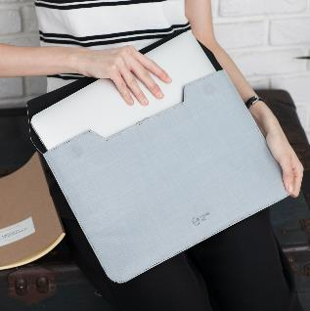
16:9 Layout 025
Title 01
The quick brown fox jumps over the lazy dog. The quick brown fox jumps over the lazy dog
TITLE 01
TITLE 02
ABC 01
80%
Title 02
ABC 01
80%
The quick brown fox jumps over the lazy dog. The quick brown fox jumps over the lazy dog
ABC 02
60%
ABC 02
60%

Slide 29
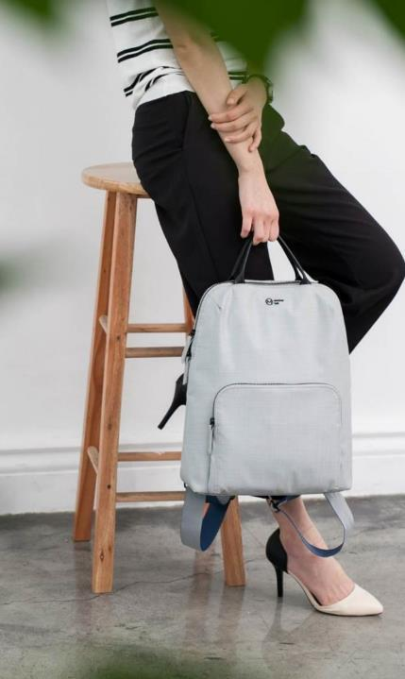
16:9 Layout 026
Content Marketing
The quick brown fox jumps over the lazy dog. The quick brown fox jumps over the lazy dog. The quick brown fox jumps over the lazy dog. The quick brown fox jumps over the lazy dog. The quick brown fox jumps over the lazy dog.

Slide 30
16:9 Layout 027
TITLE 01
TITLE 02
TITLE 03
Great Ideas
The quick brown fox jumps over the lazy dog. The quick brown fox jumps over the lazy dog. The quick brown fox jumps over the lazy dog. The quick brown fox jumps over the lazy dog.
The quick brown fox jumps over the lazy dog. The quick brown fox jumps over the lazy dog. The quick brown fox jumps over the lazy dog. The quick brown fox jumps over the lazy dog.
The quick brown fox jumps over the lazy dog. The quick brown fox jumps over the lazy dog. The quick brown fox jumps over the lazy dog. The quick brown fox jumps over the lazy dog.
The quick brown fox jumps over the lazy dog. The quick brown fox jumps over the lazy dog. The quick brown fox jumps over the lazy dog. The quick brown fox jumps over the lazy dog.

Slide 31
16:9 Layout 028
01
02
TITLE 01
TITLE 02
The quick brown fox jumps over the lazy dog. The quick brown fox jumps over the lazy dog.
The quick brown fox jumps over the lazy dog. The quick brown fox jumps over the lazy dog.
Great Ideas
The quick brown fox jumps over the lazy dog. The quick brown fox jumps over the lazy dog. The quick brown fox jumps over the lazy dog. The quick brown fox jumps over the lazy dog.
03
04
TITLE 03
TITLE 04
The quick brown fox jumps over the lazy dog. The quick brown fox jumps over the lazy dog.
The quick brown fox jumps over the lazy dog. The quick brown fox jumps over the lazy dog.

Slide 32
16:9 Layout 029
The quick brown fox jumps over the lazy dog. fox jumps over the lazy dog.
The quick brown fox jumps over the lazy dog. The quick brown fox jumps over the lazy dog. The quick brown fox jumps over the lazy dog. The quick brown fox jumps over the lazy dog. The quick brown fox jumps over the lazy dog.
The quick brown fox jumps over the lazy dog. fox jumps over the lazy dog.
The quick brown fox jumps over the lazy dog. fox jumps over the lazy dog.
The quick brown fox jumps over the lazy dog. fox jumps over the lazy dog.

Slide 33
16:9 Layout 030
Great Ideas
The quick brown fox jumps over the lazy dog. The quick brown fox jumps over the lazy dog. The quick brown fox jumps over the lazy dog. The quick brown fox jumps over the lazy dog.
Title 01
Title 02
Title 03
The quick brown fox jumps over the lazy dog. The quick brown fox jumps over the lazy dog.
The quick brown fox jumps over the lazy dog. The quick brown fox jumps over the lazy dog.
The quick brown fox jumps over the lazy dog. The quick brown fox jumps over the lazy dog.

Slide 34
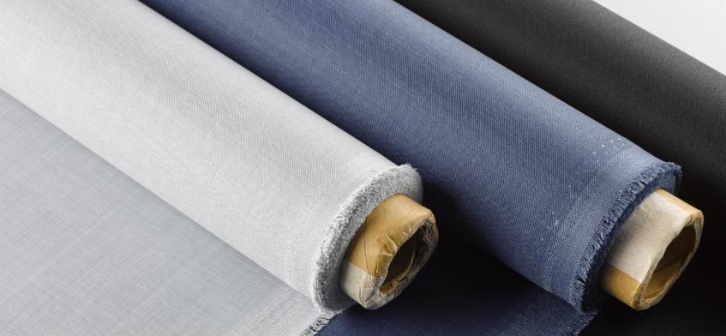
16:9 Layout 031
The quick brown fox jumps over the lazy dog. The quick brown fox jumps over the lazy dog. The quick brown fox jumps over the lazy dog. The quick brown fox jumps over the lazy dog. The quick brown fox jumps over the lazy dog.
Title 01
Title 02
Title 03
The quick brown fox jumps over the lazy dog. The quick brown fox jumps over the lazy dog.
The quick brown fox jumps over the lazy dog. The quick brown fox jumps over the lazy dog.
The quick brown fox jumps over the lazy dog. The quick brown fox jumps over the lazy dog.

Slide 35
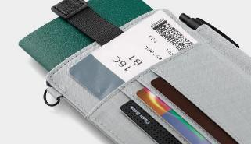
16:9 Layout 032
01
The quick brown fox jumps over the lazy dog. The quick brown fox jumps over the lazy dog.
Great Ideas
02
The quick brown fox jumps over the lazy dog. The quick brown fox jumps over the lazy dog.
The quick brown fox jumps over the lazy dog. The quick brown fox jumps over the lazy dog. The quick brown fox jumps over the lazy dog. The quick brown fox jumps over the lazy dog.
03
The quick brown fox jumps over the lazy dog. The quick brown fox jumps over the lazy dog.
04
The quick brown fox jumps over the lazy dog. The quick brown fox jumps over the lazy dog.

Slide 36
16:9 Layout 033
Title 01
Title 01
+130%
My Works
Title 02
43.5M
The quick brown fox jumps over the lazy dog. The quick brown fox jumps over the lazy dog. The quick brown fox jumps over the lazy dog.
Title 03
$68.5
The quick brown fox jumps over the lazy dog. The quick brown fox jumps over the lazy dog.

Slide 37
16:9 Layout 034
TITLE 01
TITLE 04
The quick brown fox jumps over the lazy dog. The quick brown fox jumps over the lazy dog.
The quick brown fox jumps over the lazy dog. The quick brown fox jumps over the lazy dog.
TITLE 02
TITLE 05
The quick brown fox jumps over the lazy dog. The quick brown fox jumps over the lazy dog. The quick brown fox jumps over the lazy dog.
The quick brown fox jumps over the lazy dog. The quick brown fox jumps over the lazy dog.
The quick brown fox jumps over the lazy dog. The quick brown fox jumps over the lazy dog.
TITLE 03
TITLE 06
The quick brown fox jumps over the lazy dog. The quick brown fox jumps over the lazy dog.
The quick brown fox jumps over the lazy dog. The quick brown fox jumps over the lazy dog.

Slide 38
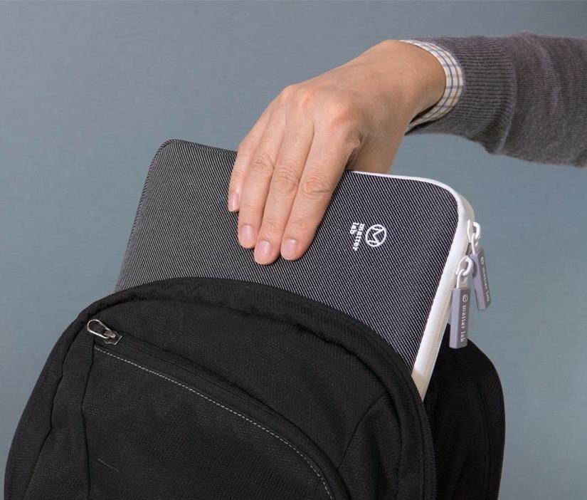
16:9 Layout 035
Title 01
+130%
Content Marketing
Title 02
43.5M
The quick brown fox jumps over the lazy dog. The quick brown fox jumps over the lazy dog. The quick brown fox jumps over the lazy dog.
Title 03
$68.5

Slide 39
About Us
16:9 Layout 036
TITLE 01
TITLE 04
The quick brown fox jumps over the lazy dog. The quick brown fox jumps over the lazy dog.
The quick brown fox jumps over the lazy dog. The quick brown fox jumps over the lazy dog.
TITLE 02
TITLE 05
The quick brown fox jumps over the lazy dog. The quick brown fox jumps over the lazy dog.
The quick brown fox jumps over the lazy dog. The quick brown fox jumps over the lazy dog.
TITLE 03
TITLE 06
The quick brown fox jumps over the lazy dog. The quick brown fox jumps over the lazy dog.
The quick brown fox jumps over the lazy dog. The quick brown fox jumps over the lazy dog.

Slide 40
16:9 Layout 037
Title 01
Business Elements
The quick brown fox jumps over the lazy dog. The quick brown fox jumps over the lazy dog. The quick brown fox jumps over the lazy dog.
Title 02
The quick brown fox jumps over the lazy dog. The quick brown fox jumps over the lazy dog. The quick brown fox jumps over the lazy dog.
Title 03

Slide 41
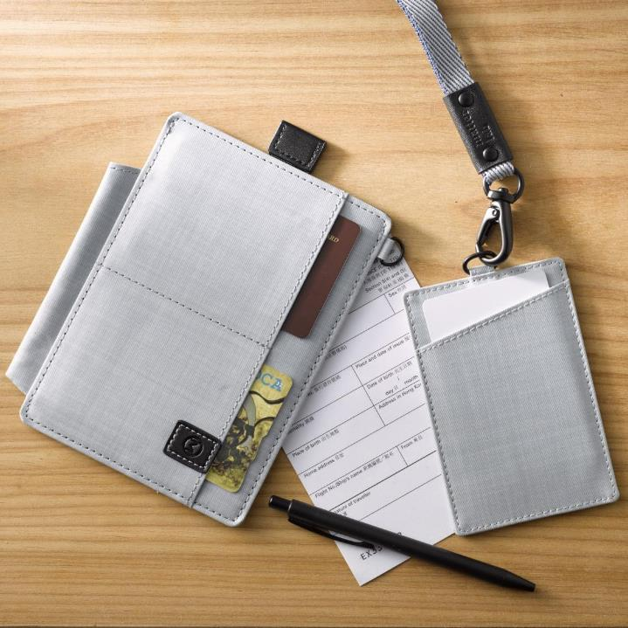
16:9 Layout 038
01.
04.
The quick brown fox jumps over the lazy dog.
The quick brown fox jumps over the lazy dog.
The quick brown fox jumps over the lazy dog. The quick brown fox jumps over the lazy dog. The quick brown fox jumps over the lazy dog.
02.
05.
The quick brown fox jumps over the lazy dog.
The quick brown fox jumps over the lazy dog.
The quick brown fox jumps over the lazy dog. The quick brown fox jumps over the lazy dog. The quick brown fox jumps over the lazy dog.
03.
06.
The quick brown fox jumps over the lazy dog.
The quick brown fox jumps over the lazy dog.

Slide 42
16:9 Layout 039
The quick brown fox jumps over the lazy dog. The quick brown fox jumps over the lazy dog.
The quick brown fox jumps over the lazy dog. The quick brown fox jumps over the lazy dog. The quick brown fox jumps over the lazy dog.
The quick brown fox jumps over the lazy dog. The quick brown fox jumps over the lazy dog.
The quick brown fox jumps over the lazy dog. The quick brown fox jumps over the lazy dog.
43.5%
The quick brown fox jumps over the lazy dog. The quick brown fox jumps over the lazy dog.

Slide 43
16:9 Layout 040
TITLE 01
TITLE 02
The quick brown fox jumps over the lazy dog.
The quick brown fox jumps over the lazy dog.
What We Do
TITLE 03
TITLE 04
The quick brown fox jumps over the lazy dog.
The quick brown fox jumps over the lazy dog. The quick brown fox jumps over the lazy dog. The quick brown fox jumps over the lazy dog.
The quick brown fox jumps over the lazy dog.

Slide 44
16:9 Layout 041
TITLE 01
TITLE 03
The quick brown fox jumps over the lazy dog. The quick brown fox jumps over the lazy dog.
The quick brown fox jumps over the lazy dog. The quick brown fox jumps over the lazy dog.
TITLE 02
TITLE 04
The quick brown fox jumps over the lazy dog. The quick brown fox jumps over the lazy dog.
The quick brown fox jumps over the lazy dog. The quick brown fox jumps over the lazy dog.

Slide 45
16:9 Layout 042
TITLE 01
TITLE 02
The quick brown fox jumps over the lazy dog. The quick brown fox jumps over the lazy dog. The quick brown fox jumps over the lazy dog.
The quick brown fox jumps over the lazy dog. The quick brown fox jumps over the lazy dog. The quick brown fox jumps over the lazy dog.
The quick brown fox jumps over the lazy dog. The quick brown fox jumps over the lazy dog. The quick brown fox jumps over the lazy dog. The quick brown fox jumps over the lazy dog. The quick brown fox jumps over the lazy dog.

Slide 46
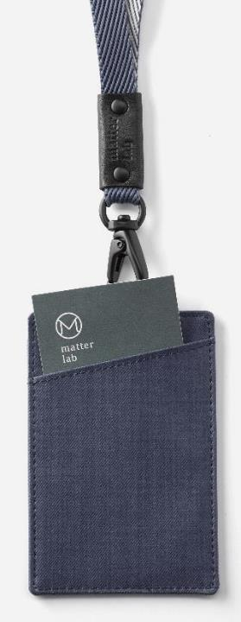
16:9 Layout 043
The quick brown fox jumps over the lazy dog. fox jumps over the lazy dog.
The quick brown fox jumps over the lazy dog. fox jumps over the lazy dog.
The quick brown fox jumps over the lazy dog. fox jumps over the lazy dog.

Slide 47
16:9 Layout 044
TITLE 01
TITLE 02
The quick brown fox jumps over the lazy dog. The quick brown fox jumps over the lazy dog. The quick brown fox jumps over the lazy dog.
The quick brown fox jumps over the lazy dog. The quick brown fox jumps over the lazy dog. The quick brown fox jumps over the lazy dog.
TITLE 03
TITLE 04
The quick brown fox jumps over the lazy dog. The quick brown fox jumps over the lazy dog. The quick brown fox jumps over the lazy dog.
The quick brown fox jumps over the lazy dog. The quick brown fox jumps over the lazy dog. The quick brown fox jumps over the lazy dog.

Slide 48
16:9 Layout 045
The quick brown fox jumps over the lazy dog. The quick brown fox jumps over the lazy dog.
The quick brown fox jumps over the lazy dog. The quick brown fox jumps over the lazy dog.
The quick brown fox jumps over the lazy dog. The quick brown fox jumps over the lazy dog.
The quick brown fox jumps over the lazy dog. The quick brown fox jumps over the lazy dog.

Slide 49
16:9 Layout 046
98.5%
The quick brown fox jumps over the lazy dog. fox jumps over the lazy dog.
The quick brown fox jumps over the lazy dog. The quick brown fox jumps over the lazy dog.
The quick brown fox jumps over the lazy dog. The quick brown fox jumps over the lazy dog. The quick brown fox jumps over the lazy dog.
The quick brown fox jumps over the lazy dog. fox jumps over the lazy dog.
36%
64%
The quick brown fox jumps over the lazy dog.
The quick brown fox jumps over the lazy dog.
The quick brown fox jumps over the lazy dog. fox jumps over the lazy dog.

Slide 50
16:9 Layout 047
40%
The quick brown fox jumps over the lazy dog. The quick brown fox jumps over the lazy dog.
30%
The quick brown fox jumps over the lazy dog. The quick brown fox jumps over the lazy dog.
20%
The quick brown fox jumps over the lazy dog. The quick brown fox jumps over the lazy dog.
10%
The quick brown fox jumps over the lazy dog. The quick brown fox jumps over the lazy dog.

Slide 51
16:9 Layout 048
The quick brown fox jumps over the lazy dog. The quick brown fox jumps over the lazy dog. The quick brown fox jumps over the lazy dog. The quick brown fox jumps over the lazy dog.
Content Marketing
The quick brown fox jumps over the lazy dog. The quick brown fox jumps over the lazy dog. The quick brown fox jumps over the lazy dog. The quick brown fox jumps over the lazy dog.
The quick brown fox jumps over the lazy dog. The quick brown fox jumps over the lazy dog. The quick brown fox jumps over the lazy dog. The quick brown fox jumps over the lazy dog.
TITLE 01
The quick brown fox jumps over the lazy dog.

Slide 52
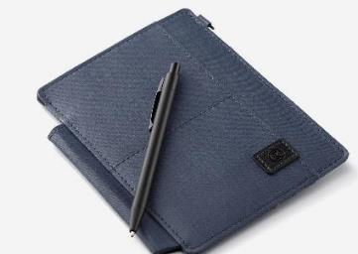
16:9 Layout 049
Our Objectives
The quick brown fox jumps over the lazy dog. The quick brown fox jumps over the lazy dog.
The quick brown fox jumps over the lazy dog. The quick brown fox jumps over the lazy dog.
The quick brown fox jumps over the lazy dog. The quick brown fox jumps over the lazy dog. The quick brown fox jumps over the lazy dog.
The quick brown fox jumps over the lazy dog. The quick brown fox jumps over the lazy dog.
The quick brown fox jumps over the lazy dog. The quick brown fox jumps over the lazy dog.

Slide 53
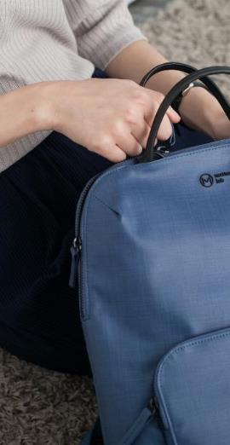
16:9 Layout 050
TITLE 01
The quick brown fox jumps over the lazy dog. The quick brown fox jumps over the lazy dog.
Social Media.
TITLE 02
The quick brown fox jumps over the lazy dog. The quick brown fox jumps over the lazy dog.

Slide 54
16:9 Layout 051
The quick brown fox jumps over the lazy dog. The quick brown fox jumps over the lazy dog. The quick brown fox jumps over the lazy dog.
The quick brown fox jumps over the lazy dog. The quick brown fox jumps over the lazy dog. The quick brown fox jumps over the lazy dog.
The quick brown fox jumps over the lazy dog. fox jumps over the lazy dog.
The quick brown fox jumps over the lazy dog. The quick brown fox jumps over the lazy dog. The quick brown fox jumps over the lazy dog.

Slide 55
16:9 Layout 052
The quick brown fox jumps over the lazy dog. The quick brown fox jumps over the lazy dog. The quick brown fox jumps over the lazy dog.
The quick brown fox jumps over the lazy dog. The quick brown fox jumps over the lazy dog. The quick brown fox jumps over the lazy dog.
The quick brown fox jumps over the lazy dog. The quick brown fox jumps over the lazy dog. The quick brown fox jumps over the lazy dog.

Slide 56
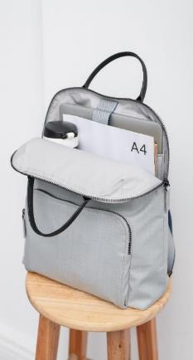
16:9 Layout 053
Our Objectives
The quick brown fox jumps over the lazy dog. The quick brown fox jumps over the lazy dog. The quick brown fox jumps over the lazy dog.
TITLE 01
TITLE 02
TITLE 03
The quick brown fox jumps over the lazy dog. The quick brown fox jumps over the lazy dog.
The quick brown fox jumps over the lazy dog. The quick brown fox jumps over the lazy dog.
The quick brown fox jumps over the lazy dog. The quick brown fox jumps over the lazy dog.

Slide 57
16:9 Layout 054
Trend Keyboard.
The quick brown fox jumps over the lazy dog. The quick brown fox jumps over the lazy dog. The quick brown fox jumps over the lazy dog. The quick brown fox jumps over the lazy dog. The quick brown fox jumps over the lazy dog.

Slide 58
16:9 Layout 055
Business Model
The quick brown fox jumps over the lazy dog. The quick brown fox jumps over the lazy dog. The quick brown fox jumps over the lazy dog.

Slide 59
16:9 Layout 056
The quick brown fox jumps over the lazy dog. The quick brown fox jumps over the lazy dog. The quick brown fox jumps over the lazy dog.
The quick brown fox jumps over the lazy dog. The quick brown fox jumps over the lazy dog. The quick brown fox jumps over the lazy dog.
77
67
67
55
88
ABC 01
80%
ABC 02
60%
’13
’14
’15
’16
’17

Slide 60
16:9 Layout 057
The quick brown fox jumps over the lazy dog. The quick brown fox jumps over the lazy dog.
Products & Services
The quick brown fox jumps over the lazy dog. The quick brown fox jumps over the lazy dog.
The quick brown fox jumps over the lazy dog. The quick brown fox jumps over the lazy dog.
The quick brown fox jumps over the lazy dog. The quick brown fox jumps over the lazy dog.

Slide 61
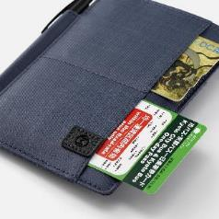
16:9 Layout 058
The quick brown fox jumps over the lazy dog. The quick brown fox jumps over the lazy dog. The quick brown fox jumps over the lazy dog.
Business Model

Slide 62
16:9 Layout 059
The quick brown fox jumps over the lazy dog. The quick brown fox jumps over the lazy dog.
The quick brown fox jumps over the lazy dog. The quick brown fox jumps over the lazy dog. The quick brown fox jumps over the lazy dog.
The quick brown fox jumps over the lazy dog. The quick brown fox jumps over the lazy dog.
2015
The quick brown fox jumps over the lazy dog. The quick brown fox jumps over the lazy dog.
2016
2017
2018
The quick brown fox jumps over the lazy dog. The quick brown fox jumps over the lazy dog.
2019

Slide 63
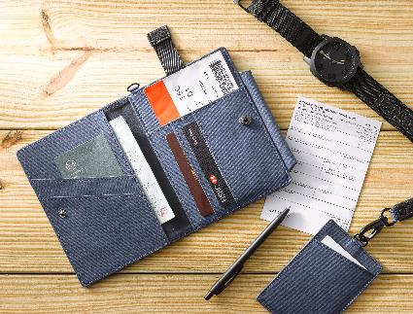
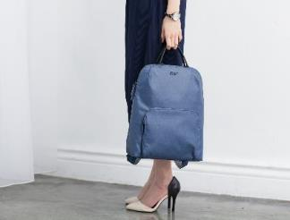
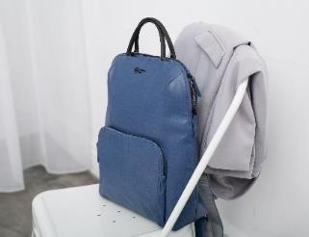
16:9 Layout 060
The quick brown fox jumps over the lazy dog. The quick brown fox jumps over the lazy dog. The quick brown fox jumps over the lazy dog.

Slide 64
16:9 Layout 061
Products & Services
Business Model
The quick brown fox jumps over the lazy dog. The quick brown fox jumps over the lazy dog. The quick brown fox jumps over the lazy dog.

Slide 65
16:9 Layout 062
Great Ideas
The quick brown fox jumps over the lazy dog. The quick brown fox jumps over the lazy dog. The quick brown fox jumps over the lazy dog. The quick brown fox jumps over the lazy dog. The quick brown fox jumps over the lazy dog.
The quick brown fox jumps over the lazy dog. The quick brown fox jumps over the lazy dog.
The quick brown fox jumps over the lazy dog. The quick brown fox jumps over the lazy dog.

Slide 66
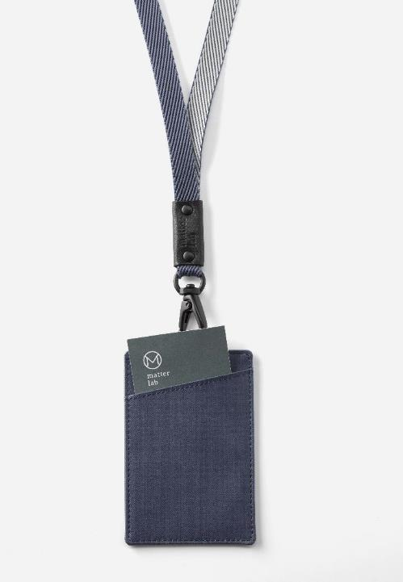
16:9 Layout 063
Products & Services
The quick brown fox jumps over the lazy dog. The quick brown fox jumps over the lazy dog. The quick brown fox jumps over the lazy dog. The quick brown fox jumps over the lazy dog. The quick brown fox jumps over the lazy dog.

Slide 67
16:9 Layout 064
Business Model
The quick brown fox jumps over the lazy dog. The quick brown fox jumps over the lazy dog. The quick brown fox jumps over the lazy dog.
The quick brown fox jumps over the lazy dog. The quick brown fox jumps over the lazy dog. The quick brown fox jumps over the lazy dog.

Slide 68
16:9 Layout 065
The quick brown fox jumps over the lazy dog. The quick brown fox jumps over the lazy dog.
WHO
WE
ARE
The quick brown fox jumps over the lazy dog. The quick brown fox jumps over the lazy dog.
The quick brown fox jumps over the lazy dog. The quick brown fox jumps over the lazy dog.
The quick brown fox jumps over the lazy dog. The quick brown fox jumps over the lazy dog.

Slide 69
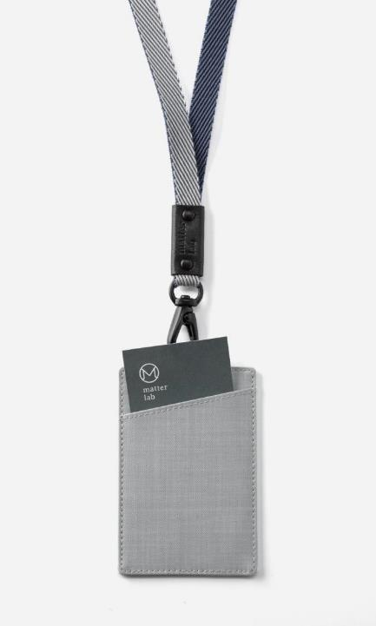
16:9 Layout 066
TITLE 01
The quick brown fox jumps over the lazy dog. The quick brown fox jumps over the lazy dog.
The quick brown fox jumps over the lazy dog. The quick brown fox jumps over the lazy dog. The quick brown fox jumps over the lazy dog. The quick brown fox jumps over the lazy dog. The quick brown fox jumps over the lazy dog.
TITLE 02
The quick brown fox jumps over the lazy dog. The quick brown fox jumps over the lazy dog.
TITLE 03
The quick brown fox jumps over the lazy dog. The quick brown fox jumps over the lazy dog.

Slide 70
16:9 Layout 067
The quick brown fox jumps over the lazy dog. The quick brown fox jumps over the lazy dog. The quick brown fox jumps over the lazy dog. The quick brown fox jumps over the lazy dog. The quick brown fox jumps over the lazy dog.

Slide 71
16:9 Layout 068
TITLE 01
TITLE 03
The quick brown fox jumps over the lazy dog. The quick brown fox jumps over the lazy dog.
The quick brown fox jumps over the lazy dog. The quick brown fox jumps over the lazy dog.
TITLE 02
TITLE 03
The quick brown fox jumps over the lazy dog. The quick brown fox jumps over the lazy dog.
The quick brown fox jumps over the lazy dog. The quick brown fox jumps over the lazy dog.

Slide 72
16:9 Layout 069
Products & Services
About Us
The quick brown fox jumps over the lazy dog. The quick brown fox jumps over the lazy dog. The quick brown fox jumps over the lazy dog.

Slide 73
5
16:9 Layout 070
The quick brown fox jumps over the lazy dog..
4
The quick brown fox jumps over the lazy dog..
The quick brown fox jumps over the lazy dog. The quick brown fox jumps over the lazy dog. The quick brown fox jumps over the lazy dog.
3
The quick brown fox jumps over the lazy dog..
2
The quick brown fox jumps over the lazy dog..
1
The quick brown fox jumps over the lazy dog. The quick brown fox jumps over the lazy dog. The quick brown fox jumps over the lazy dog.
The quick brown fox jumps over the lazy dog..

Slide 74
16:9 Layout 071
The quick brown fox jumps over the lazy dog. The quick brown fox jumps over the lazy dog. The quick brown fox jumps over the lazy dog. The quick brown fox jumps over the lazy dog. The quick brown fox jumps over the lazy dog.

Slide 75
The quick brown fox jumps over the lazy dog.
16:9 Layout 072
The quick brown fox jumps over the lazy dog.
The quick brown fox jumps over the lazy dog.
The quick brown fox jumps over the lazy dog.
The quick brown fox jumps over the lazy dog.
The quick brown fox jumps over the lazy dog.
The quick brown fox jumps over the lazy dog.
The quick brown fox jumps over the lazy dog.

Slide 76
The quick brown fox jumps over the lazy dog.
16:9 Layout 073
The quick brown fox jumps over the lazy dog.
The quick brown fox jumps over the lazy dog.
The quick brown fox jumps over the lazy dog.
The quick brown fox jumps over the lazy dog.
The quick brown fox jumps over the lazy dog.
The quick brown fox jumps over the lazy dog.

Slide 77
16:9 Layout 074
01.
The quick brown fox jumps over the lazy dog. The quick brown fox jumps over the lazy dog.
02.
The quick brown fox jumps over the lazy dog. The quick brown fox jumps over the lazy dog.
03.
The quick brown fox jumps over the lazy dog. The quick brown fox jumps over the lazy dog.

Slide 78
16:9 Layout 075
01
TITLE 01
02
TITLE 02
03
TITLE 03
The quick brown fox jumps over the lazy dog. The quick brown fox jumps over the lazy dog.
The quick brown fox jumps over the lazy dog. The quick brown fox jumps over the lazy dog.
The quick brown fox jumps over the lazy dog. The quick brown fox jumps over the lazy dog.
04
TITLE 04
05
TITLE 05
06
TITLE 06
The quick brown fox jumps over the lazy dog. The quick brown fox jumps over the lazy dog.
The quick brown fox jumps over the lazy dog. The quick brown fox jumps over the lazy dog.
The quick brown fox jumps over the lazy dog. The quick brown fox jumps over the lazy dog.

Slide 79
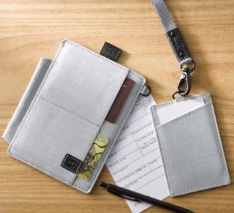
16:9 Layout 076
01
02
03
The quick brown fox jumps over the lazy dog. The quick brown fox jumps over the lazy dog.
The quick brown fox jumps over the lazy dog. The quick brown fox jumps over the lazy dog.
The quick brown fox jumps over the lazy dog. The quick brown fox jumps over the lazy dog.

Slide 80
16:9 Layout 077
The quick brown fox jumps over the lazy dog. The quick brown fox jumps over the lazy dog.
01
02
TITLE 01
TITLE 01
The quick brown fox jumps over the lazy dog. The quick brown fox jumps over the lazy dog.
The quick brown fox jumps over the lazy dog. The quick brown fox jumps over the lazy dog.
03
04
TITLE 01
TITLE 01
The quick brown fox jumps over the lazy dog. The quick brown fox jumps over the lazy dog.
The quick brown fox jumps over the lazy dog. The quick brown fox jumps over the lazy dog.

Slide 81
16:9 Layout 078
01.
The quick brown fox jumps over the lazy dog. The quick brown fox jumps over the lazy dog.
02.
The quick brown fox jumps over the lazy dog. The quick brown fox jumps over the lazy dog.
65.8%
03.
The quick brown fox jumps over the lazy dog. The quick brown fox jumps over the lazy dog.
The quick brown fox jumps over the lazy dog. The quick brown fox jumps over the lazy dog.

Slide 82
16:9 Layout 079
01
02
The quick brown fox jumps over the lazy dog. The quick brown fox jumps over the lazy dog.
The quick brown fox jumps over the lazy dog. The quick brown fox jumps over the lazy dog.
03
04
The quick brown fox jumps over the lazy dog. The quick brown fox jumps over the lazy dog.
The quick brown fox jumps over the lazy dog. The quick brown fox jumps over the lazy dog.

Slide 83
16:9 Layout 080
01.
02.
The quick brown fox jumps over the lazy dog. The quick brown fox jumps over the lazy dog.
The quick brown fox jumps over the lazy dog. The quick brown fox jumps over the lazy dog.
03.
04.
The quick brown fox jumps over the lazy dog. The quick brown fox jumps over the lazy dog.
The quick brown fox jumps over the lazy dog. The quick brown fox jumps over the lazy dog.

Slide 84
16:9 Layout 081
01
02
03
TITLE 01
TITLE 01
TITLE 01
The quick brown fox jumps over the lazy dog. The quick brown fox jumps over the lazy dog.
The quick brown fox jumps over the lazy dog. The quick brown fox jumps over the lazy dog.
The quick brown fox jumps over the lazy dog. The quick brown fox jumps over the lazy dog.
04
05
06
TITLE 01
TITLE 01
TITLE 01
The quick brown fox jumps over the lazy dog. The quick brown fox jumps over the lazy dog.
The quick brown fox jumps over the lazy dog. The quick brown fox jumps over the lazy dog.
The quick brown fox jumps over the lazy dog. The quick brown fox jumps over the lazy dog.

Slide 85
TITLE 01
16:9 Layout 082
The quick brown fox jumps over the lazy dog. The quick brown fox jumps over the lazy dog.
TITLE 02
The quick brown fox jumps over the lazy dog. The quick brown fox jumps over the lazy dog.
The quick brown fox jumps over the lazy dog. The quick brown fox jumps over the lazy dog. The quick brown fox jumps over the lazy dog.
TITLE 03
The quick brown fox jumps over the lazy dog. The quick brown fox jumps over the lazy dog.

Slide 86
16:9 Layout 083
TITLE 01
The quick brown fox jumps over the lazy dog. The quick brown fox jumps over the lazy dog. The quick brown fox jumps over the lazy dog.
Great Ideas
TITLE 02
The quick brown fox jumps over the lazy dog. The quick brown fox jumps over the lazy dog. The quick brown fox jumps over the lazy dog.
TITLE 03
The quick brown fox jumps over the lazy dog. The quick brown fox jumps over the lazy dog. The quick brown fox jumps over the lazy dog.

Slide 87
16:9 Layout 084
85%
Title
Title
The quick brown fox jumps over the lazy dog. The quick brown fox jumps over the lazy dog.
The quick brown fox jumps over the lazy dog.
The quick brown fox jumps over the lazy dog.
The quick brown fox jumps over the lazy dog.
The quick brown fox jumps over the lazy dog.
The quick brown fox jumps over the lazy dog.
The quick brown fox jumps over the lazy dog.
The quick brown fox jumps over the lazy dog.
85%
The quick brown fox jumps over the lazy dog. The quick brown fox jumps over the lazy dog.
The quick brown fox jumps over the lazy dog.

Slide 88
16:9 Layout 085
Products & Services
The quick brown fox jumps over the lazy dog.
The quick brown fox jumps over the lazy dog.
The quick brown fox jumps over the lazy dog.

Slide 89
16:9 Layout 086
The quick brown fox jumps over the lazy dog. The quick brown fox jumps over the lazy dog. The quick brown fox jumps over the lazy dog.
The quick brown fox jumps over the lazy dog. The quick brown fox jumps over the lazy dog. The quick brown fox jumps over the lazy dog.
The quick brown fox jumps over the lazy dog. The quick brown fox jumps over the lazy dog. The quick brown fox jumps over the lazy dog.

Slide 90
16:9 Layout 087
01
The quick brown fox jumps over the lazy dog.
03
The quick brown fox jumps over the lazy dog.
05
The quick brown fox jumps over the lazy dog.
02
The quick brown fox jumps over the lazy dog.
04
The quick brown fox jumps over the lazy dog.
06
The quick brown fox jumps over the lazy dog.

Slide 91
16:9 Layout 088
The quick brown fox jumps over the lazy dog. The quick brown fox jumps over the lazy dog. The quick brown fox jumps over the lazy dog.

Slide 92
16:9 Layout 089
The quick brown fox jumps over the lazy dog. The quick brown fox jumps over the lazy dog.
The quick brown fox jumps over the lazy dog. The quick brown fox jumps over the lazy dog.
The quick brown fox jumps over the lazy dog. The quick brown fox jumps over the lazy dog.
The quick brown fox jumps over the lazy dog. The quick brown fox jumps over the lazy dog.

Slide 93
16:9 Layout 090
The quick brown fox jumps over the lazy dog. The quick brown fox jumps over the lazy dog. The quick brown fox jumps over the lazy dog. The quick brown fox jumps over the lazy dog. The quick brown fox jumps over the lazy dog.
Products & Services

Slide 94
16:9 Layout 091
TITLE 01
TITLE 03
01
03
The quick brown fox jumps over the lazy dog. The quick brown fox jumps over the lazy dog. The quick brown fox jumps over the lazy dog.
The quick brown fox jumps over the lazy dog. The quick brown fox jumps over the lazy dog. The quick brown fox jumps over the lazy dog.
TITLE 02
TITLE 04
02
04
The quick brown fox jumps over the lazy dog. The quick brown fox jumps over the lazy dog. The quick brown fox jumps over the lazy dog.
The quick brown fox jumps over the lazy dog. The quick brown fox jumps over the lazy dog. The quick brown fox jumps over the lazy dog.

Slide 95
16:9 Layout 092
TITLE 01
TITLE 02
TITLE 03
TITLE 04
The quick brown fox jumps over the lazy dog.
The quick brown fox jumps over the lazy dog.
The quick brown fox jumps over the lazy dog.
The quick brown fox jumps over the lazy dog.

Slide 96
16:9 Layout 093
TITLE
The quick brown fox jumps over the lazy dog. The quick brown fox jumps over the lazy dog. The quick brown fox jumps over the lazy dog.
TITLE 01
TITLE 02
The quick brown fox jumps over the lazy dog.
The quick brown fox jumps over the lazy dog.

Slide 97
TITLE 01
16:9 Layout 094
The quick brown fox jumps over the lazy dog. The quick brown fox jumps over the lazy dog. The quick brown fox jumps over the lazy dog.
①
The quick brown fox jumps over the lazy dog.
TITLE 02
②
The quick brown fox jumps over the lazy dog.
The quick brown fox jumps over the lazy dog. The quick brown fox jumps over the lazy dog. The quick brown fox jumps over the lazy dog.
③
The quick brown fox jumps over the lazy dog.
TITLE 03
④
The quick brown fox jumps over the lazy dog. The quick brown fox jumps over the lazy dog. The quick brown fox jumps over the lazy dog.
The quick brown fox jumps over the lazy dog.

Slide 98
16:9 Layout 095
TITLE 01
WHAT WE DO
The quick brown fox jumps over the lazy dog. The quick brown fox jumps over the lazy dog.
TITLE 02
The quick brown fox jumps over the lazy dog. The quick brown fox jumps over the lazy dog.
TITLE 013
The quick brown fox jumps over the lazy dog. The quick brown fox jumps over the lazy dog.

Slide 99
16:9 Layout 096
1
2
The quick brown fox jumps over the lazy dog. The quick brown fox jumps over the lazy dog.
The quick brown fox jumps over the lazy dog. The quick brown fox jumps over the lazy dog.
TITLE 01
TITLE 02
3
4
The quick brown fox jumps over the lazy dog. The quick brown fox jumps over the lazy dog.
The quick brown fox jumps over the lazy dog. The quick brown fox jumps over the lazy dog.
The quick brown fox jumps over the lazy dog. The quick brown fox jumps over the lazy dog.
TITLE 03
TITLE 04

Slide 100
16:9 Layout 097
The quick brown fox jumps over the lazy dog. The quick brown fox jumps over the lazy dog.
The quick brown fox jumps over the lazy dog. The quick brown fox jumps over the lazy dog.
The quick brown fox jumps over the lazy dog. The quick brown fox jumps over the lazy dog.
The quick brown fox jumps over the lazy dog. The quick brown fox jumps over the lazy dog.

Slide 101
16:9 Layout 098
The quick brown fox jumps over the lazy dog. The quick brown fox jumps over the lazy dog.
TITLE 02
TITLE 04
The quick brown fox jumps over the lazy dog.
The quick brown fox jumps over the lazy dog.
TITLE 01
TITLE 03
TITLE 05
The quick brown fox jumps over the lazy dog.
The quick brown fox jumps over the lazy dog.
The quick brown fox jumps over the lazy dog.

Slide 102
16:9 Layout 099
The quick brown fox jumps over the lazy dog.
630,113
The quick brown fox jumps over the lazy dog. The quick brown fox jumps over the lazy dog. The quick brown fox jumps over the lazy dog.
175,45
The quick brown fox jumps over the lazy dog. The quick brown fox jumps over the lazy dog. The quick brown fox jumps over the lazy dog.
The quick brown fox jumps over the lazy dog.
446,598
The quick brown fox jumps over the lazy dog. The quick brown fox jumps over the lazy dog. The quick brown fox jumps over the lazy dog.
The quick brown fox jumps over the lazy dog.

Slide 103
16:9 Layout 100
The quick brown fox jumps over the lazy dog. The quick brown fox jumps over the lazy dog. The quick brown fox jumps over the lazy dog.

Slide 104
16:9 Layout 101
The quick brown fox jumps over the lazy dog. The quick brown fox jumps over the lazy dog.
The quick brown fox jumps over the lazy dog.
The quick brown fox jumps over the lazy dog. The quick brown fox jumps over the lazy dog.
The quick brown fox jumps over the lazy dog. The quick brown fox jumps over the lazy dog.
The quick brown fox jumps over the lazy dog. The quick brown fox jumps over the lazy dog.
The quick brown fox jumps over the lazy dog. The quick brown fox jumps over the lazy dog.
The quick brown fox jumps over the lazy dog.

Slide 105
16:9 Layout 102
01
TITLE 01
02
TITLE 02
03
TITLE 03
The quick brown fox jumps over the lazy dog. The quick brown fox jumps over the lazy dog.
The quick brown fox jumps over the lazy dog. The quick brown fox jumps over the lazy dog.
The quick brown fox jumps over the lazy dog. The quick brown fox jumps over the lazy dog.
The quick brown fox jumps over the lazy dog.
The quick brown fox jumps over the lazy dog.
The quick brown fox jumps over the lazy dog.
The quick brown fox jumps over the lazy dog.
The quick brown fox jumps over the lazy dog.
The quick brown fox jumps over the lazy dog.
The quick brown fox jumps over the lazy dog.
The quick brown fox jumps over the lazy dog.
The quick brown fox jumps over the lazy dog.
The quick brown fox jumps over the lazy dog.
The quick brown fox jumps over the lazy dog.
The quick brown fox jumps over the lazy dog.

Slide 106
16:9 Layout 103
98.8%
The quick brown fox jumps over the lazy dog. The quick brown fox jumps over the lazy dog. The quick brown fox jumps over the lazy dog.

Slide 107
16:9 Layout 104
TITLE 01
TITLE 02
TITLE 03
The quick brown fox jumps over the lazy dog. The quick brown fox jumps over the lazy dog.
The quick brown fox jumps over the lazy dog. The quick brown fox jumps over the lazy dog.
The quick brown fox jumps over the lazy dog. The quick brown fox jumps over the lazy dog.

Slide 108
16:9 Layout 105
TITLE 01
The quick brown fox jumps over the lazy dog. The quick brown fox jumps over the lazy dog. The quick brown fox jumps over the lazy dog.
TITLE 02
The quick brown fox jumps over the lazy dog. The quick brown fox jumps over the lazy dog. The quick brown fox jumps over the lazy dog.
TITLE 03
The quick brown fox jumps over the lazy dog. The quick brown fox jumps over the lazy dog. The quick brown fox jumps over the lazy dog.

Slide 109
16:9 Layout 106
TITLE 01
TITLE 03
The quick brown fox jumps over the lazy dog. The quick brown fox jumps over the lazy dog.
The quick brown fox jumps over the lazy dog. The quick brown fox jumps over the lazy dog.
TITLE 02
TITLE 03
The quick brown fox jumps over the lazy dog. The quick brown fox jumps over the lazy dog.
The quick brown fox jumps over the lazy dog. The quick brown fox jumps over the lazy dog.

Slide 110
16:9 Layout 107
TITLE 01
The quick brown fox jumps over the lazy dog. The quick brown fox jumps over the lazy dog. The quick brown fox jumps over the lazy dog.
TITLE 02
The quick brown fox jumps over the lazy dog. The quick brown fox jumps over the lazy dog.
TITLE 03
The quick brown fox jumps over the lazy dog. The quick brown fox jumps over the lazy dog.

Slide 111
16:9 Layout 108
The quick brown fox jumps over the lazy dog.
The quick brown fox jumps over the lazy dog.
S
W
The quick brown fox jumps over the lazy dog.
The quick brown fox jumps over the lazy dog.
O
T
The quick brown fox jumps over the lazy dog.
The quick brown fox jumps over the lazy dog.
The quick brown fox jumps over the lazy dog.
The quick brown fox jumps over the lazy dog.

Slide 112
16:9 Layout 109
1
The quick brown fox jumps over the lazy dog. The quick brown fox jumps over the lazy dog. The quick brown fox jumps over the lazy dog.
2
The quick brown fox jumps over the lazy dog. The quick brown fox jumps over the lazy dog. The quick brown fox jumps over the lazy dog.
3
The quick brown fox jumps over the lazy dog. The quick brown fox jumps over the lazy dog. The quick brown fox jumps over the lazy dog.
4
The quick brown fox jumps over the lazy dog. The quick brown fox jumps over the lazy dog. The quick brown fox jumps over the lazy dog.

Slide 113
16:9 Layout 110
TITLE 01
TITLE 04
The quick brown fox jumps over the lazy dog. The quick brown fox jumps over the lazy dog.
The quick brown fox jumps over the lazy dog. The quick brown fox jumps over the lazy dog.
TITLE 02
TITLE 05
The quick brown fox jumps over the lazy dog. The quick brown fox jumps over the lazy dog.
The quick brown fox jumps over the lazy dog. The quick brown fox jumps over the lazy dog.
TITLE 03
TITLE 06
The quick brown fox jumps over the lazy dog. The quick brown fox jumps over the lazy dog.
The quick brown fox jumps over the lazy dog. The quick brown fox jumps over the lazy dog.

Slide 114
16:9 Layout 111
Agenda
Process
The quick brown fox jumps over the lazy dog.
The quick brown fox jumps over the lazy dog.
Security
Success
The quick brown fox jumps over the lazy dog.
The quick brown fox jumps over the lazy dog.

Slide 115
16:9 Layout 112
01
TITLE 01
02
TITLE 02
03
TITLE 03
The quick brown fox jumps over the lazy dog. The quick brown fox jumps over the lazy dog.
The quick brown fox jumps over the lazy dog. The quick brown fox jumps over the lazy dog.
The quick brown fox jumps over the lazy dog. The quick brown fox jumps over the lazy dog.
04
TITLE 04
05
TITLE 05
06
TITLE 06
The quick brown fox jumps over the lazy dog. The quick brown fox jumps over the lazy dog.
The quick brown fox jumps over the lazy dog. The quick brown fox jumps over the lazy dog.
The quick brown fox jumps over the lazy dog. The quick brown fox jumps over the lazy dog.

Slide 116
01
16:9 Layout 113
TITLE 01
The quick brown fox jumps over the lazy dog. The quick brown fox jumps over the lazy dog.
02
TITLE 03
The quick brown fox jumps over the lazy dog. The quick brown fox jumps over the lazy dog.
03
TITLE 03
The quick brown fox jumps over the lazy dog. The quick brown fox jumps over the lazy dog.
04
TITLE 04
The quick brown fox jumps over the lazy dog. The quick brown fox jumps over the lazy dog.

Slide 117
16:9 Layout 114
1111111111111111111111
1
The quick brown fox jumps over the lazy dog. The quick brown fox jumps over the lazy dog.
The quick brown fox jumps over the lazy dog..
1111111111111111111111
2
The quick brown fox jumps over the lazy dog. The quick brown fox jumps over the lazy dog.
The quick brown fox jumps over the lazy dog..
1111111111111111111111
3
The quick brown fox jumps over the lazy dog. The quick brown fox jumps over the lazy dog.
The quick brown fox jumps over the lazy dog..

Slide 118
16:9 Layout 115
98.3%
The quick brown fox jumps over the lazy dog. The quick brown fox jumps over the lazy dog.
TITLE 01
TITLE 02
TITLE 03
TITLE 04
TITLE 05
The quick brown fox jumps over the lazy dog.
The quick brown fox jumps over the lazy dog.
The quick brown fox jumps over the lazy dog.
The quick brown fox jumps over the lazy dog.
The quick brown fox jumps over the lazy dog.

Slide 119
16:9 Layout 116
Agenda
Security
Success
The quick brown fox jumps over the lazy dog. The quick brown fox jumps over the lazy dog.
The quick brown fox jumps over the lazy dog. The quick brown fox jumps over the lazy dog.
The quick brown fox jumps over the lazy dog. The quick brown fox jumps over the lazy dog.
Agenda
Security
Success
The quick brown fox jumps over the lazy dog. The quick brown fox jumps over the lazy dog.
The quick brown fox jumps over the lazy dog. The quick brown fox jumps over the lazy dog.
The quick brown fox jumps over the lazy dog. The quick brown fox jumps over the lazy dog.

Slide 120
16:9 Layout 117
Item A
Item B
The quick brown fox jumps over the lazy dog.
The quick brown fox jumps over the lazy dog.

Slide 121
16:9 Layout 118
Agenda
The quick brown fox jumps over the lazy dog. The quick brown fox jumps over the lazy dog.
Success
The quick brown fox jumps over the lazy dog. The quick brown fox jumps over the lazy dog.
The quick brown fox jumps over the lazy dog. The quick brown fox jumps over the lazy dog. The quick brown fox jumps over the lazy dog. The quick brown fox jumps over the lazy dog. The quick brown fox jumps over the lazy dog.
Security
The quick brown fox jumps over the lazy dog. The quick brown fox jumps over the lazy dog.

Slide 122
16:9 Layout 119
98.5%
$598
288+
n
The quick brown fox jumps over the lazy dog.
The quick brown fox jumps over the lazy dog.
The quick brown fox jumps over the lazy dog.
41.6%
$426
73.7+
The quick brown fox jumps over the lazy dog.
The quick brown fox jumps over the lazy dog.
The quick brown fox jumps over the lazy dog.

Slide 123
16:9 Layout 120
Business
Business
Business
The quick brown fox jumps over the lazy dog.
The quick brown fox jumps over the lazy dog.
The quick brown fox jumps over the lazy dog.
Business
Business
Business
The quick brown fox jumps over the lazy dog.
The quick brown fox jumps over the lazy dog.
The quick brown fox jumps over the lazy dog.

Slide 124
16:9 Layout 121
The quick brown fox jumps over the lazy dog.
The quick brown fox jumps over the lazy dog.
The quick brown fox jumps over the lazy dog.
The quick brown fox jumps over the lazy dog.
The quick brown fox jumps over the lazy dog.
The quick brown fox jumps over the lazy dog.

Slide 125
16:9 Layout 122
Agenda
Security
The quick brown fox jumps over the lazy dog. The quick brown fox jumps over the lazy dog. The quick brown fox jumps over the lazy dog.
The quick brown fox jumps over the lazy dog. The quick brown fox jumps over the lazy dog. The quick brown fox jumps over the lazy dog.
Process
Success
The quick brown fox jumps over the lazy dog. The quick brown fox jumps over the lazy dog. The quick brown fox jumps over the lazy dog.
The quick brown fox jumps over the lazy dog. The quick brown fox jumps over the lazy dog. The quick brown fox jumps over the lazy dog.

Slide 126
16:9 Layout 123
TITLE 01
TITLE 02
The quick brown fox jumps over the lazy dog. The quick brown fox jumps over the lazy dog.
The quick brown fox jumps over the lazy dog. The quick brown fox jumps over the lazy dog.
TITLE 03
TITLE 04
The quick brown fox jumps over the lazy dog. The quick brown fox jumps over the lazy dog.
The quick brown fox jumps over the lazy dog. The quick brown fox jumps over the lazy dog.

Slide 127
16:9 Layout 124
The quick brown fox jumps over the lazy dog. The quick brown fox jumps over the lazy dog.
The quick brown fox jumps over the lazy dog. The quick brown fox jumps over the lazy dog.
The quick brown fox jumps over the lazy dog. The quick brown fox jumps over the lazy dog.
The quick brown fox jumps over the lazy dog. The quick brown fox jumps over the lazy dog.
TITLE
The quick brown fox jumps over the lazy dog. The quick brown fox jumps over the lazy dog.
The quick brown fox jumps over the lazy dog. The quick brown fox jumps over the lazy dog.

Slide 128
16:9 Layout 125
TITLE 01
TITLE 02
TITLE 03
The quick brown fox jumps over the lazy dog. The quick brown fox jumps over the lazy dog. The quick brown fox jumps over the lazy dog.
The quick brown fox jumps over the lazy dog. The quick brown fox jumps over the lazy dog. The quick brown fox jumps over the lazy dog.
The quick brown fox jumps over the lazy dog. The quick brown fox jumps over the lazy dog. The quick brown fox jumps over the lazy dog.

Slide 129
16:9 Layout 126
TITLE 01
TITLE 03
The quick brown fox jumps over the lazy dog. The quick brown fox jumps over the lazy dog.
The quick brown fox jumps over the lazy dog. The quick brown fox jumps over the lazy dog.
TITLE 02
TITLE 04
The quick brown fox jumps over the lazy dog. The quick brown fox jumps over the lazy dog.
The quick brown fox jumps over the lazy dog. The quick brown fox jumps over the lazy dog.

Slide 130
16:9 Layout 127
TITLE 02
The quick brown fox jumps over the lazy dog. The quick brown fox jumps over the lazy dog. The quick brown fox jumps over the lazy dog.
43.5%
TITLE 01
$30.1bn
The quick brown fox jumps over the lazy dog. The quick brown fox jumps over the lazy dog. The quick brown fox jumps over the lazy dog.
The quick brown fox jumps over the lazy dog. The quick brown fox jumps over the lazy dog. The quick brown fox jumps over the lazy dog.
The quick brown fox jumps over the lazy dog. The quick brown fox jumps over the lazy dog.

Slide 131
16:9 Layout 128
The quick brown fox jumps over the lazy dog. The quick brown fox jumps over the lazy dog. The quick brown fox jumps over the lazy dog.
Section 2.
Services
The quick brown fox jumps over the lazy dog. The quick brown fox jumps over the lazy dog. The quick brown fox jumps over the lazy dog. The quick brown fox jumps over the lazy dog.

Slide 132
16:9 Layout 129
The quick brown fox jumps over the lazy dog. The quick brown fox jumps over the lazy dog.
The quick brown fox jumps over the lazy dog. The quick brown fox jumps over the lazy dog.
The quick brown fox jumps over the lazy dog. The quick brown fox jumps over the lazy dog.
The quick brown fox jumps over the lazy dog. The quick brown fox jumps over the lazy dog. The quick brown fox jumps over the lazy dog. The quick brown fox jumps over the lazy dog.
The quick brown fox jumps over the lazy dog. The quick brown fox jumps over the lazy dog.

Slide 133
16:9 Layout 130
The quick brown fox jumps over the lazy dog. The quick brown fox jumps over the lazy dog.
The quick brown fox jumps over the lazy dog. The quick brown fox jumps over the lazy dog.
The quick brown fox jumps over the lazy dog. The quick brown fox jumps over the lazy dog.
The quick brown fox jumps over the lazy dog. The quick brown fox jumps over the lazy dog.
Business
The quick brown fox jumps over the lazy dog. The quick brown fox jumps over the lazy dog.

Slide 134
16:9 Layout 131
The quick brown fox jumps over the lazy dog. The quick brown fox jumps over the lazy dog.
630,113
The quick brown fox jumps over the lazy dog..
The quick brown fox jumps over the lazy dog. The quick brown fox jumps over the lazy dog.
72,519
The quick brown fox jumps over the lazy dog..
The quick brown fox jumps over the lazy dog. The quick brown fox jumps over the lazy dog.

Slide 135
16:9 Layout 132
Agenda
Security
Success
The quick brown fox jumps over the lazy dog. The quick brown fox jumps over the lazy dog.
The quick brown fox jumps over the lazy dog. The quick brown fox jumps over the lazy dog.
The quick brown fox jumps over the lazy dog. The quick brown fox jumps over the lazy dog.
Agenda
Security
Success
The quick brown fox jumps over the lazy dog. The quick brown fox jumps over the lazy dog.
The quick brown fox jumps over the lazy dog. The quick brown fox jumps over the lazy dog.
The quick brown fox jumps over the lazy dog. The quick brown fox jumps over the lazy dog.

Slide 136
16:9 Layout 133
The quick brown fox jumps over the lazy dog. The quick brown fox jumps over the lazy dog. The quick brown fox jumps over the lazy dog. The quick brown fox jumps over the lazy dog. The quick brown fox jumps over the lazy dog.
The quick brown fox jumps over the lazy dog. The quick brown fox jumps over the lazy dog.
The quick brown fox jumps over the lazy dog. The quick brown fox jumps over the lazy dog.

Slide 137
16:9 Layout 134
The quick brown fox jumps over the lazy dog. The quick brown fox jumps over the lazy dog. The quick brown fox jumps over the lazy dog. The quick brown fox jumps over the lazy dog. The quick brown fox jumps over the lazy dog.
TITLE 01
The quick brown fox jumps over the lazy dog.
TITLE 02
The quick brown fox jumps over the lazy dog. The quick brown fox jumps over the lazy dog.
TITLE 03
The quick brown fox jumps over the lazy dog. The quick brown fox jumps over the lazy dog.

Slide 138
16:9 Layout 135
TITLE 01
TITLE 02
The quick brown fox jumps over the lazy dog. The quick brown fox jumps over the lazy dog.
The quick brown fox jumps over the lazy dog. The quick brown fox jumps over the lazy dog.
TITLE 03
TITLE 04
The quick brown fox jumps over the lazy dog. The quick brown fox jumps over the lazy dog.
The quick brown fox jumps over the lazy dog. The quick brown fox jumps over the lazy dog.

Slide 139
16:9 Layout 136
TITLE 01
The quick brown fox jumps over the lazy dog. The quick brown fox jumps over the lazy dog.
The quick brown fox jumps over the lazy dog. The quick brown fox jumps over the lazy dog. The quick brown fox jumps over the lazy dog.
TITLE 02
The quick brown fox jumps over the lazy dog. The quick brown fox jumps over the lazy dog. The quick brown fox jumps over the lazy dog.
TITLE 03
The quick brown fox jumps over the lazy dog. The quick brown fox jumps over the lazy dog.
The quick brown fox jumps over the lazy dog. The quick brown fox jumps over the lazy dog. The quick brown fox jumps over the lazy dog.
TITLE 04
The quick brown fox jumps over the lazy dog. The quick brown fox jumps over the lazy dog. The quick brown fox jumps over the lazy dog.

Slide 140
16:9 Layout 137
TITLE 01
The quick brown fox jumps over the lazy dog. The quick brown fox jumps over the lazy dog.
TITLE 02
The quick brown fox jumps over the lazy dog. The quick brown fox jumps over the lazy dog.
TITLE 03
The quick brown fox jumps over the lazy dog. The quick brown fox jumps over the lazy dog.

Slide 141
16:9 Layout 138
1111111111111111111111
Title
The quick brown fox jumps over the lazy dog. The quick brown fox jumps over the lazy dog.
The quick brown fox jumps over the lazy dog..
43.5%
1111111111111111111111
The quick brown fox jumps over the lazy dog..
Title
1111111111111111111111
The quick brown fox jumps over the lazy dog. The quick brown fox jumps over the lazy dog.
43.5%
The quick brown fox jumps over the lazy dog..

Slide 142
16:9 Layout 139
01
The quick brown fox jumps over the lazy dog. The quick brown fox jumps over the lazy dog.
02
The quick brown fox jumps over the lazy dog. The quick brown fox jumps over the lazy dog.
The quick brown fox jumps over the lazy dog.
03
The quick brown fox jumps over the lazy dog. The quick brown fox jumps over the lazy dog.
04
The quick brown fox jumps over the lazy dog. The quick brown fox jumps over the lazy dog.

Slide 143
16:9 Layout 140
The quick brown fox jumps over the lazy dog. The quick brown fox jumps over the lazy dog.
The quick brown fox jumps over the lazy dog.
The quick brown fox jumps over the lazy dog. The quick brown fox jumps over the lazy dog.
The quick brown fox jumps over the lazy dog. The quick brown fox jumps over the lazy dog.
The quick brown fox jumps over the lazy dog.
The quick brown fox jumps over the lazy dog. The quick brown fox jumps over the lazy dog.

Slide 144
16:9 Layout 141
The quick brown fox jumps over the lazy dog. The quick brown fox jumps over the lazy dog.
The quick brown fox jumps over the lazy dog. The quick brown fox jumps over the lazy dog.
The quick brown fox jumps over the lazy dog. The quick brown fox jumps over the lazy dog.
The quick brown fox jumps over the lazy dog. The quick brown fox jumps over the lazy dog.
The quick brown fox jumps over the lazy dog. The quick brown fox jumps over the lazy dog.
The quick brown fox jumps over the lazy dog. The quick brown fox jumps over the lazy dog.

Slide 145
16:9 Layout 142
Business
The quick brown fox jumps over the lazy dog. The quick brown fox jumps over the lazy dog.
Business
The quick brown fox jumps over the lazy dog. The quick brown fox jumps over the lazy dog.
The quick brown fox jumps over the lazy dog. The quick brown fox jumps over the lazy dog.
Business
The quick brown fox jumps over the lazy dog. The quick brown fox jumps over the lazy dog.
Business
The quick brown fox jumps over the lazy dog. The quick brown fox jumps over the lazy dog.

Slide 146
16:9 Layout 143
The quick brown fox jumps over the lazy dog. The quick brown fox jumps over the lazy dog. The quick brown fox jumps over the lazy dog. The quick brown fox jumps over the lazy dog. The quick brown fox jumps over the lazy dog.
630,113
$40,698
63.8%
The quick brown fox jumps over the lazy dog..
The quick brown fox jumps over the lazy dog..
The quick brown fox jumps over the lazy dog..

Slide 147
16:9 Layout 144
$30.1bn
+8.1%
+10.7%
The quick brown fox jumps over the lazy dog.
The quick brown fox jumps over the lazy dog.
The quick brown fox jumps over the lazy dog.
The quick brown fox jumps over the lazy dog. The quick brown fox jumps over the lazy dog.
The quick brown fox jumps over the lazy dog. The quick brown fox jumps over the lazy dog.

Slide 148
16:9 Layout 145
TITLE 01
TITLE 02
TITLE 03
The quick brown fox jumps over the lazy dog. The quick brown fox jumps over the lazy dog.
The quick brown fox jumps over the lazy dog. The quick brown fox jumps over the lazy dog.
The quick brown fox jumps over the lazy dog. The quick brown fox jumps over the lazy dog.

Slide 149
16:9 Layout 146
The quick brown fox jumps over the lazy dog. The quick brown fox jumps over the lazy dog.
The quick brown fox jumps over the lazy dog. The quick brown fox jumps over the lazy dog.
The quick brown fox jumps over the lazy dog. The quick brown fox jumps over the lazy dog.
The quick brown fox jumps over the lazy dog. The quick brown fox jumps over the lazy dog.

Slide 150
16:9 Layout 147
$40,698
72,519
The quick brown fox jumps over the lazy dog..
The quick brown fox jumps over the lazy dog..
630,113
63.8%
The quick brown fox jumps over the lazy dog..
The quick brown fox jumps over the lazy dog..

Slide 151
16:9 Layout 148
The quick brown fox jumps over the lazy dog. The quick brown fox jumps over the lazy dog.
$30.1bn
The quick brown fox jumps over the lazy dog. The quick brown fox jumps over the lazy dog.
The quick brown fox jumps over the lazy dog.
The quick brown fox jumps over the lazy dog. The quick brown fox jumps over the lazy dog.

Slide 152
16:9 Layout 149
The quick brown fox jumps over the lazy dog. The quick brown fox jumps over the lazy dog.
Products & Services
The quick brown fox jumps over the lazy dog. The quick brown fox jumps over the lazy dog.
The quick brown fox jumps over the lazy dog. The quick brown fox jumps over the lazy dog.
The quick brown fox jumps over the lazy dog. The quick brown fox jumps over the lazy dog.

Slide 153
16:9 Layout 150
Platform
The quick brown fox jumps over the lazy dog. The quick brown fox jumps over the lazy dog. The quick brown fox jumps over the lazy dog. The quick brown fox jumps over the lazy dog.
Agenda
Process
The quick brown fox jumps over the lazy dog.
The quick brown fox jumps over the lazy dog.

Slide 154
16:9 Layout 151
98.8%
The quick brown fox jumps over the lazy dog. The quick brown fox jumps over the lazy dog. The quick brown fox jumps over the lazy dog.
Agenda
Security
Success
The quick brown fox jumps over the lazy dog. The quick brown fox jumps over the lazy dog.
The quick brown fox jumps over the lazy dog. The quick brown fox jumps over the lazy dog.
The quick brown fox jumps over the lazy dog. The quick brown fox jumps over the lazy dog.

Slide 155
16:9 Layout 152
The quick brown fox jumps over the lazy dog. The quick brown fox jumps over the lazy dog.
The quick brown fox jumps over the lazy dog. The quick brown fox jumps over the lazy dog.
The quick brown fox jumps over the lazy dog. The quick brown fox jumps over the lazy dog.
The quick brown fox jumps over the lazy dog. The quick brown fox jumps over the lazy dog.
The quick brown fox jumps over the lazy dog. The quick brown fox jumps over the lazy dog.
The quick brown fox jumps over the lazy dog. The quick brown fox jumps over the lazy dog.

Slide 156
16:9 Layout 153
The quick brown fox jumps over the lazy dog. The quick brown fox jumps over the lazy dog.
The quick brown fox jumps over the lazy dog.
The quick brown fox jumps over the lazy dog. The quick brown fox jumps over the lazy dog.
The quick brown fox jumps over the lazy dog.
The quick brown fox jumps over the lazy dog. The quick brown fox jumps over the lazy dog.
The quick brown fox jumps over the lazy dog.

Slide 157
16:9 Layout 154
Title
Title
The quick brown fox jumps over the lazy dog. The quick brown fox jumps over the lazy dog.
The quick brown fox jumps over the lazy dog. The quick brown fox jumps over the lazy dog.
43.5%
43.5%
The quick brown fox jumps over the lazy dog. The quick brown fox jumps over the lazy dog. The quick brown fox jumps over the lazy dog.

Slide 158
16:9 Layout 155
The quick brown fox jumps over the lazy dog. The quick brown fox jumps over the lazy dog.
88
77
67
67
55
88
The quick brown fox jumps over the lazy dog. The quick brown fox jumps over the lazy dog.
’12
’13
’14
’15
’16
’17
The quick brown fox jumps over the lazy dog. The quick brown fox jumps over the lazy dog.
The quick brown fox jumps over the lazy dog. The quick brown fox jumps over the lazy dog. The quick brown fox jumps over the lazy dog..

Slide 159
16:9 Layout 156
The quick brown fox jumps over the lazy dog. The quick brown fox jumps over the lazy dog.
The quick brown fox jumps over the lazy dog. The quick brown fox jumps over the lazy dog.
Products & Services
The quick brown fox jumps over the lazy dog. The quick brown fox jumps over the lazy dog.
The quick brown fox jumps over the lazy dog. The quick brown fox jumps over the lazy dog.

Slide 160
16:9 Layout 157
Business
The quick brown fox jumps over the lazy dog. The quick brown fox jumps over the lazy dog.
Business
The quick brown fox jumps over the lazy dog. The quick brown fox jumps over the lazy dog.
Business
The quick brown fox jumps over the lazy dog. The quick brown fox jumps over the lazy dog.
Business
The quick brown fox jumps over the lazy dog. The quick brown fox jumps over the lazy dog.

Slide 161
16:9 Layout 158
The quick brown fox jumps over the lazy dog.
The quick brown fox jumps over the lazy dog.
The quick brown fox jumps over the lazy dog.
80%
The quick brown fox jumps over the lazy dog. The quick brown fox jumps over the lazy dog.
The quick brown fox jumps over the lazy dog.
The quick brown fox jumps over the lazy dog.
The quick brown fox jumps over the lazy dog.
The quick brown fox jumps over the lazy dog.
The quick brown fox jumps over the lazy dog.
The quick brown fox jumps over the lazy dog.

Slide 162
16:9 Layout 159
43.5%
43.5%
43.5%
43.5%
$30.1bn
$30.1bn
$30.1bn
$30.1bn
The quick brown fox jumps over the lazy dog. The quick brown fox jumps over the lazy dog.
The quick brown fox jumps over the lazy dog. The quick brown fox jumps over the lazy dog.
The quick brown fox jumps over the lazy dog. The quick brown fox jumps over the lazy dog.
The quick brown fox jumps over the lazy dog. The quick brown fox jumps over the lazy dog.

Slide 163
Costumer Report
The quick brown fox jumps over the lazy dog. The quick brown fox jumps over the lazy dog.
16:9 Layout 160
The quick brown fox jumps over the lazy dog. The quick brown fox jumps over the lazy dog. The quick brown fox jumps over the lazy dog. The quick brown fox jumps over the lazy dog.

Slide 164
16:9 Layout 161
The quick brown fox jumps over the lazy dog. The quick brown fox jumps over the lazy dog. The quick brown fox jumps over the lazy dog.
$ 86Billions
$ 25Billions
The quick brown fox jumps over the lazy dog. The quick brown fox jumps over the lazy dog. The quick brown fox jumps over the lazy dog.

Slide 165
16:9 Layout 162
TITLE 01
TITLE 02
The quick brown fox jumps over the lazy dog. The quick brown fox jumps over the lazy dog. The quick brown fox jumps over the lazy dog.
The quick brown fox jumps over the lazy dog. The quick brown fox jumps over the lazy dog. The quick brown fox jumps over the lazy dog.
TITLE 03
TITLE 04
The quick brown fox jumps over the lazy dog. The quick brown fox jumps over the lazy dog. The quick brown fox jumps over the lazy dog.
The quick brown fox jumps over the lazy dog. The quick brown fox jumps over the lazy dog. The quick brown fox jumps over the lazy dog.

Slide 166
16:9 Layout 163
Business
Business
The quick brown fox jumps over the lazy dog.
The quick brown fox jumps over the lazy dog.
Business
Business
The quick brown fox jumps over the lazy dog.
The quick brown fox jumps over the lazy dog.

Slide 167
16:9 Layout 164
630,113
$40,698
63.8%
The quick brown fox jumps over the lazy dog..
The quick brown fox jumps over the lazy dog..
The quick brown fox jumps over the lazy dog..
72,519
$3,418
45.1%
The quick brown fox jumps over the lazy dog..
The quick brown fox jumps over the lazy dog..
The quick brown fox jumps over the lazy dog..

Slide 168
16:9 Layout 165
Agenda
Security
Success
The quick brown fox jumps over the lazy dog. The quick brown fox jumps over the lazy dog.
The quick brown fox jumps over the lazy dog. The quick brown fox jumps over the lazy dog.
The quick brown fox jumps over the lazy dog. The quick brown fox jumps over the lazy dog.
The quick brown fox jumps over the lazy dog. The quick brown fox jumps over the lazy dog. The quick brown fox jumps over the lazy dog.

Slide 169
16:9 Layout 166
$25 BN
The quick brown fox jumps over the lazy dog. The quick brown fox jumps over the lazy dog. The quick brown fox jumps over the lazy dog.
3
$22 BN
The quick brown fox jumps over the lazy dog. The quick brown fox jumps over the lazy dog. The quick brown fox jumps over the lazy dog.
$18 BN
The quick brown fox jumps over the lazy dog. The quick brown fox jumps over the lazy dog. The quick brown fox jumps over the lazy dog.

Slide 170
16:9 Layout 167
The quick brown fox jumps over the lazy dog. The quick brown fox jumps over the lazy dog.
The quick brown fox jumps over the lazy dog. The quick brown fox jumps over the lazy dog.
The quick brown fox jumps over the lazy dog. The quick brown fox jumps over the lazy dog.
The quick brown fox jumps over the lazy dog. The quick brown fox jumps over the lazy dog.
The quick brown fox jumps over the lazy dog. The quick brown fox jumps over the lazy dog.
The quick brown fox jumps over the lazy dog. The quick brown fox jumps over the lazy dog.

Slide 171
16:9 Layout 168
TITLE 01
TITLE 04
The quick brown fox jumps over the lazy dog.
The quick brown fox jumps over the lazy dog.
TITLE 02
TITLE 05
The quick brown fox jumps over the lazy dog.
The quick brown fox jumps over the lazy dog.
TITLE 03
TITLE 06
The quick brown fox jumps over the lazy dog.
The quick brown fox jumps over the lazy dog.

Slide 172
16:9 Layout 169
Agenda
Agenda
The quick brown fox jumps over the lazy dog. The quick brown fox jumps over the lazy dog.
The quick brown fox jumps over the lazy dog. The quick brown fox jumps over the lazy dog.
Success
Success
The quick brown fox jumps over the lazy dog. The quick brown fox jumps over the lazy dog.
The quick brown fox jumps over the lazy dog. The quick brown fox jumps over the lazy dog.
Security
Security
The quick brown fox jumps over the lazy dog. The quick brown fox jumps over the lazy dog.
The quick brown fox jumps over the lazy dog. The quick brown fox jumps over the lazy dog.

