Slide 1


Slide 2


獨家贊助
Make Organizing Fun!
讓收納更有趣!
www.matter-lab.com
www.facebook.com/matterlab.taiwan

Slide 3


Before
After

Slide 4


Before
After

Slide 5


Before
After

Slide 6


Before
After

Slide 7

Hexagon Image Effects 001
The quick brown fox jumps over the lazy dog. The quick brown fox jumps over the lazy dog.
The quick brown fox jumps over the lazy dog. The quick brown fox jumps over the lazy dog.
The quick brown fox jumps over the lazy dog. The quick brown fox jumps over the lazy dog.
The quick brown fox jumps over the lazy dog. The quick brown fox jumps over the lazy dog.

Slide 9

Hexagon Image Effects 002
The quick brown fox jumps over the lazy dog. The quick brown fox jumps over the lazy dog.
The quick brown fox jumps over the lazy dog. The quick brown fox jumps over the lazy dog.
The quick brown fox jumps over the lazy dog. The quick brown fox jumps over the lazy dog.
The quick brown fox jumps over the lazy dog. The quick brown fox jumps over the lazy dog.

Slide 11

Hexagon Image Effects 003
01
The quick brown fox jumps over the lazy dog.
02
The quick brown fox jumps over the lazy dog.
03
The quick brown fox jumps over the lazy dog.
04
The quick brown fox jumps over the lazy dog.

Slide 13
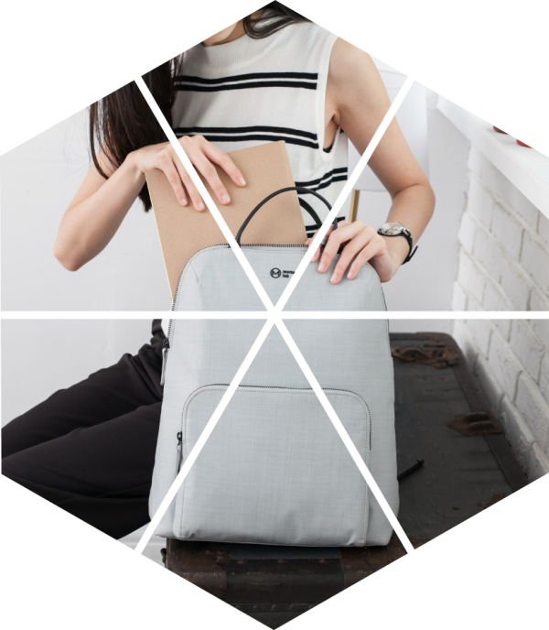
Hexagon Image Effects 004
The quick brown fox jumps over the lazy dog. The quick brown fox jumps over the lazy dog.
The quick brown fox jumps over the lazy dog. The quick brown fox jumps over the lazy dog.
The quick brown fox jumps over the lazy dog. The quick brown fox jumps over the lazy dog.
The quick brown fox jumps over the lazy dog. The quick brown fox jumps over the lazy dog.

Slide 15

Hexagon Image Effects 005
The quick brown fox jumps over the lazy dog. The quick brown fox jumps over the lazy dog.
The quick brown fox jumps over the lazy dog. The quick brown fox jumps over the lazy dog.
The quick brown fox jumps over the lazy dog. The quick brown fox jumps over the lazy dog.
The quick brown fox jumps over the lazy dog. The quick brown fox jumps over the lazy dog.

Slide 17

Hexagon Image Effects 006
The quick brown fox jumps over the lazy dog.
The quick brown fox jumps over the lazy dog.
The quick brown fox jumps over the lazy dog.
The quick brown fox jumps over the lazy dog.

Slide 19

Hexagon Image Effects 007
Agenda
The quick brown fox jumps over the lazy dog.
Process
The quick brown fox jumps over the lazy dog.
Security
The quick brown fox jumps over the lazy dog.
Success
The quick brown fox jumps over the lazy dog.

Slide 21

Hexagon Image Effects 008
The quick brown fox jumps over the lazy dog. The quick brown fox jumps over the lazy dog.
The quick brown fox jumps over the lazy dog. The quick brown fox jumps over the lazy dog.
The quick brown fox jumps over the lazy dog. The quick brown fox jumps over the lazy dog.

Slide 23
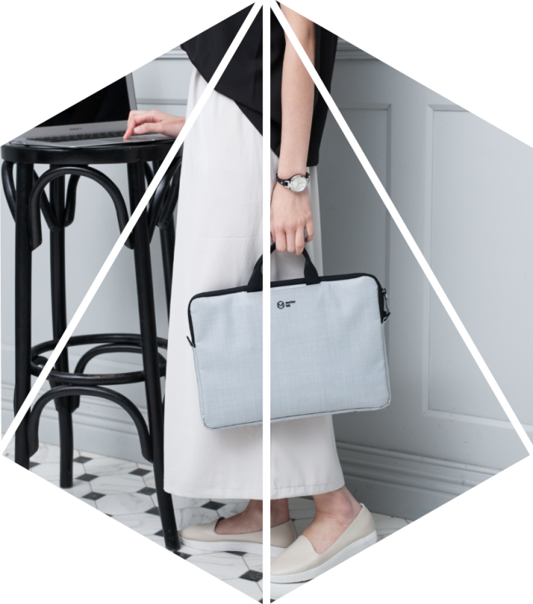
Hexagon Image Effects 009
The quick brown fox jumps over the lazy dog. The quick brown fox jumps over the lazy dog. The quick brown fox jumps over the lazy dog. The quick brown fox jumps over the lazy dog.

Slide 25

Hexagon Image Effects 010
The quick brown fox jumps over the lazy dog. The quick brown fox jumps over the lazy dog.
The quick brown fox jumps over the lazy dog. The quick brown fox jumps over the lazy dog.
The quick brown fox jumps over the lazy dog. The quick brown fox jumps over the lazy dog.

Slide 27

Hexagon Image Effects 011
The quick brown fox jumps over the lazy dog. The quick brown fox jumps over the lazy dog.
The quick brown fox jumps over the lazy dog. The quick brown fox jumps over the lazy dog.
The quick brown fox jumps over the lazy dog. The quick brown fox jumps over the lazy dog.
The quick brown fox jumps over the lazy dog. The quick brown fox jumps over the lazy dog.

Slide 29

Hexagon Image Effects 012
The quick brown fox jumps over the lazy dog. The quick brown fox jumps over the lazy dog.
The quick brown fox jumps over the lazy dog. The quick brown fox jumps over the lazy dog.
The quick brown fox jumps over the lazy dog. The quick brown fox jumps over the lazy dog.
The quick brown fox jumps over the lazy dog. The quick brown fox jumps over the lazy dog.

Slide 31
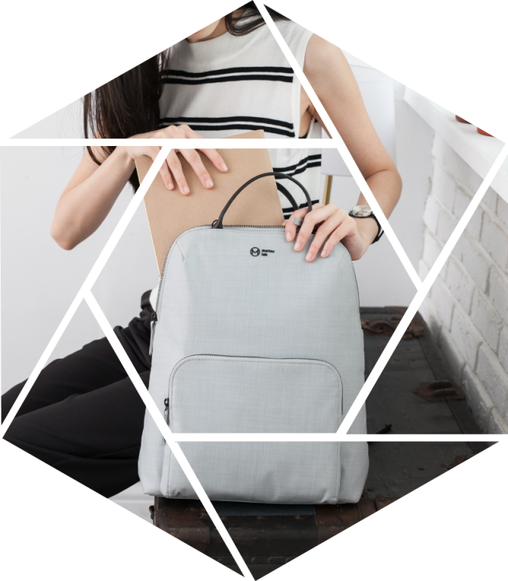
Hexagon Image Effects 013
The quick brown fox jumps over the lazy dog. The quick brown fox jumps over the lazy dog. The quick brown fox jumps over the lazy dog. The quick brown fox jumps over the lazy dog.

Slide 33

Hexagon Image Effects 014
01
The quick brown fox jumps over the lazy dog.
02
The quick brown fox jumps over the lazy dog.
03
The quick brown fox jumps over the lazy dog.
04
The quick brown fox jumps over the lazy dog.

Slide 35

Hexagon Image Effects 015
Business
The quick brown fox jumps over the lazy dog. The quick brown fox jumps over the lazy dog.
Business
The quick brown fox jumps over the lazy dog. The quick brown fox jumps over the lazy dog.
Business
The quick brown fox jumps over the lazy dog. The quick brown fox jumps over the lazy dog.

Slide 37

Hexagon Image Effects 016
The quick brown fox jumps over the lazy dog. The quick brown fox jumps over the lazy dog.
The quick brown fox jumps over the lazy dog. The quick brown fox jumps over the lazy dog.
The quick brown fox jumps over the lazy dog. The quick brown fox jumps over the lazy dog.
The quick brown fox jumps over the lazy dog. The quick brown fox jumps over the lazy dog.

Slide 39

Hexagon Image Effects 017
The quick brown fox jumps over the lazy dog. The quick brown fox jumps over the lazy dog.
The quick brown fox jumps over the lazy dog. The quick brown fox jumps over the lazy dog.
The quick brown fox jumps over the lazy dog. The quick brown fox jumps over the lazy dog.
The quick brown fox jumps over the lazy dog. The quick brown fox jumps over the lazy dog.

Slide 41

Hexagon Image Effects 018
Agenda
The quick brown fox jumps over the lazy dog.
Process
The quick brown fox jumps over the lazy dog.
Security
The quick brown fox jumps over the lazy dog.
Success
The quick brown fox jumps over the lazy dog.

Slide 43
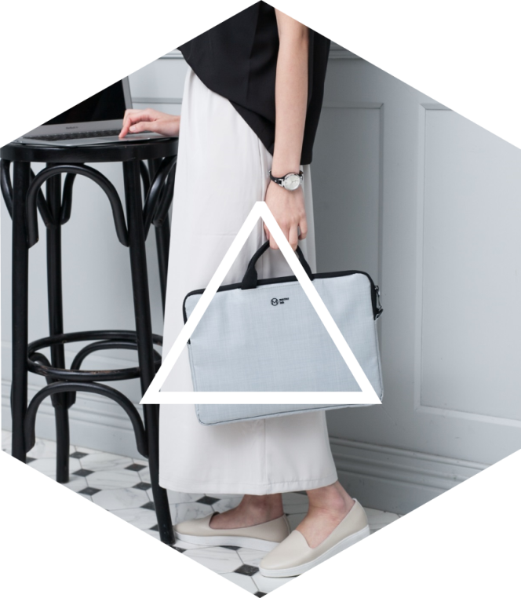
Hexagon Image Effects 019
The quick brown fox jumps over the lazy dog. The quick brown fox jumps over the lazy dog.
The quick brown fox jumps over the lazy dog. The quick brown fox jumps over the lazy dog.
The quick brown fox jumps over the lazy dog. The quick brown fox jumps over the lazy dog.
The quick brown fox jumps over the lazy dog. The quick brown fox jumps over the lazy dog.

Slide 45
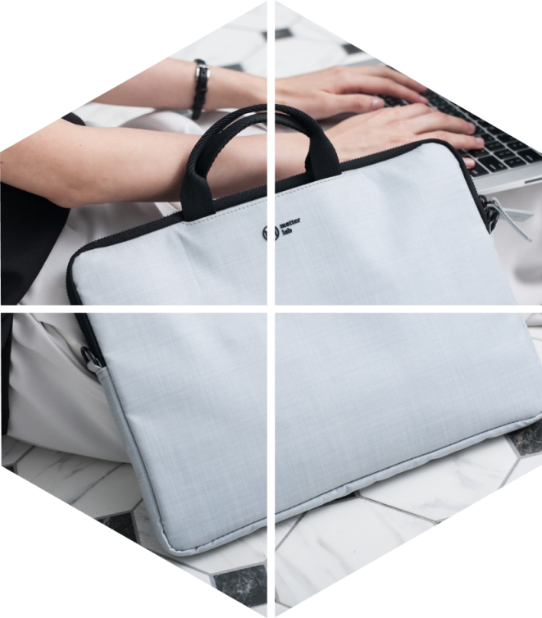
Hexagon Image Effects 020
Business
The quick brown fox jumps over the lazy dog. The quick brown fox jumps over the lazy dog.
Business
The quick brown fox jumps over the lazy dog. The quick brown fox jumps over the lazy dog.
Business
The quick brown fox jumps over the lazy dog. The quick brown fox jumps over the lazy dog.

Slide 47
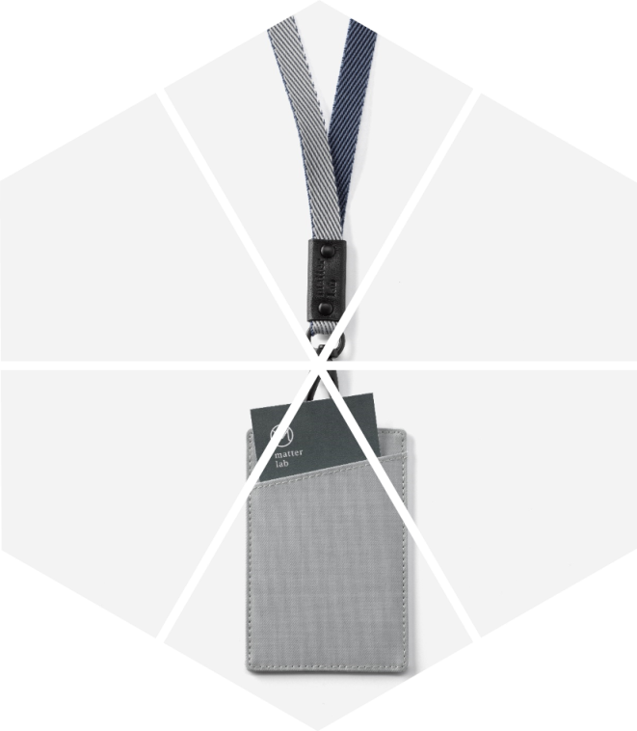
Hexagon Image Effects 021
The quick brown fox jumps over the lazy dog. The quick brown fox jumps over the lazy dog.
The quick brown fox jumps over the lazy dog. The quick brown fox jumps over the lazy dog.
The quick brown fox jumps over the lazy dog. The quick brown fox jumps over the lazy dog.
The quick brown fox jumps over the lazy dog. The quick brown fox jumps over the lazy dog.

Slide 49
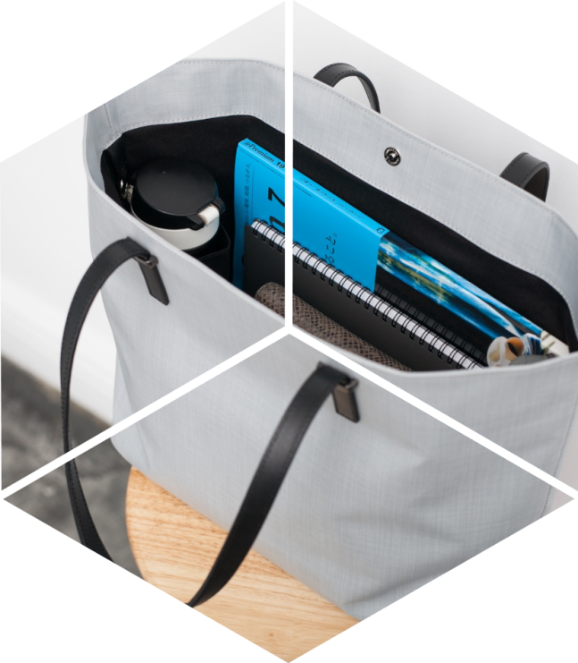
Hexagon Image Effects 022
The quick brown fox jumps over the lazy dog. The quick brown fox jumps over the lazy dog.
The quick brown fox jumps over the lazy dog. The quick brown fox jumps over the lazy dog.
The quick brown fox jumps over the lazy dog. The quick brown fox jumps over the lazy dog.
The quick brown fox jumps over the lazy dog. The quick brown fox jumps over the lazy dog.

Slide 51

Hexagon Image Effects 023
01
The quick brown fox jumps over the lazy dog.
02
The quick brown fox jumps over the lazy dog.
03
The quick brown fox jumps over the lazy dog.
04
The quick brown fox jumps over the lazy dog.

Slide 53

Hexagon Image Effects 024
The quick brown fox jumps over the lazy dog. The quick brown fox jumps over the lazy dog.
The quick brown fox jumps over the lazy dog. The quick brown fox jumps over the lazy dog.
The quick brown fox jumps over the lazy dog. The quick brown fox jumps over the lazy dog.
The quick brown fox jumps over the lazy dog. The quick brown fox jumps over the lazy dog.

Slide 55

Hexagon Image Effects 025
The quick brown fox jumps over the lazy dog. The quick brown fox jumps over the lazy dog.
The quick brown fox jumps over the lazy dog. The quick brown fox jumps over the lazy dog.
The quick brown fox jumps over the lazy dog. The quick brown fox jumps over the lazy dog.
The quick brown fox jumps over the lazy dog. The quick brown fox jumps over the lazy dog.

Slide 57

Hexagon Image Effects 026
Agenda
The quick brown fox jumps over the lazy dog.
Process
The quick brown fox jumps over the lazy dog.
Security
The quick brown fox jumps over the lazy dog.
Success
The quick brown fox jumps over the lazy dog.

Slide 59

Hexagon Image Effects 027
The quick brown fox jumps over the lazy dog. The quick brown fox jumps over the lazy dog.
The quick brown fox jumps over the lazy dog. The quick brown fox jumps over the lazy dog.
The quick brown fox jumps over the lazy dog. The quick brown fox jumps over the lazy dog.
The quick brown fox jumps over the lazy dog. The quick brown fox jumps over the lazy dog.

Slide 61

Hexagon Image Effects 028
Title
Title
The quick brown fox jumps over the lazy dog. The quick brown fox jumps over the lazy dog.
The quick brown fox jumps over the lazy dog. The quick brown fox jumps over the lazy dog.
Title
Title
The quick brown fox jumps over the lazy dog. The quick brown fox jumps over the lazy dog.
The quick brown fox jumps over the lazy dog. The quick brown fox jumps over the lazy dog.

Slide 63
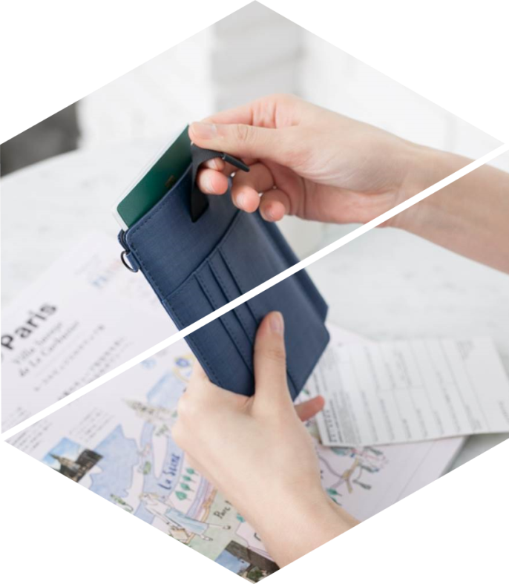
Hexagon Image Effects 029
Business
The quick brown fox jumps over the lazy dog. The quick brown fox jumps over the lazy dog.
Business
The quick brown fox jumps over the lazy dog. The quick brown fox jumps over the lazy dog.
Business
The quick brown fox jumps over the lazy dog. The quick brown fox jumps over the lazy dog.

Slide 65

Hexagon Image Effects 030
The quick brown fox jumps over the lazy dog. The quick brown fox jumps over the lazy dog.
The quick brown fox jumps over the lazy dog. The quick brown fox jumps over the lazy dog.
The quick brown fox jumps over the lazy dog. The quick brown fox jumps over the lazy dog.
The quick brown fox jumps over the lazy dog. The quick brown fox jumps over the lazy dog.

Slide 67
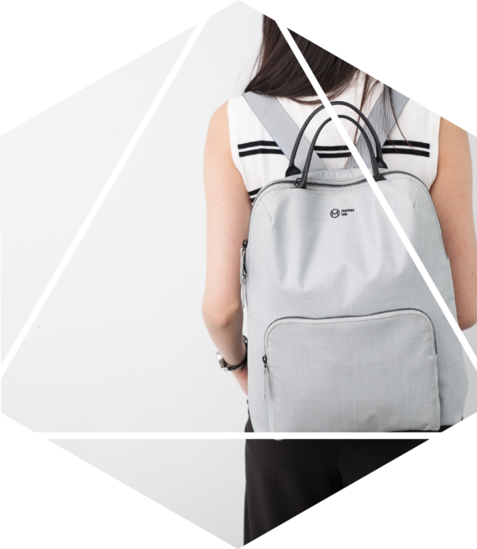
Hexagon Image Effects 031
Agenda
Process
The quick brown fox jumps over the lazy dog.
The quick brown fox jumps over the lazy dog.
Security
Success
The quick brown fox jumps over the lazy dog.
The quick brown fox jumps over the lazy dog.

Slide 69

Hexagon Image Effects 032
The quick brown fox jumps over the lazy dog. The quick brown fox jumps over the lazy dog.
The quick brown fox jumps over the lazy dog. The quick brown fox jumps over the lazy dog.
The quick brown fox jumps over the lazy dog. The quick brown fox jumps over the lazy dog.

Slide 71

Hexagon Image Effects 033
The quick brown fox jumps over the lazy dog. The quick brown fox jumps over the lazy dog. The quick brown fox jumps over the lazy dog. The quick brown fox jumps over the lazy dog.

Slide 73

Hexagon Image Effects 034
The quick brown fox jumps over the lazy dog. The quick brown fox jumps over the lazy dog.
The quick brown fox jumps over the lazy dog. The quick brown fox jumps over the lazy dog.
The quick brown fox jumps over the lazy dog. The quick brown fox jumps over the lazy dog.
The quick brown fox jumps over the lazy dog. The quick brown fox jumps over the lazy dog.

Slide 75
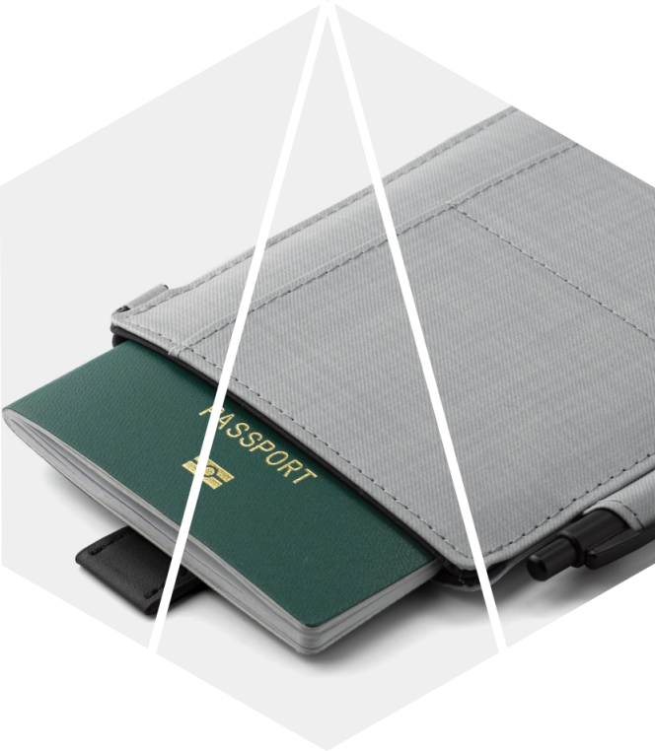
Hexagon Image Effects 035
Title
Title
The quick brown fox jumps over the lazy dog. The quick brown fox jumps over the lazy dog.
The quick brown fox jumps over the lazy dog. The quick brown fox jumps over the lazy dog.
Title
Title
The quick brown fox jumps over the lazy dog. The quick brown fox jumps over the lazy dog.
The quick brown fox jumps over the lazy dog. The quick brown fox jumps over the lazy dog.

Slide 77


歡迎加入商業簡報網粉絲專頁

Slide 78


Slide 79


Slide 80


