Slide 2
獨家贊助
Make Organizing Fun!
讓收納更有趣!
www.matter-lab.com
www.facebook.com/matterlab.taiwan

Slide 4
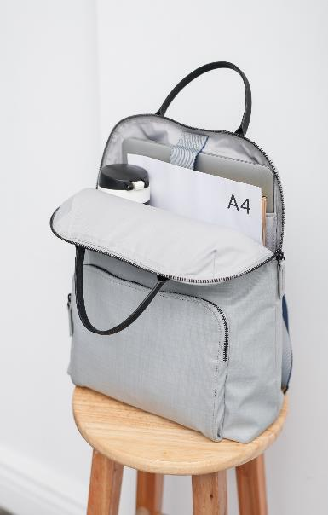
Picture
Beyond Picture
ITEM A
ITEM B
ITEM C
ITEM A
ITEM B
ITEM C

Slide 5
Beyond Picture 001
The quick brown fox jumps over the lazy dog. The quick brown fox jumps over the lazy dog.
The quick brown fox jumps over the lazy dog. The quick brown fox jumps over the lazy dog.
The quick brown fox jumps over the lazy dog. The quick brown fox jumps over the lazy dog.
Title
Title
Title
The quick brown fox jumps over the lazy dog.
The quick brown fox jumps over the lazy dog.
The quick brown fox jumps over the lazy dog.
The quick brown fox jumps over the lazy dog. The quick brown fox jumps over the lazy dog.

Slide 6
Make Organizing Fun.
Beyond Picture 002
The quick brown fox jumps over the lazy dog. The quick brown fox jumps over the lazy dog.
The quick brown fox jumps over the lazy dog. The quick brown fox jumps over the lazy dog.
The quick brown fox jumps over the lazy dog. The quick brown fox jumps over the lazy dog.

Slide 7
ITEM A
ITEM B
ITEM C
The quick brown fox jumps over the lazy dog. The quick brown fox jumps over the lazy dog.
The quick brown fox jumps over the lazy dog. The quick brown fox jumps over the lazy dog.
The quick brown fox jumps over the lazy dog. The quick brown fox jumps over the lazy dog.
Beyond Picture 003

Slide 8
Beyond Picture 004
The quick brown fox jumps over the lazy dog. The quick brown fox jumps over the lazy dog. The quick brown fox jumps over the lazy dog..

Slide 9
Beyond Picture 005
Make Organizing Fun.
The quick brown fox jumps over the lazy dog. The quick brown fox jumps over the lazy dog.
The quick brown fox jumps over the lazy dog. The quick brown fox jumps over the lazy dog.
The quick brown fox jumps over the lazy dog. The quick brown fox jumps over the lazy dog.
The quick brown fox jumps over the lazy dog. The quick brown fox jumps over the lazy dog.

Slide 10
Beyond Picture 006
The quick brown fox jumps over the lazy dog. The quick brown fox jumps over the lazy dog.
The quick brown fox jumps over the lazy dog. The quick brown fox jumps over the lazy dog.
Title
Title
The quick brown fox jumps over the lazy dog.
The quick brown fox jumps over the lazy dog.
Title
Title
The quick brown fox jumps over the lazy dog. The quick brown fox jumps over the lazy dog.
The quick brown fox jumps over the lazy dog.
The quick brown fox jumps over the lazy dog.
The quick brown fox jumps over the lazy dog. The quick brown fox jumps over the lazy dog.

Slide 11
Make Organizing Fun!
The quick brown fox jumps over the lazy dog. The quick brown fox jumps over the lazy dog. The quick brown fox jumps over the lazy dog. The quick brown fox jumps over the lazy dog. The quick brown fox jumps over the lazy dog. The quick brown fox jumps over the lazy dog.
Beyond Picture 007

Slide 12
Beyond Picture 008
The quick brown fox jumps over the lazy dog. The quick brown fox jumps over the lazy dog.
315
576
The quick brown fox jumps over the lazy dog. The quick brown fox jumps over the lazy dog.
The quick brown fox jumps over the lazy dog.
The quick brown fox jumps over the lazy dog.
The quick brown fox jumps over the lazy dog. The quick brown fox jumps over the lazy dog.
589
168
The quick brown fox jumps over the lazy dog. The quick brown fox jumps over the lazy dog.
The quick brown fox jumps over the lazy dog.
The quick brown fox jumps over the lazy dog.
The quick brown fox jumps over the lazy dog. The quick brown fox jumps over the lazy dog.

Slide 13
Beyond Picture 009

Slide 14
Beyond Picture 010
The quick brown fox jumps over the lazy dog.
The quick brown fox jumps over the lazy dog. The quick brown fox jumps over the lazy dog. The quick brown fox jumps over the lazy dog..

Slide 15
Beyond Picture 011
Make Organizing Fun.
The quick brown fox jumps over the lazy dog. The quick brown fox jumps over the lazy dog.
01
The quick brown fox jumps over the lazy dog.
02
The quick brown fox jumps over the lazy dog.
03
The quick brown fox jumps over the lazy dog.
04
The quick brown fox jumps over the lazy dog.

Slide 16
Beyond Picture 012
The quick brown fox jumps over the lazy dog. The quick brown fox jumps over the lazy dog. The quick brown fox jumps over the lazy dog. The quick brown fox jumps over the lazy dog.
Make Organizing Fun.

Slide 17
Beyond Picture 013
n
The quick brown fox jumps over the lazy dog. The quick brown fox jumps over the lazy dog.
The quick brown fox jumps over the lazy dog. The quick brown fox jumps over the lazy dog.
The quick brown fox jumps over the lazy dog. The quick brown fox jumps over the lazy dog.
The quick brown fox jumps over the lazy dog. The quick brown fox jumps over the lazy dog.

Slide 18
Beyond Picture 014

Slide 19
Beyond Picture 015
Business
Make Organizing Fun.
The quick brown fox jumps over the lazy dog. The quick brown fox jumps over the lazy dog.
Business
The quick brown fox jumps over the lazy dog. The quick brown fox jumps over the lazy dog.
The quick brown fox jumps over the lazy dog. The quick brown fox jumps over the lazy dog.
Business
The quick brown fox jumps over the lazy dog. The quick brown fox jumps over the lazy dog.

Slide 20
Beyond Picture 016
The quick brown fox jumps over the lazy dog. The quick brown fox jumps over the lazy dog.
The quick brown fox jumps over the lazy dog. The quick brown fox jumps over the lazy dog.
The quick brown fox jumps over the lazy dog. The quick brown fox jumps over the lazy dog.

Slide 21
Make Organizing Fun.
Beyond Picture 017
The quick brown fox jumps over the lazy dog. The quick brown fox jumps over the lazy dog. The quick brown fox jumps over the lazy dog. The quick brown fox jumps over the lazy dog.
Title
Title
The quick brown fox jumps over the lazy dog. The quick brown fox jumps over the lazy dog.
The quick brown fox jumps over the lazy dog. The quick brown fox jumps over the lazy dog.

Slide 22
Beyond Picture 018
The quick brown fox jumps over the lazy dog. The quick brown fox jumps over the lazy dog.
The quick brown fox jumps over the lazy dog. The quick brown fox jumps over the lazy dog.
The quick brown fox jumps over the lazy dog. The quick brown fox jumps over the lazy dog.
The quick brown fox jumps over the lazy dog. The quick brown fox jumps over the lazy dog.

Slide 23
Beyond Picture 019
Agenda
Security
The quick brown fox jumps over the lazy dog.
The quick brown fox jumps over the lazy dog.
Process
Success
The quick brown fox jumps over the lazy dog.
The quick brown fox jumps over the lazy dog.

Slide 24
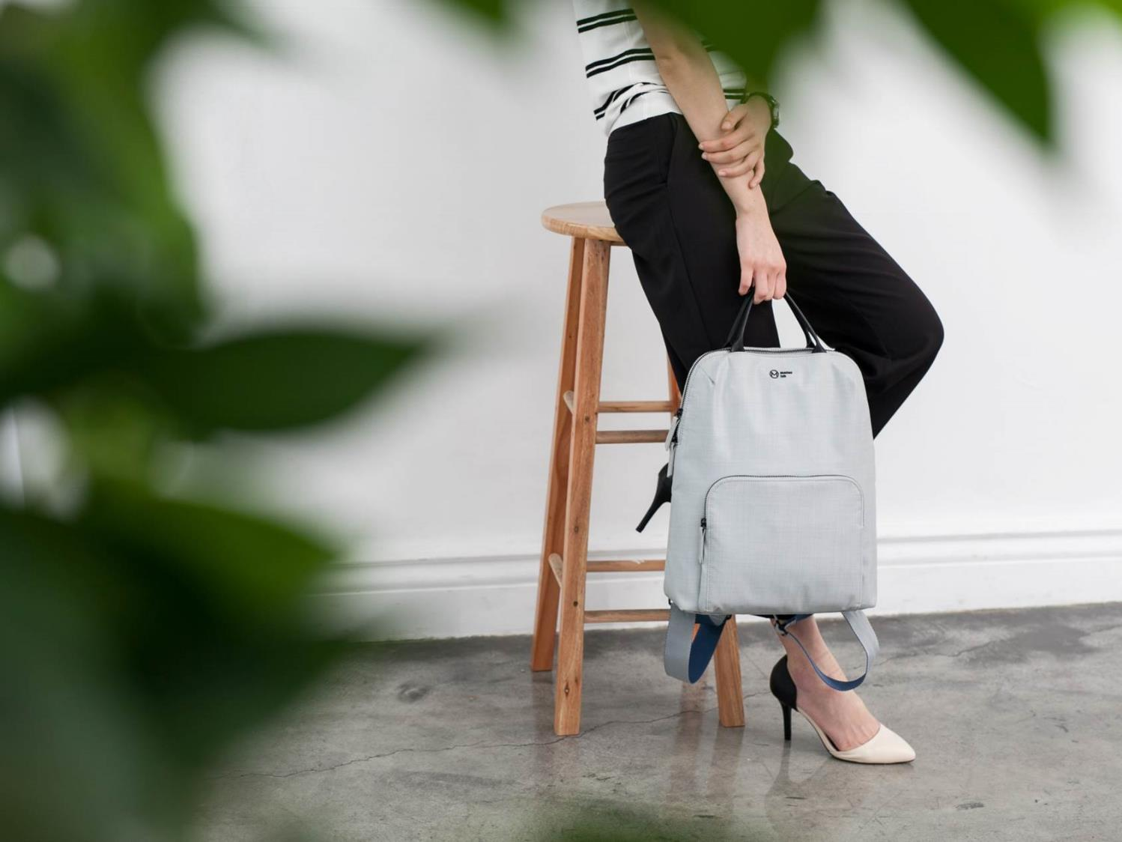
Beyond Picture 020

Slide 25
Beyond Picture 021
The quick brown fox jumps over the lazy dog. The quick brown fox jumps over the lazy dog.
The quick brown fox jumps over the lazy dog. The quick brown fox jumps over the lazy dog.
The quick brown fox jumps over the lazy dog. The quick brown fox jumps over the lazy dog.
The quick brown fox jumps over the lazy dog. The quick brown fox jumps over the lazy dog.

Slide 26
Beyond Picture 022

Slide 27
Beyond Picture 023

Slide 28
Beyond Picture 024
Make Organizing Fun.
The quick brown fox jumps over the lazy dog. The quick brown fox jumps over the lazy dog. The quick brown fox jumps over the lazy dog. The quick brown fox jumps over the lazy dog.

Slide 29
Beyond Picture 025
Make Organizing Fun!
The quick brown fox jumps over the lazy dog. The quick brown fox jumps over the lazy dog. The quick brown fox jumps over the lazy dog. The quick brown fox jumps over the lazy dog.

Slide 30
Beyond Picture 026
The quick brown fox jumps over the lazy dog. The quick brown fox jumps over the lazy dog. The quick brown fox jumps over the lazy dog. The quick brown fox jumps over the lazy dog. The quick brown fox jumps over the lazy dog.
Item
Item
The quick brown fox jumps over the lazy dog.
The quick brown fox jumps over the lazy dog.
Item
The quick brown fox jumps over the lazy dog.

Slide 31
Beyond Picture 027

Slide 32
Beyond Picture 028
1.
Title
2.
Title
3.
Title
4.
Title
The quick brown fox jumps over the lazy dog. The quick brown fox jumps over the lazy dog.
The quick brown fox jumps over the lazy dog. The quick brown fox jumps over the lazy dog.
The quick brown fox jumps over the lazy dog. The quick brown fox jumps over the lazy dog.
The quick brown fox jumps over the lazy dog. The quick brown fox jumps over the lazy dog.

Slide 33
Beyond Picture 029
The quick brown fox jumps over the lazy dog. The quick brown fox jumps over the lazy dog.
Make Organizing Fun.
The quick brown fox jumps over the lazy dog. The quick brown fox jumps over the lazy dog.
The quick brown fox jumps over the lazy dog. The quick brown fox jumps over the lazy dog.
The quick brown fox jumps over the lazy dog. The quick brown fox jumps over the lazy dog.

Slide 34
Beyond Picture 030
The quick brown fox jumps over the lazy dog. The quick brown fox jumps over the lazy dog. The quick brown fox jumps over the lazy dog. The quick brown fox jumps over the lazy dog.

Slide 35
Beyond Picture 031
The quick brown fox jumps over the lazy dog.
The quick brown fox jumps over the lazy dog.
The quick brown fox jumps over the lazy dog.
The quick brown fox jumps over the lazy dog.
The quick brown fox jumps over the lazy dog.
The quick brown fox jumps over the lazy dog.

Slide 36
Beyond Picture 032
The quick brown fox jumps over the lazy dog. The quick brown fox jumps over the lazy dog. The quick brown fox jumps over the lazy dog. The quick brown fox jumps over the lazy dog.

Slide 37
Beyond Picture 033
Business
The quick brown fox jumps over the lazy dog. The quick brown fox jumps over the lazy dog.
Business
The quick brown fox jumps over the lazy dog. The quick brown fox jumps over the lazy dog.

Slide 38
Beyond Picture 034
12.5%
The quick brown fox jumps over the lazy dog. The quick brown fox jumps over the lazy dog.
The quick brown fox jumps over the lazy dog.
The quick brown fox jumps over the lazy dog. The quick brown fox jumps over the lazy dog.
18.58
The quick brown fox jumps over the lazy dog.
The quick brown fox jumps over the lazy dog. The quick brown fox jumps over the lazy dog.
32.4%
The quick brown fox jumps over the lazy dog. The quick brown fox jumps over the lazy dog.
The quick brown fox jumps over the lazy dog.

Slide 39
Beyond Picture 035
The quick brown fox jumps over the lazy dog.
The quick brown fox jumps over the lazy dog.
The quick brown fox jumps over the lazy dog.
The quick brown fox jumps over the lazy dog.
The quick brown fox jumps over the lazy dog.
The quick brown fox jumps over the lazy dog.

Slide 40
Beyond Picture 036
Agenda
Process
The quick brown fox jumps over the lazy dog.
The quick brown fox jumps over the lazy dog.
Security
Success
The quick brown fox jumps over the lazy dog.
The quick brown fox jumps over the lazy dog.

Slide 41
Beyond Picture 037
The quick brown fox jumps over the lazy dog.
The quick brown fox jumps over the lazy dog.
The quick brown fox jumps over the lazy dog.
The quick brown fox jumps over the lazy dog.
The quick brown fox jumps over the lazy dog.
The quick brown fox jumps over the lazy dog.

Slide 42
Beyond Picture 038
The quick brown fox jumps over the lazy dog.
The quick brown fox jumps over the lazy dog.
The quick brown fox jumps over the lazy dog.

Slide 43
Beyond Picture 039
The quick brown fox jumps over the lazy dog
The quick brown fox jumps over the lazy dog
The quick brown fox jumps over the lazy dog
The quick brown fox jumps over the lazy dog
The quick brown fox jumps over the lazy dog

Slide 44
Beyond Picture 040
01
02
03
04
Make Organizing Fun.
Title
Title
Title
The quick brown fox jumps over the lazy dog. The quick brown fox jumps over the lazy dog.
The quick brown fox jumps over the lazy dog. The quick brown fox jumps over the lazy dog.
The quick brown fox jumps over the lazy dog. The quick brown fox jumps over the lazy dog.

Slide 45
Beyond Picture 041
ITEM A
ITEM B
ITEM C
ITEM D
ITEM E
ITEM F

Slide 46
Beyond Picture 042
Make Organizing Fun!
Make Organizing Fun!
The quick brown fox jumps over the lazy dog. The quick brown fox jumps over the lazy dog.
The quick brown fox jumps over the lazy dog. The quick brown fox jumps over the lazy dog.
The quick brown fox jumps over the lazy dog. The quick brown fox jumps over the lazy dog.
The quick brown fox jumps over the lazy dog. The quick brown fox jumps over the lazy dog.

Slide 47
Beyond Picture 043
The quick brown fox jumps over the lazy dog. The quick brown fox jumps over the lazy dog.
The quick brown fox jumps over the lazy dog. The quick brown fox jumps over the lazy dog.
The quick brown fox jumps over the lazy dog. The quick brown fox jumps over the lazy dog.
The quick brown fox jumps over the lazy dog. The quick brown fox jumps over the lazy dog.

Slide 48
Beyond Picture 044
The quick brown fox jumps over the lazy dog. The quick brown fox jumps over the lazy dog. The quick brown fox jumps over the lazy dog. The quick brown fox jumps over the lazy dog.

Slide 49
01
02
03
04
05
06
Beyond Picture 045
The quick brown fox jumps over the lazy dog. The quick brown fox jumps over the lazy dog.
The quick brown fox jumps over the lazy dog. The quick brown fox jumps over the lazy dog.
The quick brown fox jumps over the lazy dog. The quick brown fox jumps over the lazy dog.

Slide 50
Beyond Picture 046
The quick brown fox jumps over the lazy dog. The quick brown fox jumps over the lazy dog.
The quick brown fox jumps over the lazy dog. The quick brown fox jumps over the lazy dog.
The quick brown fox jumps over the lazy dog. The quick brown fox jumps over the lazy dog.

Slide 51
Beyond Picture 047
Title
Title
Title
Title
The quick brown fox jumps over the lazy dog.
The quick brown fox jumps over the lazy dog.
The quick brown fox jumps over the lazy dog.
The quick brown fox jumps over the lazy dog.
The quick brown fox jumps over the lazy dog. The quick brown fox jumps over the lazy dog.
The quick brown fox jumps over the lazy dog. The quick brown fox jumps over the lazy dog.
The quick brown fox jumps over the lazy dog. The quick brown fox jumps over the lazy dog.
The quick brown fox jumps over the lazy dog. The quick brown fox jumps over the lazy dog.

Slide 52
Beyond Picture 048
The quick brown fox jumps over the lazy dog. The quick brown fox jumps over the lazy dog.
Make Organizing Fun.
The quick brown fox jumps over the lazy dog. The quick brown fox jumps over the lazy dog.
The quick brown fox jumps over the lazy dog. The quick brown fox jumps over the lazy dog.
The quick brown fox jumps over the lazy dog. The quick brown fox jumps over the lazy dog.

Slide 53
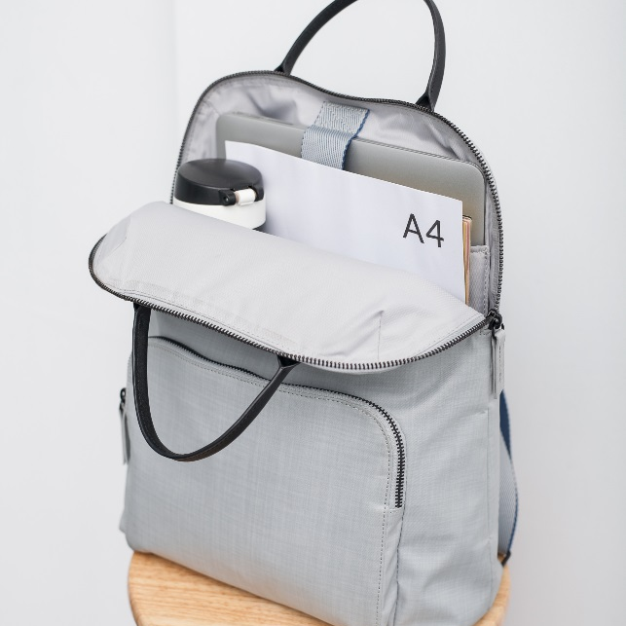
Beyond Picture 049
The quick brown fox jumps over the lazy dog. The quick brown fox jumps over the lazy dog.
The quick brown fox jumps over the lazy dog. The quick brown fox jumps over the lazy dog.
The quick brown fox jumps over the lazy dog. The quick brown fox jumps over the lazy dog.
The quick brown fox jumps over the lazy dog. The quick brown fox jumps over the lazy dog.

Slide 54
Beyond Picture 050
The quick brown fox jumps over the lazy dog. The quick brown fox jumps over the lazy dog. The quick brown fox jumps over the lazy dog. The quick brown fox jumps over the lazy dog. The quick brown fox jumps over the lazy dog. The quick brown fox jumps over the lazy dog.
Make Organizing Fun.
The quick brown fox jumps over the lazy dog. The quick brown fox jumps over the lazy dog.
The quick brown fox jumps over the lazy dog. The quick brown fox jumps over the lazy dog.

Slide 55
Beyond Picture 051
01
02
03
04
01
The quick brown fox jumps over the lazy dog.
03
The quick brown fox jumps over the lazy dog.
02
The quick brown fox jumps over the lazy dog.
04
The quick brown fox jumps over the lazy dog.

Slide 56
Beyond Picture 052
The quick brown fox jumps over the lazy dog. The quick brown fox jumps over the lazy dog. The quick brown fox jumps over the lazy dog. The quick brown fox jumps over the lazy dog. The quick brown fox jumps over the lazy dog.

Slide 57
Beyond Picture 053
The quick brown fox jumps over the lazy dog. The quick brown fox jumps over the lazy dog.
The quick brown fox jumps over the lazy dog. The quick brown fox jumps over the lazy dog.
The quick brown fox jumps over the lazy dog. The quick brown fox jumps over the lazy dog.
Picture

Slide 58
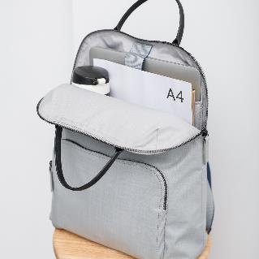
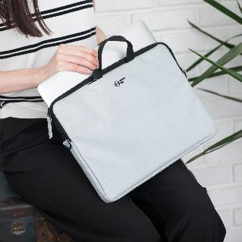
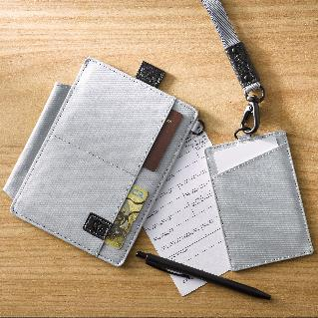
Beyond Picture 054
Agenda
Security
The quick brown fox jumps over the lazy dog. The quick brown fox jumps over the lazy dog.
The quick brown fox jumps over the lazy dog. The quick brown fox jumps over the lazy dog.
Process
Success
The quick brown fox jumps over the lazy dog. The quick brown fox jumps over the lazy dog.
The quick brown fox jumps over the lazy dog. The quick brown fox jumps over the lazy dog.

Slide 59
Beyond Picture 055

Slide 60
Beyond Picture 056
The quick brown fox jumps over the lazy dog. The quick brown fox jumps over the lazy dog.
Success
The quick brown fox jumps over the lazy dog. The quick brown fox jumps over the lazy dog.
The quick brown fox jumps over the lazy dog. The quick brown fox jumps over the lazy dog. The quick brown fox jumps over the lazy dog. The quick brown fox jumps over the lazy dog.
The quick brown fox jumps over the lazy dog. The quick brown fox jumps over the lazy dog.
The quick brown fox jumps over the lazy dog. The quick brown fox jumps over the lazy dog.

Slide 61
Beyond Picture 057
The quick brown fox jumps over the lazy dog. The quick brown fox jumps over the lazy dog.
The quick brown fox jumps over the lazy dog. The quick brown fox jumps over the lazy dog.
The quick brown fox jumps over the lazy dog. The quick brown fox jumps over the lazy dog.
The quick brown fox jumps over the lazy dog. The quick brown fox jumps over the lazy dog.

Slide 62
Beyond Picture 058
The quick brown fox jumps over the lazy dog. The quick brown fox jumps over the lazy dog.
The quick brown fox jumps over the lazy dog. The quick brown fox jumps over the lazy dog.
The quick brown fox jumps over the lazy dog. The quick brown fox jumps over the lazy dog.
The quick brown fox jumps over the lazy dog. The quick brown fox jumps over the lazy dog.

Slide 63
Beyond Picture 059
Title
Title
Title
Title
The quick brown fox jumps over the lazy dog. The quick brown fox jumps over the lazy dog..
The quick brown fox jumps over the lazy dog. The quick brown fox jumps over the lazy dog..
The quick brown fox jumps over the lazy dog. The quick brown fox jumps over the lazy dog..
The quick brown fox jumps over the lazy dog. The quick brown fox jumps over the lazy dog..

Slide 64
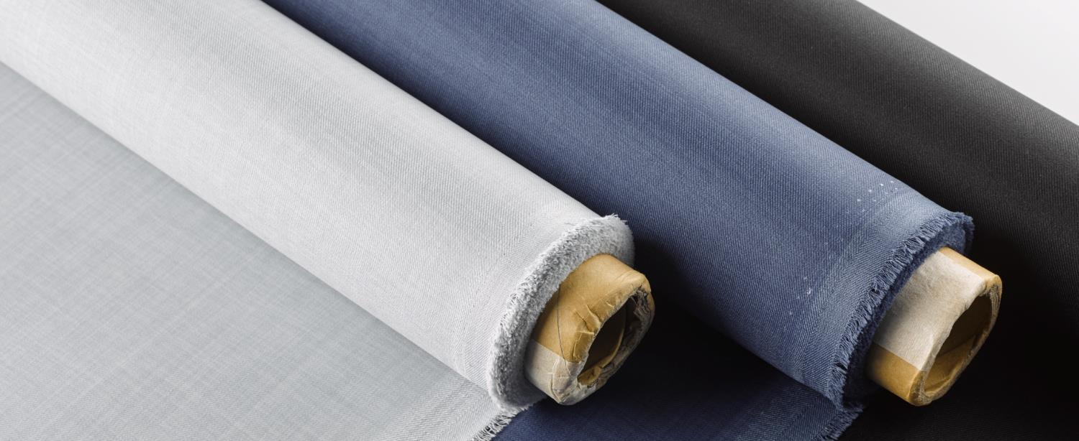
Beyond Picture 060
Make Organizing Fun.
Process
Security
The quick brown fox jumps over the lazy dog. The quick brown fox jumps over the lazy dog. The quick brown fox jumps over the lazy dog.
The quick brown fox jumps over the lazy dog. The quick brown fox jumps over the lazy dog. The quick brown fox jumps over the lazy dog.

Slide 65
Beyond Picture 061
Item 01
Item 02
Item 03
The quick brown fox jumps over the lazy dog.
The quick brown fox jumps over the lazy dog.
The quick brown fox jumps over the lazy dog.
Item 04
Item 05
Item 06
The quick brown fox jumps over the lazy dog.
The quick brown fox jumps over the lazy dog.
The quick brown fox jumps over the lazy dog.

Slide 66
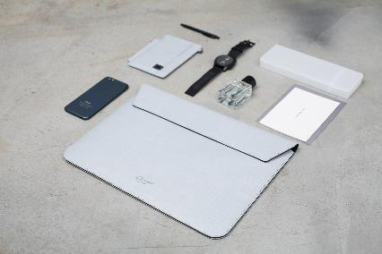
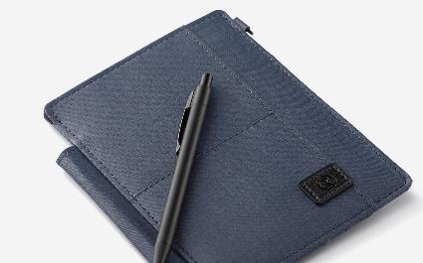
Beyond Picture 062
1.Introduction
2.Who We Are ?
3.Services
1.Introduction
2.Who We Are ?
3.Services
1.Introduction
2.Who We Are ?
3.Services
1.Introduction
2.Who We Are ?
3.Services

Slide 67
Beyond Picture 063
ITEM A
ITEM B
ITEM C
The quick brown fox jumps over the lazy dog.
The quick brown fox jumps over the lazy dog.
The quick brown fox jumps over the lazy dog.
The quick brown fox jumps over the lazy dog.
The quick brown fox jumps over the lazy dog.
The quick brown fox jumps over the lazy dog.
The quick brown fox jumps over the lazy dog.
The quick brown fox jumps over the lazy dog.
The quick brown fox jumps over the lazy dog.

Slide 68
Beyond Picture 064
Agenda
Process
The quick brown fox jumps over the lazy dog.
The quick brown fox jumps over the lazy dog.
Security
Success
The quick brown fox jumps over the lazy dog.
The quick brown fox jumps over the lazy dog.

Slide 69
Beyond Picture 065
The quick brown fox jumps over the lazy dog. The quick brown fox jumps over the lazy dog. The quick brown fox jumps over the lazy dog. The quick brown fox jumps over the lazy dog.
The quick brown fox jumps over the lazy dog. The quick brown fox jumps over the lazy dog. The quick brown fox jumps over the lazy dog. The quick brown fox jumps over the lazy dog.

Slide 70
Beyond Picture 066
Business
The quick brown fox jumps over the lazy dog. The quick brown fox jumps over the lazy dog.
Business
The quick brown fox jumps over the lazy dog. The quick brown fox jumps over the lazy dog.
Business
The quick brown fox jumps over the lazy dog. The quick brown fox jumps over the lazy dog.

Slide 71
Beyond Picture 067
The quick brown fox jumps over the lazy dog. The quick brown fox jumps over the lazy dog.
The quick brown fox jumps over the lazy dog. The quick brown fox jumps over the lazy dog.
The quick brown fox jumps over the lazy dog. The quick brown fox jumps over the lazy dog.
The quick brown fox jumps over the lazy dog. The quick brown fox jumps over the lazy dog.

Slide 72
Beyond Picture 068
The quick brown fox jumps over the lazy dog. The quick brown fox jumps over the lazy dog.
The quick brown fox jumps over the lazy dog. The quick brown fox jumps over the lazy dog.
The quick brown fox jumps over the lazy dog. The quick brown fox jumps over the lazy dog.
The quick brown fox jumps over the lazy dog. The quick brown fox jumps over the lazy dog.

Slide 73
Beyond Picture 069
Title
Title
Title
The quick brown fox jumps over the lazy dog. The quick brown fox jumps over the lazy dog.
The quick brown fox jumps over the lazy dog. The quick brown fox jumps over the lazy dog.
The quick brown fox jumps over the lazy dog. The quick brown fox jumps over the lazy dog.

Slide 74
Beyond Picture 070
Title
Title
Title
The quick brown fox jumps over the lazy dog. The quick brown fox jumps over the lazy dog.
The quick brown fox jumps over the lazy dog. The quick brown fox jumps over the lazy dog.
The quick brown fox jumps over the lazy dog. The quick brown fox jumps over the lazy dog.

Slide 75
Beyond Picture 071
The quick brown fox jumps over the lazy dog. The quick brown fox jumps over the lazy dog.
The quick brown fox jumps over the lazy dog. The quick brown fox jumps over the lazy dog.
The quick brown fox jumps over the lazy dog. The quick brown fox jumps over the lazy dog.
The quick brown fox jumps over the lazy dog. The quick brown fox jumps over the lazy dog.

Slide 76
Beyond Picture 072
Title
Title
The quick brown fox jumps over the lazy dog. The quick brown fox jumps over the lazy dog.
The quick brown fox jumps over the lazy dog. The quick brown fox jumps over the lazy dog.
Title
Title
The quick brown fox jumps over the lazy dog. The quick brown fox jumps over the lazy dog.
The quick brown fox jumps over the lazy dog. The quick brown fox jumps over the lazy dog.

Slide 77
Beyond Picture 073
Make Organizing Fun!
The quick brown fox jumps over the lazy dog. The quick brown fox jumps over the lazy dog. The quick brown fox jumps over the lazy dog. The quick brown fox jumps over the lazy dog.
Agenda
Security
The quick brown fox jumps over the lazy dog.
The quick brown fox jumps over the lazy dog.
Process
Success
The quick brown fox jumps over the lazy dog.
The quick brown fox jumps over the lazy dog.

Slide 78
Beyond Picture 074
The quick brown fox jumps over the lazy dog. The quick brown fox jumps over the lazy dog. The quick brown fox jumps over the lazy dog.

Slide 79
Beyond Picture 075
The quick brown fox jumps over the lazy dog.
The quick brown fox jumps over the lazy dog.
The quick brown fox jumps over the lazy dog.
The quick brown fox jumps over the lazy dog.
The quick brown fox jumps over the lazy dog.
The quick brown fox jumps over the lazy dog.
The quick brown fox jumps over the lazy dog.
The quick brown fox jumps over the lazy dog.
The quick brown fox jumps over the lazy dog.

Slide 80
Beyond Picture 076
The quick brown fox jumps over the lazy dog. The quick brown fox jumps over the lazy dog.
The quick brown fox jumps over the lazy dog. The quick brown fox jumps over the lazy dog.
The quick brown fox jumps over the lazy dog. The quick brown fox jumps over the lazy dog.
The quick brown fox jumps over the lazy dog. The quick brown fox jumps over the lazy dog.

Slide 81
Beyond Picture 077
Business
The quick brown fox jumps over the lazy dog. The quick brown fox jumps over the lazy dog.
Business
The quick brown fox jumps over the lazy dog. The quick brown fox jumps over the lazy dog.
Business
The quick brown fox jumps over the lazy dog. The quick brown fox jumps over the lazy dog.

Slide 82
Beyond Picture 078
The quick brown fox jumps over the lazy dog. The quick brown fox jumps over the lazy dog.
The quick brown fox jumps over the lazy dog. The quick brown fox jumps over the lazy dog.
The quick brown fox jumps over the lazy dog. The quick brown fox jumps over the lazy dog.
The quick brown fox jumps over the lazy dog. The quick brown fox jumps over the lazy dog.

Slide 83
Beyond Picture 079
The quick brown fox jumps over the lazy dog. The quick brown fox jumps over the lazy dog.
The quick brown fox jumps over the lazy dog. The quick brown fox jumps over the lazy dog.
Make Organizing Fun.
The quick brown fox jumps over the lazy dog. The quick brown fox jumps over the lazy dog.
The quick brown fox jumps over the lazy dog. The quick brown fox jumps over the lazy dog.

Slide 84
Beyond Picture 080
The quick brown fox jumps over the lazy dog. The quick brown fox jumps over the lazy dog. The quick brown fox jumps over the lazy dog. The quick brown fox jumps over the lazy dog.

Slide 85
Beyond Picture 081
The quick brown fox jumps over the lazy dog.
Title
The quick brown fox jumps over the lazy dog. The quick brown fox jumps over the lazy dog.
The quick brown fox jumps over the lazy dog. The quick brown fox jumps over the lazy dog.

Slide 86
Beyond Picture 082
Agenda
Security
The quick brown fox jumps over the lazy dog.
The quick brown fox jumps over the lazy dog.
Process
Success
The quick brown fox jumps over the lazy dog.
The quick brown fox jumps over the lazy dog.

Slide 87
Beyond Picture 083
Make Organizing Fun.
01
The quick brown fox jumps over the lazy dog.
02
The quick brown fox jumps over the lazy dog.
03
The quick brown fox jumps over the lazy dog.
04
The quick brown fox jumps over the lazy dog.

Slide 88
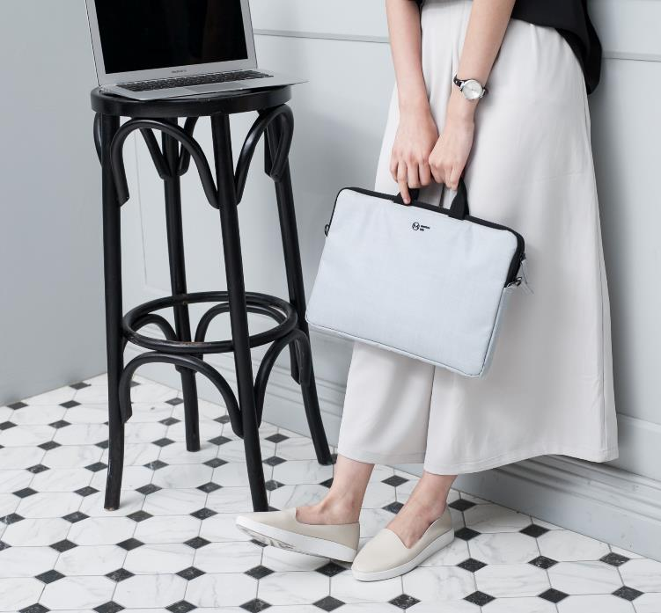
Beyond Picture 084
1
The quick brown fox jumps over the lazy dog. The quick brown fox jumps over the lazy dog.
2
The quick brown fox jumps over the lazy dog. The quick brown fox jumps over the lazy dog.
3
The quick brown fox jumps over the lazy dog. The quick brown fox jumps over the lazy dog.

Slide 89
Beyond Picture 085
The quick brown fox jumps over the lazy dog.
The quick brown fox jumps over the lazy dog.
ITEM A
ITEM B
ITEM B
ITEM D
The quick brown fox jumps over the lazy dog.
The quick brown fox jumps over the lazy dog.

Slide 90
Beyond Picture 086
Make Organizing Fun.
The quick brown fox jumps over the lazy dog. The quick brown fox jumps over the lazy dog.
Agenda
Security
The quick brown fox jumps over the lazy dog.
The quick brown fox jumps over the lazy dog.
Process
Success
The quick brown fox jumps over the lazy dog.
The quick brown fox jumps over the lazy dog.

Slide 91
Beyond Picture 087
Agenda
The quick brown fox jumps over the lazy dog.
Process
The quick brown fox jumps over the lazy dog.
ITEM B
Security
The quick brown fox jumps over the lazy dog.
Success
The quick brown fox jumps over the lazy dog.
ITEM A
ITEM C

Slide 92
Beyond Picture 088
The quick brown fox jumps over the lazy dog. The quick brown fox jumps over the lazy dog.
The quick brown fox jumps over the lazy dog. The quick brown fox jumps over the lazy dog.
The quick brown fox jumps over the lazy dog. The quick brown fox jumps over the lazy dog.

Slide 93
Beyond Picture 089
The quick brown fox jumps over the lazy dog. The quick brown fox jumps over the lazy dog.
The quick brown fox jumps over the lazy dog. The quick brown fox jumps over the lazy dog.
The quick brown fox jumps over the lazy dog. The quick brown fox jumps over the lazy dog.
The quick brown fox jumps over the lazy dog. The quick brown fox jumps over the lazy dog.

Slide 94
Beyond Picture 090
Agenda
The quick brown fox jumps over the lazy dog.
Process
The quick brown fox jumps over the lazy dog.
Security
The quick brown fox jumps over the lazy dog.
Success
The quick brown fox jumps over the lazy dog.
The quick brown fox jumps over the lazy dog.

Slide 95
Beyond Picture 091
Title
Title
Title
The quick brown fox jumps over the lazy dog.
The quick brown fox jumps over the lazy dog.
The quick brown fox jumps over the lazy dog.

Slide 96
Beyond Picture 092
The quick brown fox jumps over the lazy dog. The quick brown fox jumps over the lazy dog.
The quick brown fox jumps over the lazy dog. The quick brown fox jumps over the lazy dog.
The quick brown fox jumps over the lazy dog. The quick brown fox jumps over the lazy dog.
The quick brown fox jumps over the lazy dog. The quick brown fox jumps over the lazy dog.

Slide 97
Beyond Picture 093
01.
Title
The quick brown fox jumps over the lazy dog.
02.
Title
The quick brown fox jumps over the lazy dog.
03.
Title
The quick brown fox jumps over the lazy dog.
04.
Title
The quick brown fox jumps over the lazy dog.

Slide 98
Beyond Picture 094
Title
Title
The quick brown fox jumps over the lazy dog. The quick brown fox jumps over the lazy dog.
The quick brown fox jumps over the lazy dog. The quick brown fox jumps over the lazy dog.
Title
Title
The quick brown fox jumps over the lazy dog. The quick brown fox jumps over the lazy dog.
The quick brown fox jumps over the lazy dog. The quick brown fox jumps over the lazy dog.

Slide 99
Beyond Picture 095

Slide 100
Beyond Picture 096
1
2
3
4
5
6

Slide 101
Beyond Picture 097
The quick brown fox jumps over the lazy dog.
The quick brown fox jumps over the lazy dog.
The quick brown fox jumps over the lazy dog.
The quick brown fox jumps over the lazy dog.
The quick brown fox jumps over the lazy dog.
The quick brown fox jumps over the lazy dog.

Slide 102
Beyond Picture 098
Item
Item
Item
The quick brown fox jumps over the lazy dog.
The quick brown fox jumps over the lazy dog.
The quick brown fox jumps over the lazy dog.

Slide 103
Beyond Picture 099
Item A
Item B
Item C
Item D
Item E
Item F

Slide 104
Beyond Picture 100
The quick brown fox jumps over the lazy dog. The quick brown fox jumps over the lazy dog.
The quick brown fox jumps over the lazy dog. The quick brown fox jumps over the lazy dog.
The quick brown fox jumps over the lazy dog. The quick brown fox jumps over the lazy dog.

Slide 105
Beyond Picture 101
The quick brown fox jumps over the lazy dog. The quick brown fox jumps over the lazy dog.
The quick brown fox jumps over the lazy dog. The quick brown fox jumps over the lazy dog.
1
2
The quick brown fox jumps over the lazy dog. The quick brown fox jumps over the lazy dog.
The quick brown fox jumps over the lazy dog. The quick brown fox jumps over the lazy dog.
3
4

Slide 106
歡迎加入商業簡報網粉絲專頁

